Slide 1


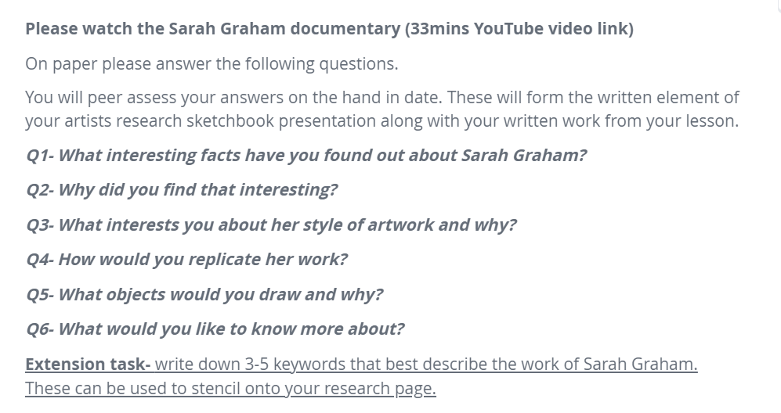



www.sarahgrahm.info

