Slide 1



Year 7 Curriculum Information & Aspirations Evening

Slide 2
Important dates
Thursday 2nd October: CAT tests (no revision required!)
Thursday 13th November 3.45-6.15: Year 7 PLG Evening
Thursday 4th December: Year 7 Industry Day
Thursday 5th March: World Book Day
Thursday 21st May: Year 7 Parents’ Evening
Monday 1st June – Friday 12th June: End of year assessments
Monday 15th June: Year 7-10 Rewards trip
Thursday 2nd July: Year 7 Sports Day
Attitude and/or Progress Reports:
November
February
July
Welcome to the Year 7 Curriculum Information & Aspirations Evening

Slide 3

Mr cregg
Headteacher

Slide 4
tonight’s presentations
Curriculum: Miss Catlow
Teaching & Learning, Home Learning & Independent Study: Mrs Robinson
Literacy: Mrs Hamilton
Aspirations: Miss Whybrow

Slide 5
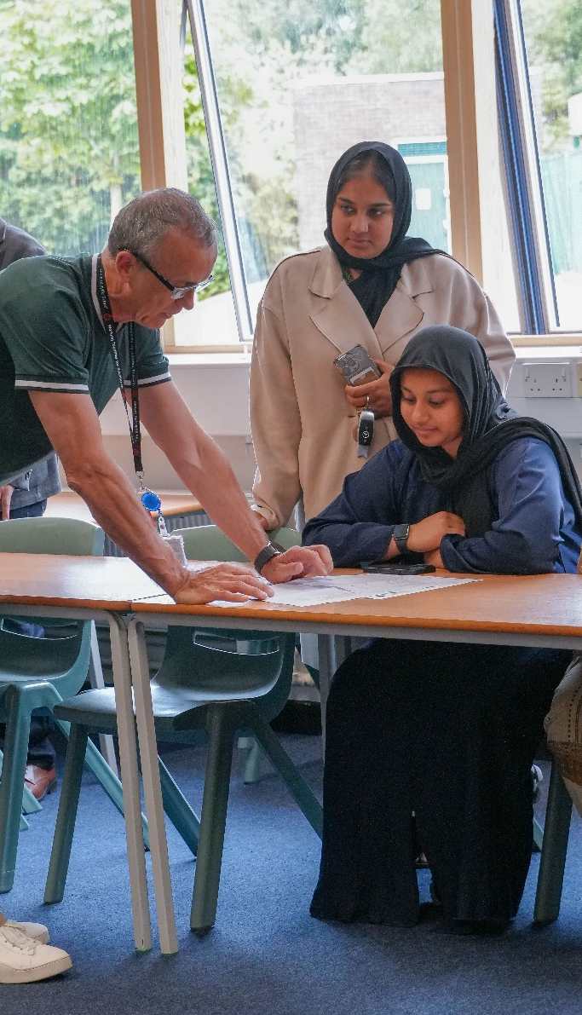
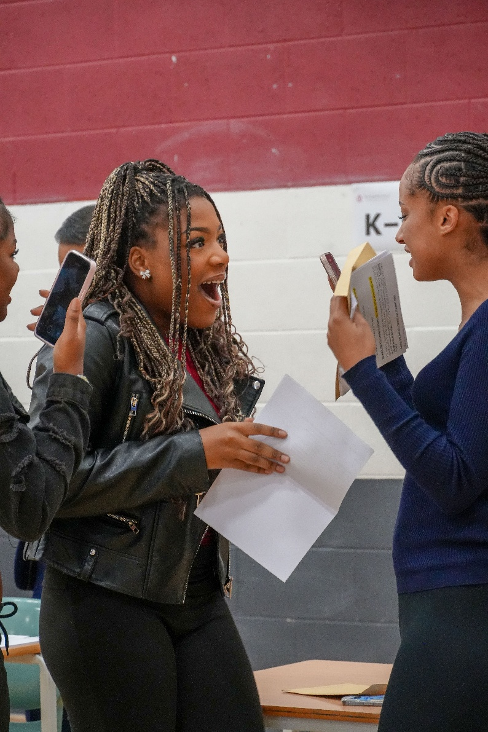
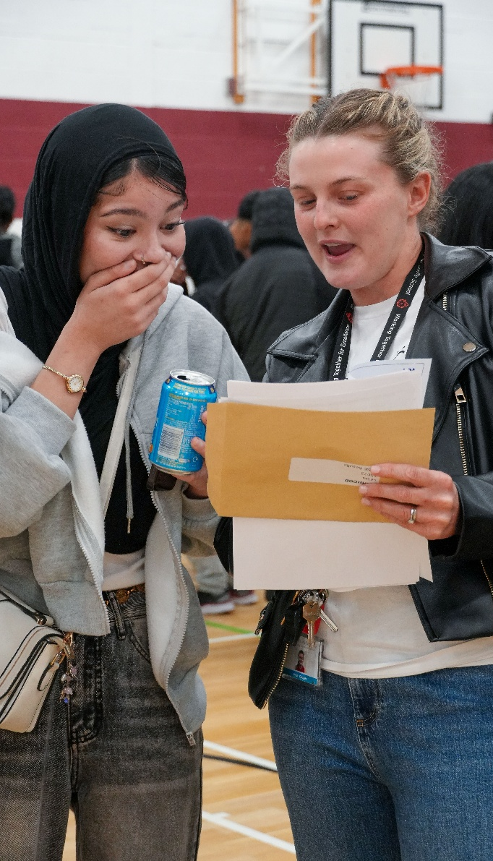
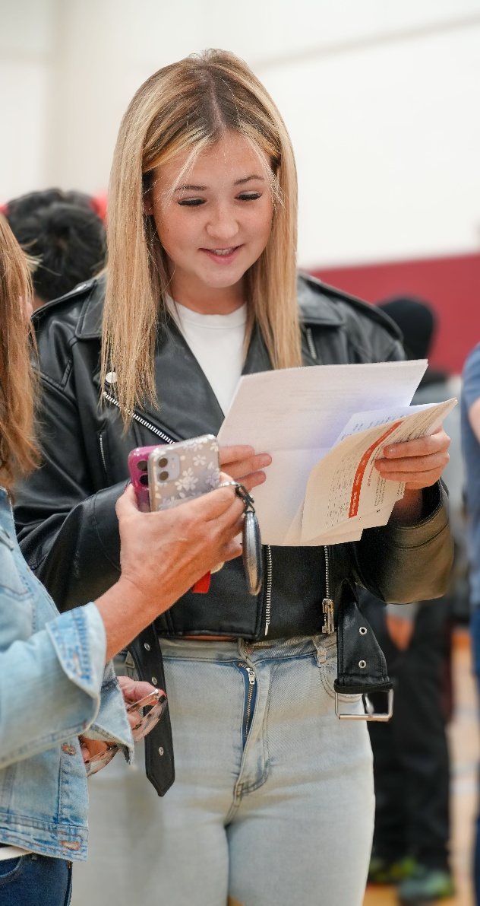
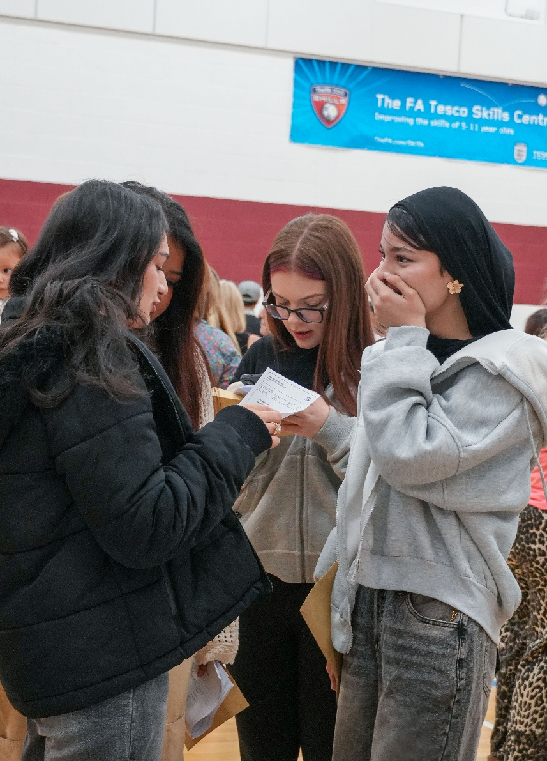
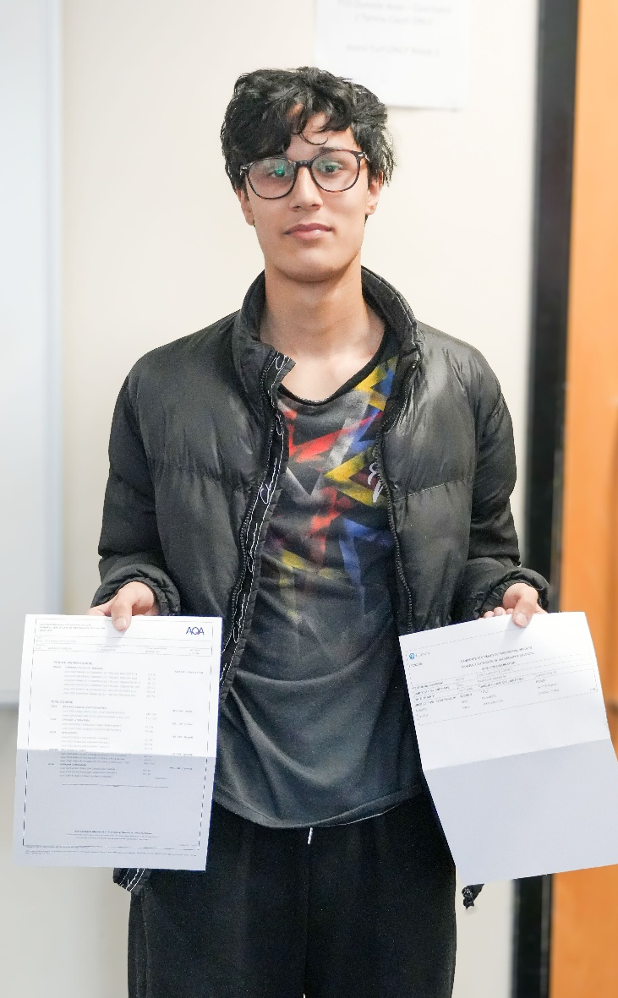
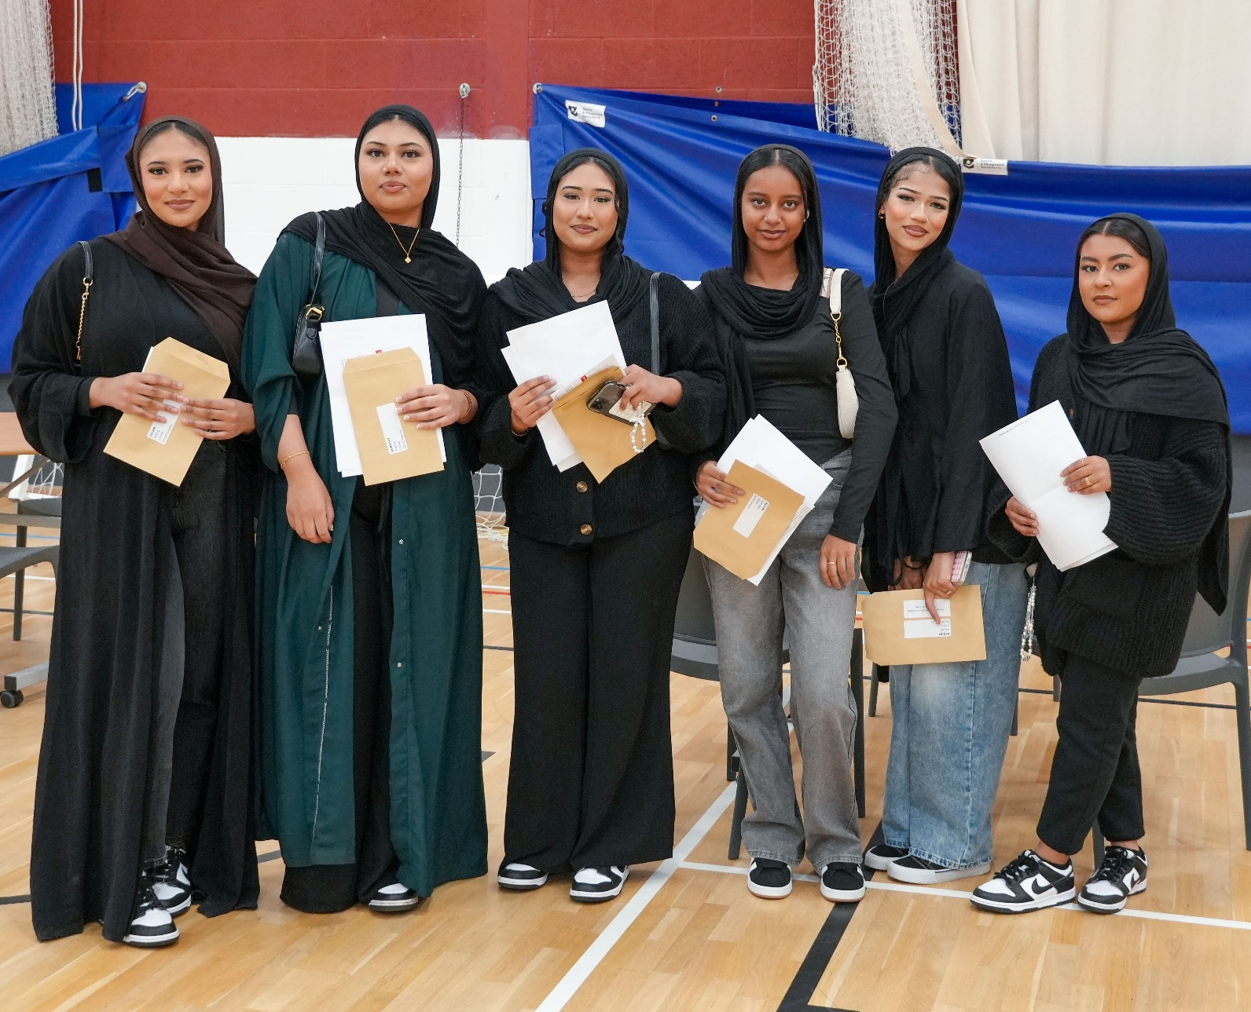
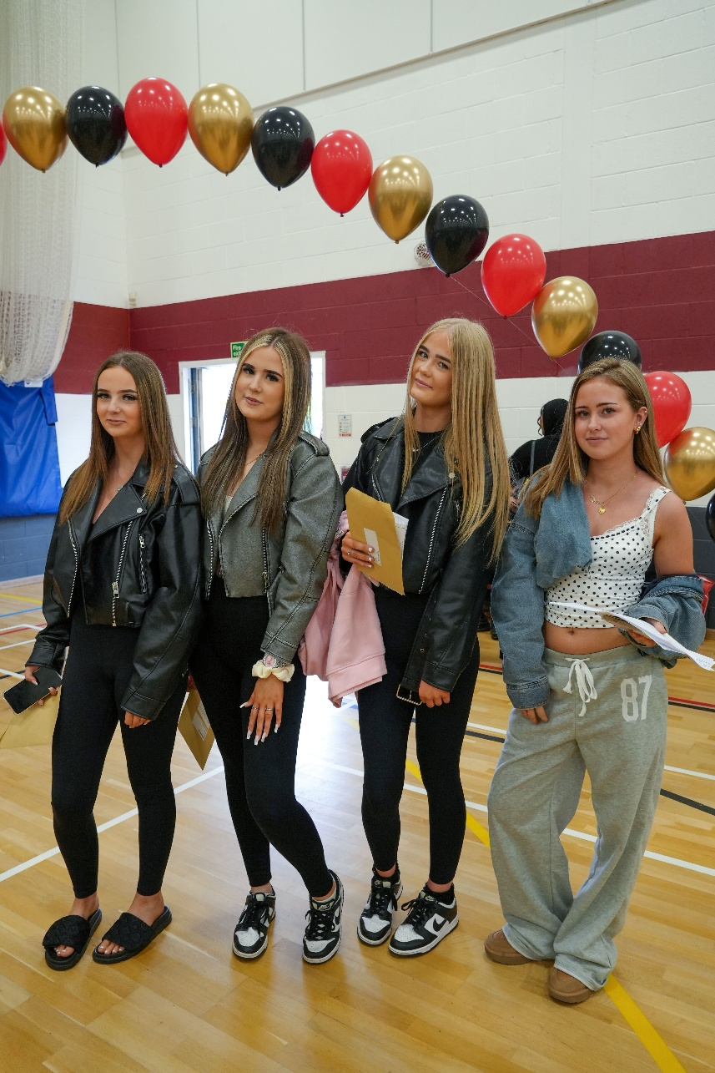
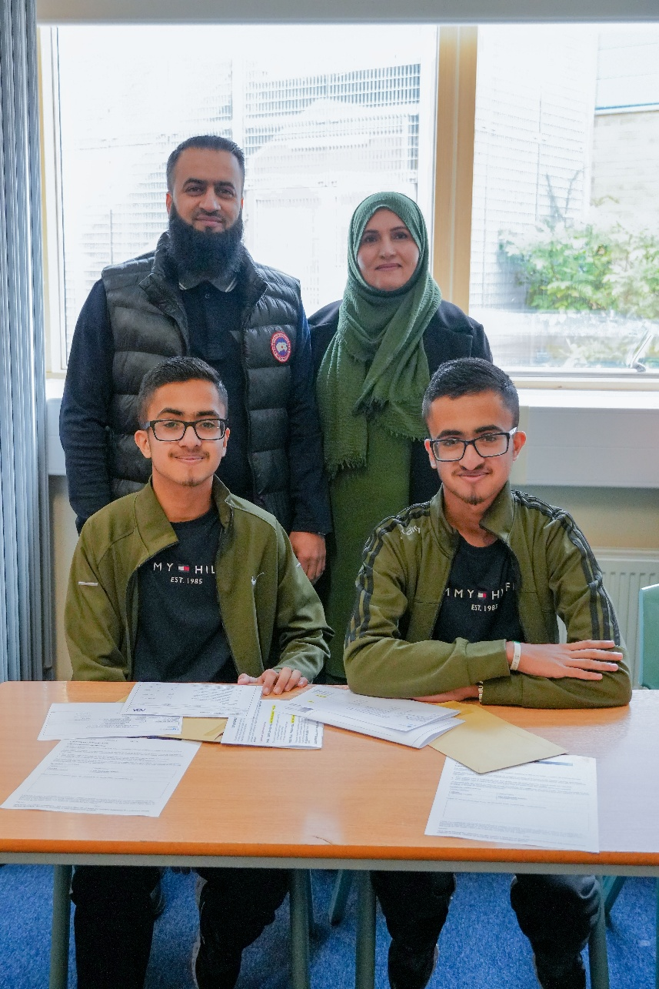
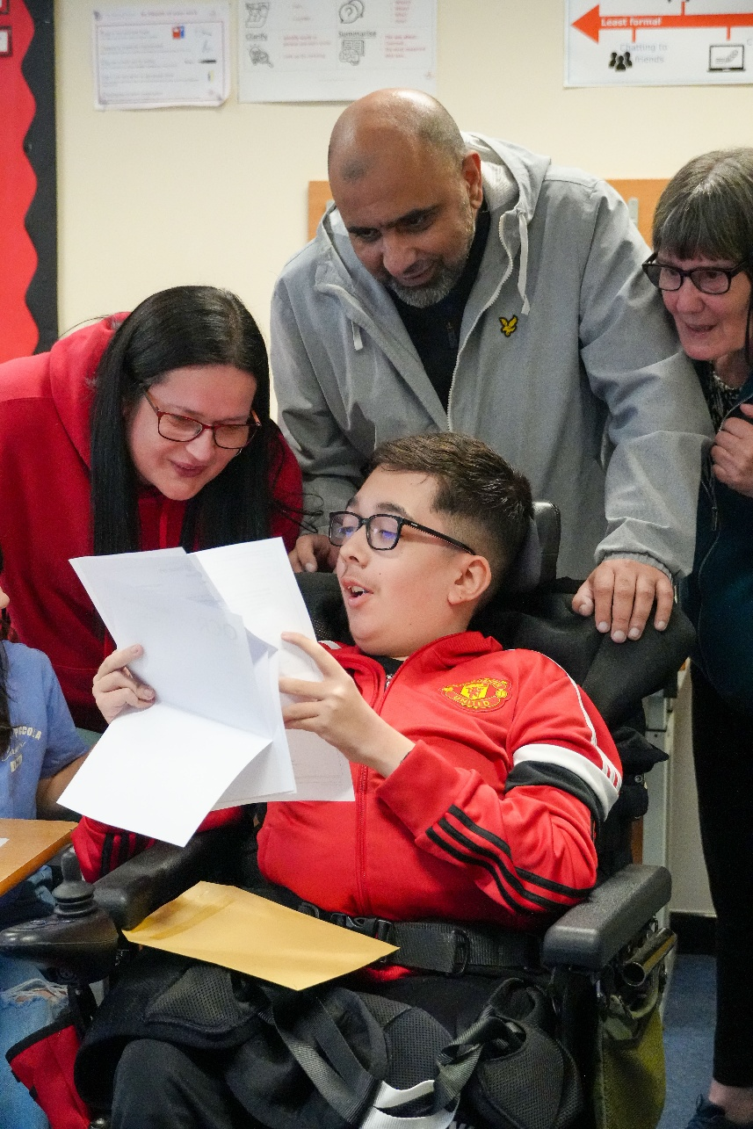

Slide 6
GCSE Outcomes 2025
Attainment 8 42.42
9-7 in English & Maths 6.9%
9-5 in English & Maths 37.0%
9-4 in English & Maths 58.4%
(No Progress 8 measure this year)

Slide 7
miss catlow
Deputy Headteacher
Quality of Education

Slide 8
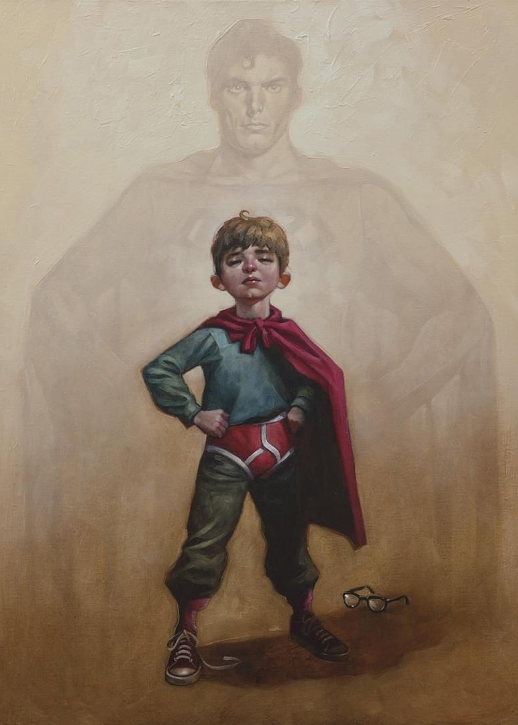
The Curriculum: Our vision
We are committed to providing young people with the highest quality of education for them to achieve their personal excellence.
KNOWLEDGE
TACKLING SOCIAL INEQUALITY
BEST POSSIBLE CHANCE OF SUCCESS
well qualified, resilient, independent and confident young adults
highly positive contribution to their community and wider society

Slide 9
The Curriculum: Our intent
purposeful and rich curriculum
deep subject knowledge
broad range of subjects
acquire and retain the core knowledge
literacy, numeracy, spiritual, moral, social and cultural development

Slide 10
The Curriculum: Organisation
Students are split into two ‘blocks’ and each has six groups.
The blocks are equal in terms of prior attainment, as set out by their performance in their Maths and English exams at Key Stage 2.

Slide 11
The Curriculum: Organisation
Most subjects: 5 mixed attainment plus one support.
English: 1 ‘top set’
Drama, Music, Art, DT: 6 equal mixed attainment
PE: 6 mixed attainment, single gender
All students have access to the full and broad curriculum, and literacy development is prioritised through standalone reading and grammar lessons throughout Years 7-9.
Students follow a two-week timetable.

Slide 12
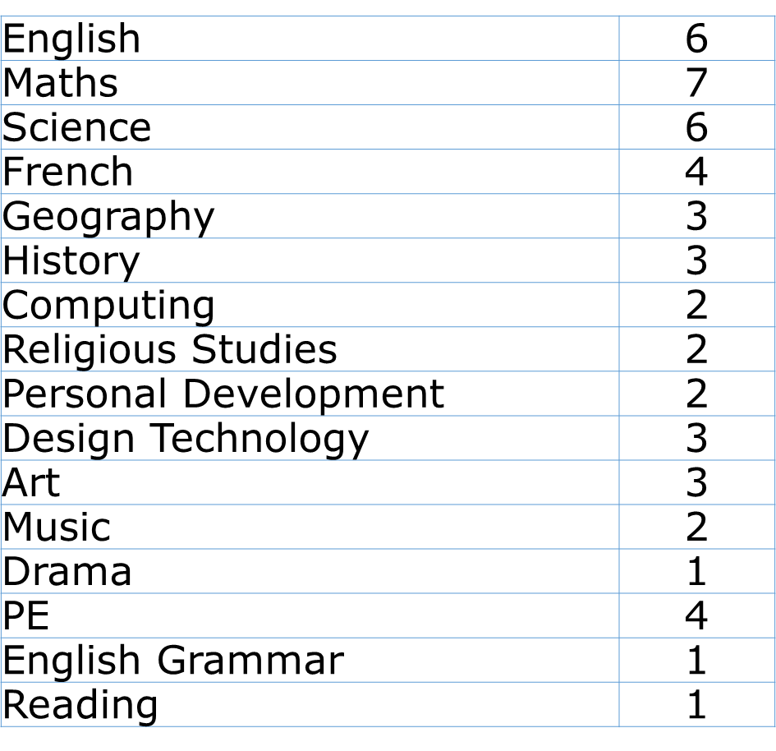
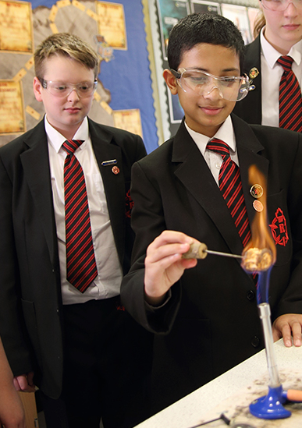

The Curriculum: Subject Learning Hours

Slide 13
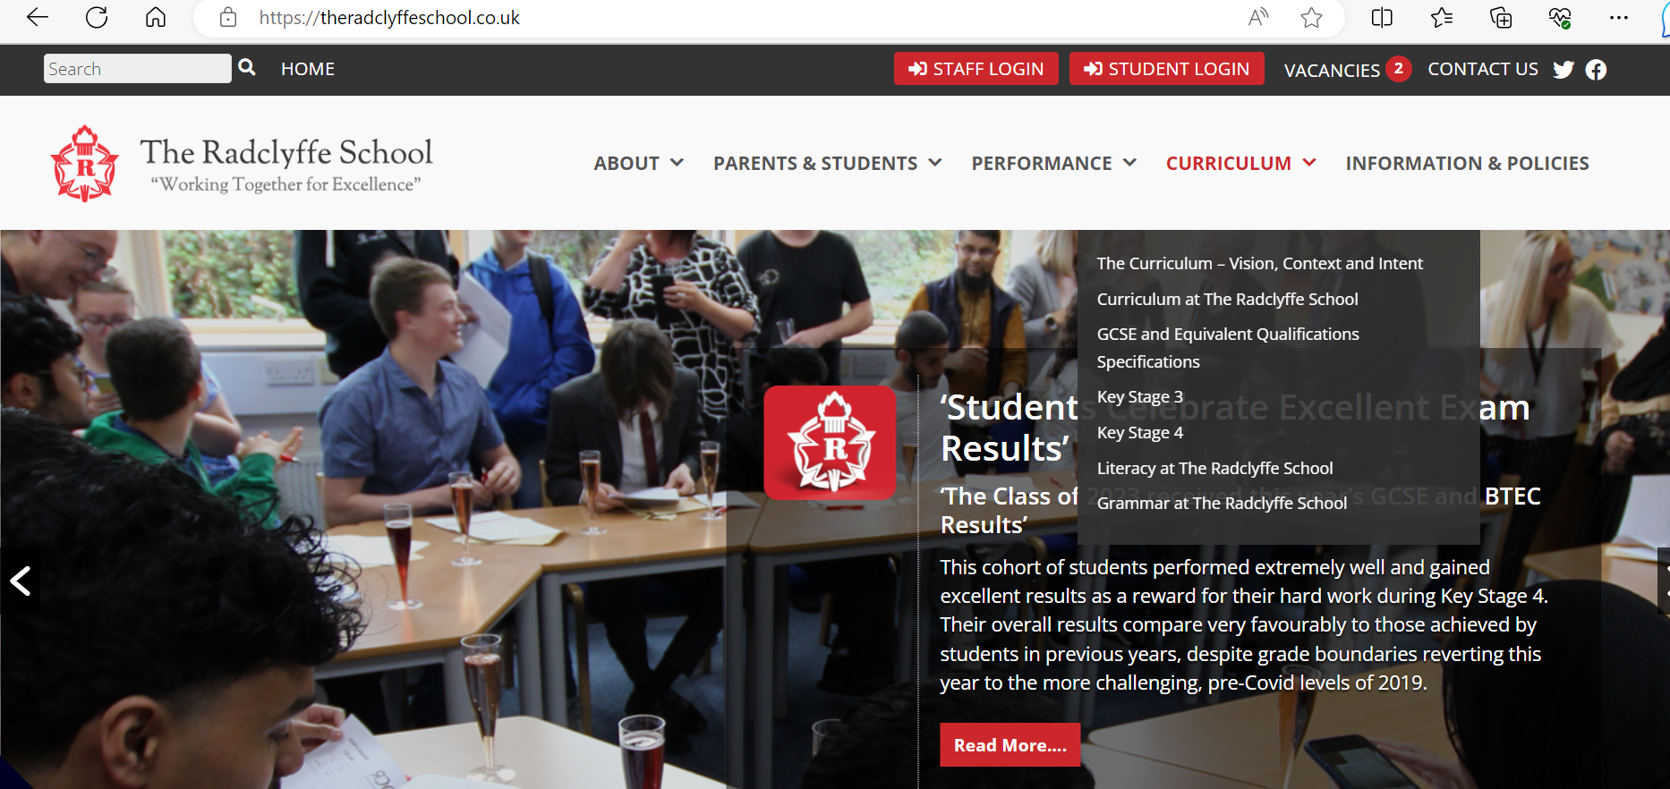
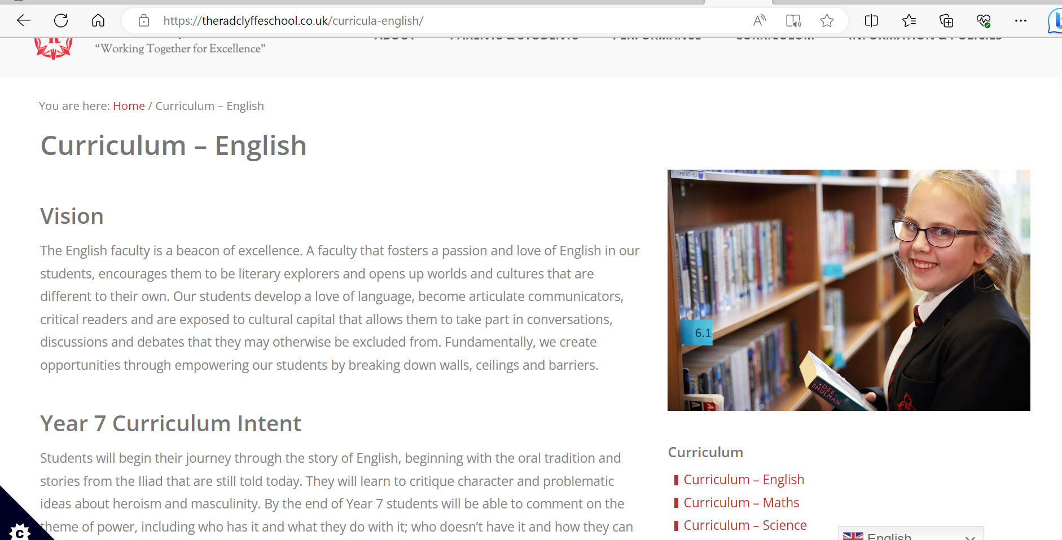
https://theradclyffeschool.co.uk/

Slide 14
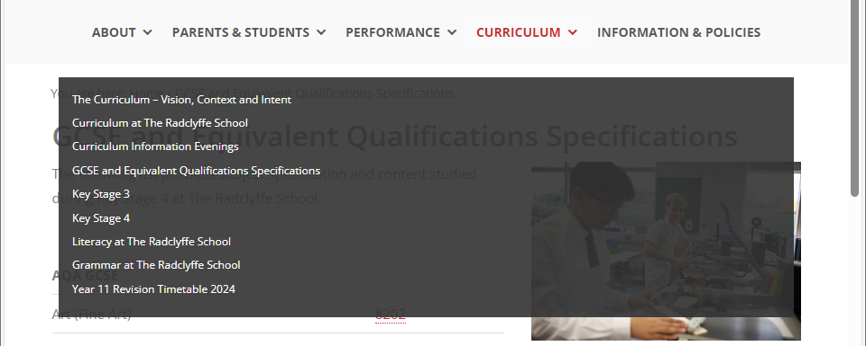
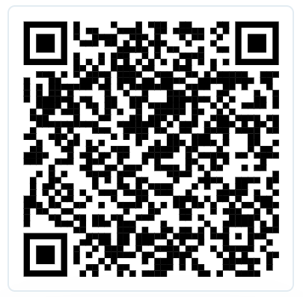
https://theradclyffeschool.co.uk/

Slide 15
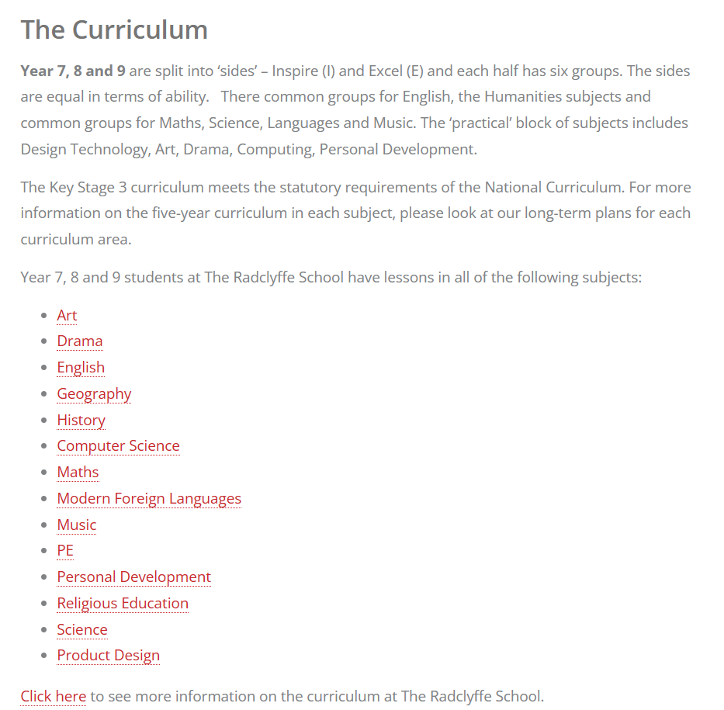
https://theradclyffeschool.co.uk/

Slide 16
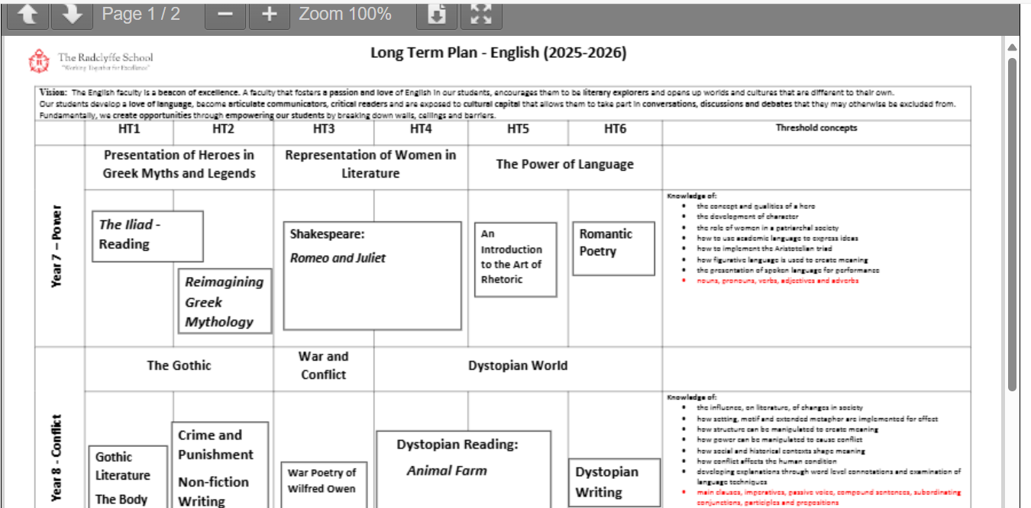
https://theradclyffeschool.co.uk/

Slide 17
mrs robinson
Assistant Headteacher
Learning & Teaching

Slide 18
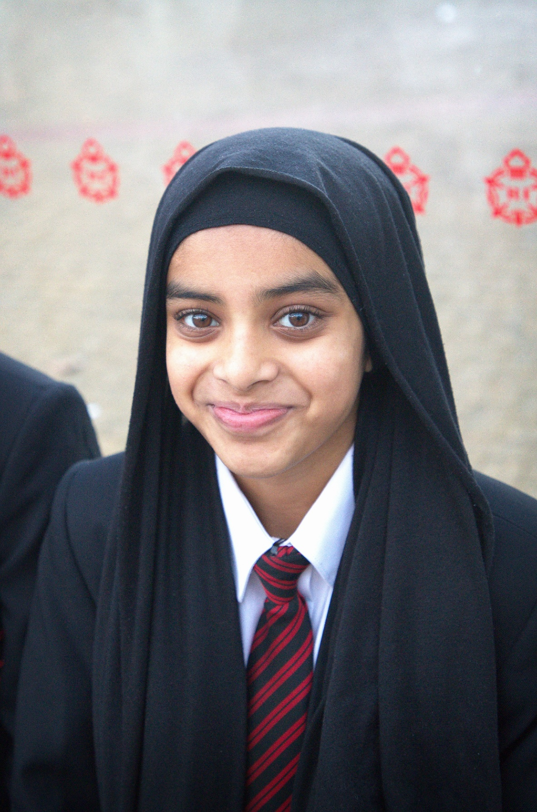
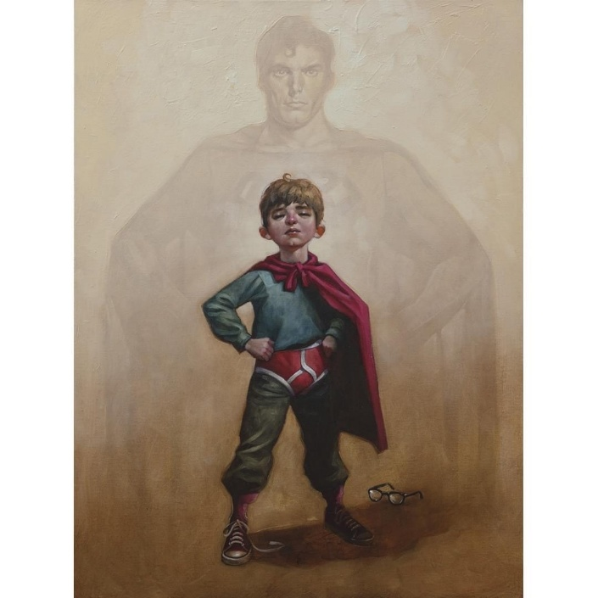

High Quality Teaching and Learning
The best available evidence indicates that great teaching is the most important lever schools have to improve pupil attainment. Ensuring every teacher is supported in delivering high-quality teaching is essential to achieving the best outcomes for all pupils.
Mrs Black Halls – Deputy Headteacher - Curriculum
Notes:
EEF state that mastery learning approaches, individualized instruction and collaborative learning approaches have a huge impact in terms of boosting students outcomes.

Slide 19
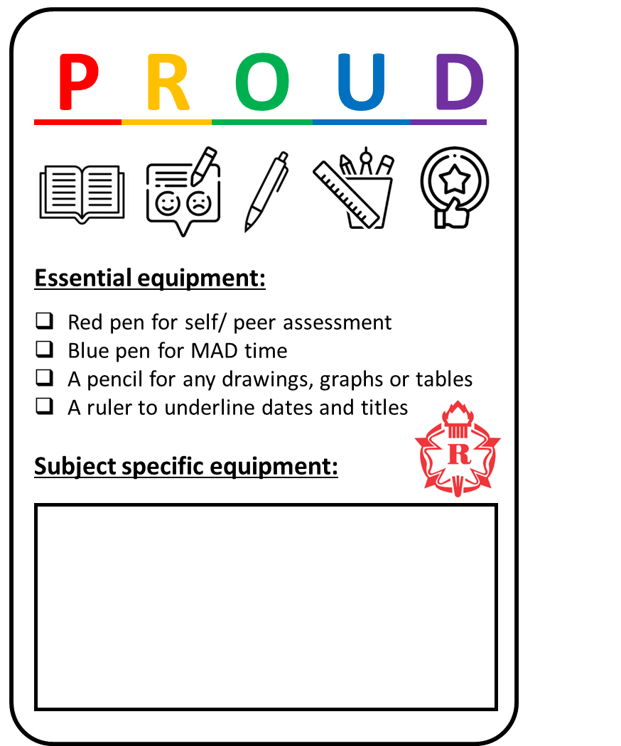



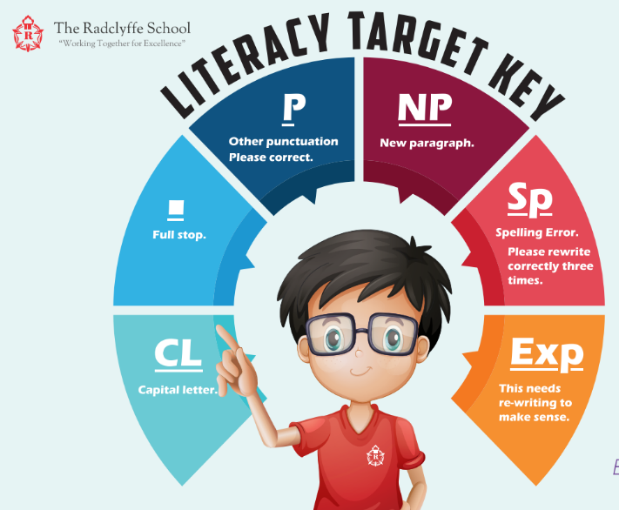

Learning at The Radclyffe School
Self and Peer Assessment Formative Assessment and checking for understanding must be an integral part of every lesson.
Self or peer assess work as instructed by your teacher. This should be completed in red pen.
Your Learning
Respect your own learning and complete your work to the best of your ability. Always be PROUD of your work.
Teacher Feedback You will receive feedback from your teacher every lesson through live modelling, live marking, whole class feedback or individual feedback.
MAD (Make-A-Difference Time) Use teacher feedback to make improvements to your work using a blue pen.
This is important for you to make progress.
Literacy Your teachers will share important vocabulary with you each lesson, model reading and support you with developing writing.
Learning at Home Complete all home learning that is set by your teacher on Satchel One.

Slide 20
Classroom Climates
What are the classroom climates?
Classroom climates help us to understand how students and teachers should behave in the classroom. The three climates we are introducing are not brand new and should not be surprising – we are simply making expectations clear for everyone in the school.
The climates will provide opportunities for teacher talk, class discussion, paired work, group tasks, and silent work. All of these are important to our learning and will support everyone in achieving their best.

Slide 21





Climate 1
One voice
Focus on the speaker
Track the speaker
Listen carefully
Be calm and respectful
Sub title
Bullet point
Bullet point
Bullet point
Bullet point

Slide 22

Climate 2
Learning through talk
Work in pairs or groups
Share ideas
Take turns
Ask questions
Active – not silent
Sub title
Bullet point
Bullet point
Bullet point
Bullet point

Slide 23

Climate 3
Learning independently
Space to think
Challenging work
Working hard
Showing resilience
Making connections to the wider world
Sub title
Bullet point
Bullet point
Bullet point
Bullet point

Slide 24
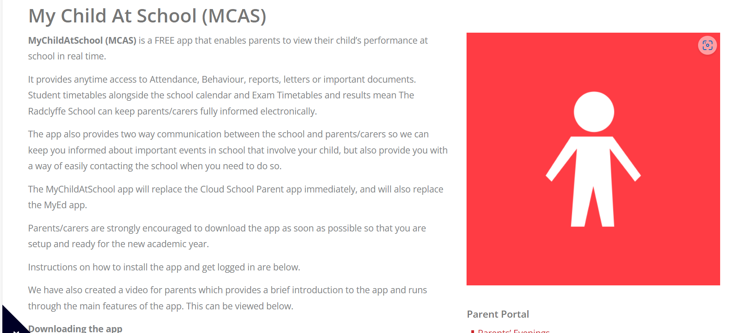
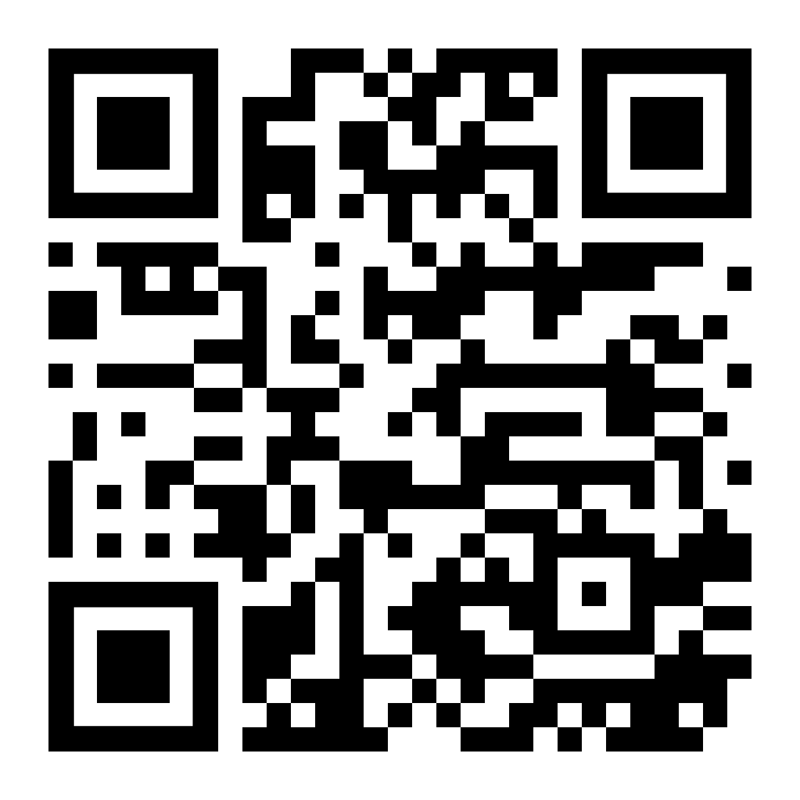
Mychildatschool (MCAS) is a FREE app that enables parents to view their child’s performance at school in real time.
It provides anytime access to attendance, behaviour, reports, letters or important documents. Student timetables alongside the school calendar and exam timetables and results mean the Radclyffe School can keep parents/carers fully informed electronically. This is where parents and carers will be able to view your child’s options choices

Slide 25
INDEPENDENCE
MAKE EVERY MINUTE COUNT

Slide 26

MAKE EVERY MINUTE COUNT
INDEPENDENT LEARNERS
Take personal responsibility
Subject strengths and weaknesses
Utilise PLG sessions to work on your study skills
Studying at home for all your assessments
Utilise the teachers in your subjects
Plan and complete Home Learning

Slide 27
SUPPORTING AT HOME
Show an interest
Check Satchel One, ask about home learning
Encourage revision now
Watch the news together
Offer to test them on what they have been learning
Read with them – at least 20mins per day – model it!
Help them be organised: check TT each night and support bag packing
Ensure they have all the necessary equipment: bag, pens, mathematical tools

Slide 28
mrs hamilton
Whole School
Literacy Lead

Slide 29



Reading fluency is like a golden ticket for your child.

Slide 30

Why should you encourage your child to read?
25% of 15-year-olds have a reading age of 12 or under
1 in 8 disadvantaged children in the UK do not own a single book at home
Children who are weak readers will struggle as much in maths and science at GCSE as they do in English and the arts subjects
Students are less able to learn in school if they do not develop sufficient reading skills
In the words of the DfE, ‘more demanding’ GCSE exams were introduced in 2017
Exams now tend to include wordier questions – problematic for students with a low reading age

Slide 31
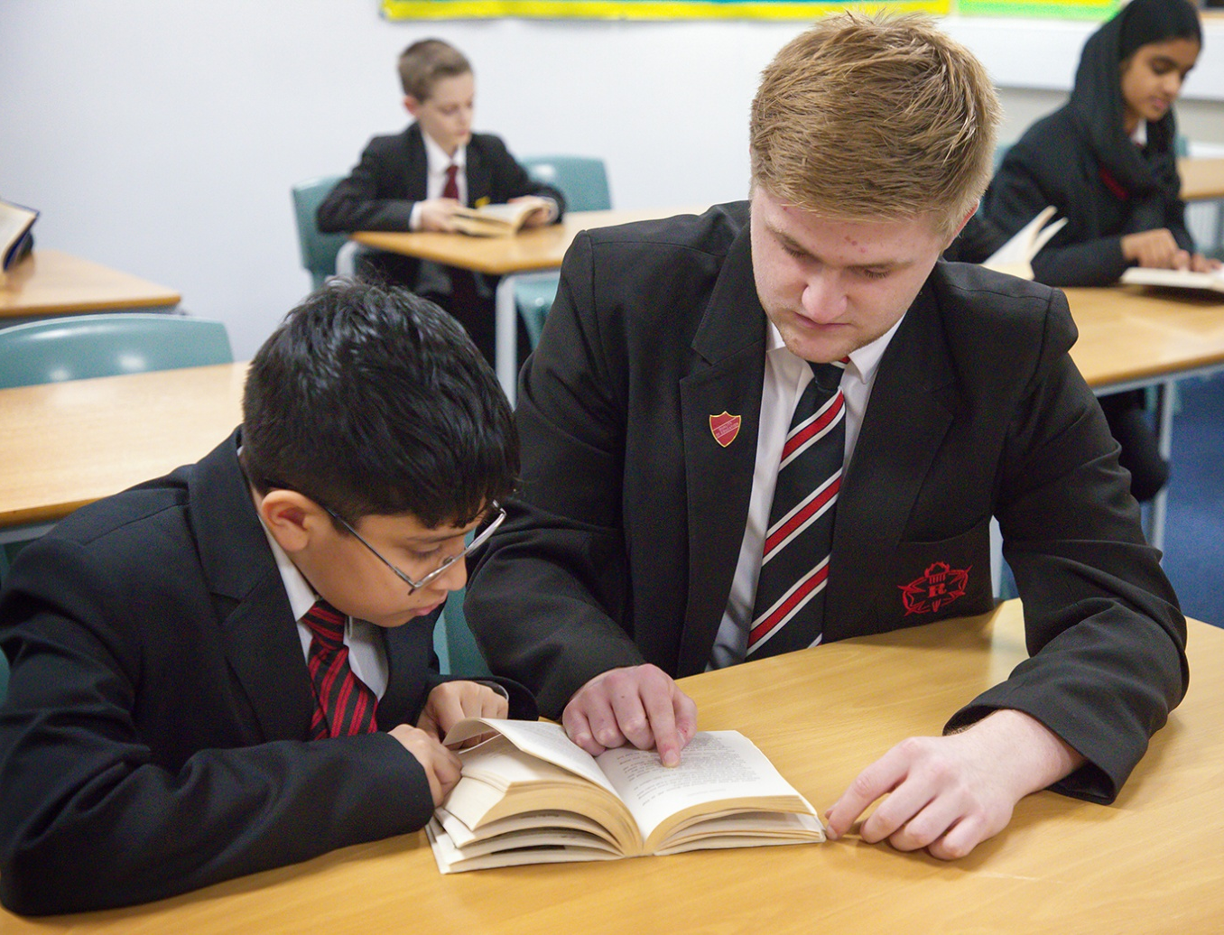
The benefits of reading
Children who read books more than once a week by age 16 gain higher results than those who read less regularly
19% of readers say that reading stops them from feeling lonely.
Regular readers for pleasure reported fewer feelings of stress and depression than non-readers
Studies have shown that those who read for pleasure have higher levels of self-esteem and a greater ability to cope with difficult situations
Reading for pleasure has been found to improve sleeping patterns
Adults who read for just 30 minutes a week are 20% more likely to report greater life satisfaction
People who read for 3.5hours a week (30mins a day) have a 17% higher life expectancy than those who don’t
30mins is 2% of your day

Slide 32

Testing
NGRT
All Year 7 students are currently being tested using the online NGRT in their library lesson
There is no revision or preparation needed as it is a cognitive test rather than knowledge-base
Salford Test
Used to triangulate other data
Used at the start and finish of interventions to show progress
Completed on paper with a member of the library or SEND team
STAR testing
Designed to assess student comprehension
Allows library staff to provide students with an appropriate book within their ZPD
Allows us to monitor their engagement and progress with their reading and reward progress

Slide 33


Reading Interventions
We have invested in two new reading programmes:
Sparx Reader
All students will have access
Can be accessed on most devices
Encourages students to read and regularly review their understanding as they go
LexiaPowerUp
A selection of students will be invited to attend (based on need)
Identifies gaps in knowledge and tailors learning to student needs
Adaptive and reflective to ensure rapid progress
Delivered weekly during PLG time (to avoid lost learning in other areas)
What we are doing:
PLG reading
EXACT testing
Literacy explicitly taught in lessons
Access to library at break and lunch
Lexia intervention
Sparx Reader
What you can do:
Encourage them to read 'widely and often'
Read with them/ to them
Support the interventions

Slide 34

Advice:
Check regularly that they have a book and are reading it
Start small (5mins to start and build up)
Encourage them to attend their intervention sessions
Be a role model – stand in the gap
Contact school if you have any questions
Invitation:
Please come up to the library on level 3 straight after this session for light refreshments and to collect a ‘golden ticket’ for your child.

Slide 35
miss whybrow
Associate Assistant
Headteacher: Transition

Slide 36

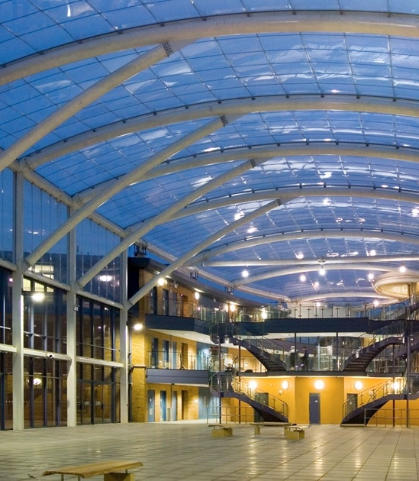


“It’s too hard!”
“I can’t do that.”
“I’m not good enough.”
“I don’t know what to do.”
“I’ll do it later!”
“What’s the point?”
“I can’t be bothered.”

Slide 37
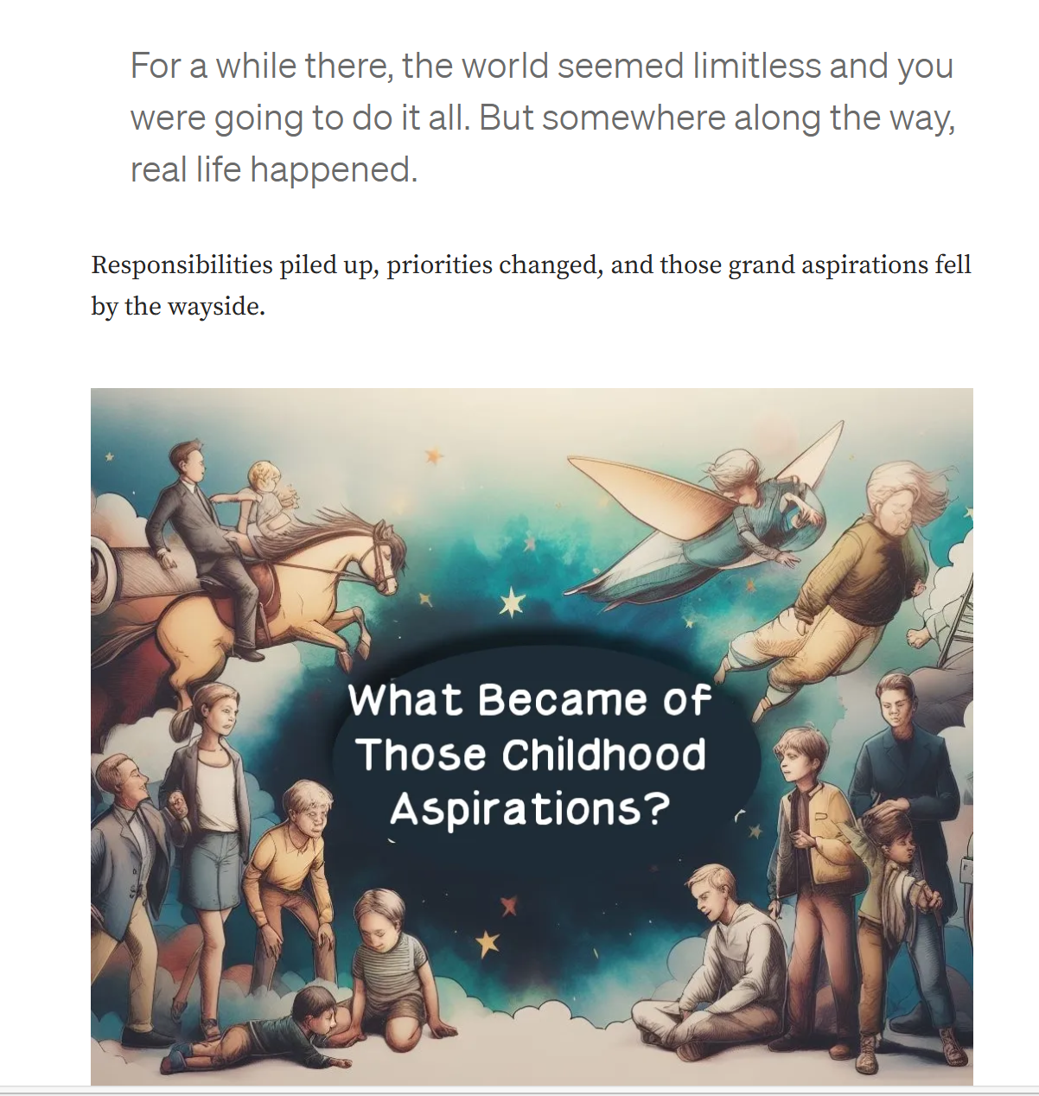
Walt Disney, for example, dreamed of creating magical experiences and characters as a child, going on to pioneer the American animation industry with Mickey Mouse and Disneyland.
Oprah Winfrey had big dreams from an early age. Born into poverty to a single teenage mother, Oprah was reading and reciting Bible verses by age three, and knew she wanted to be “paid to talk.”
Steven Spielberg, one of the most successful filmmakers of all time, dreamed of directing movies as a child.
He started making amateur films as a teenager, eventually dropping out of college to pursue his passion. His blockbusters like Jaws, E.T., and Jurassic Park have inspired generations.

Slide 38
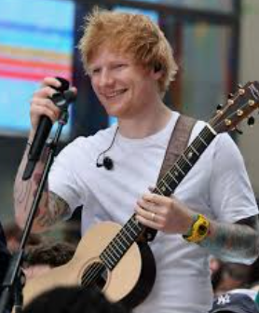
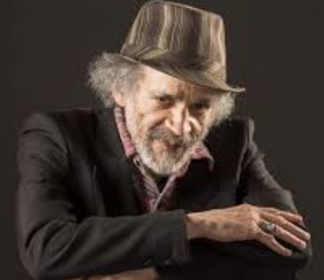
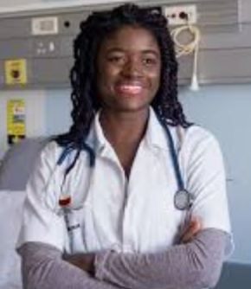

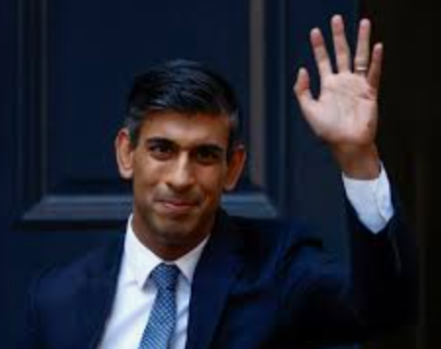
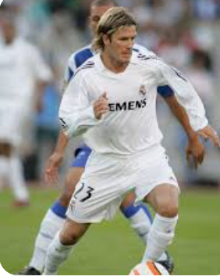
“Why not me?”
At the Radclyffe School, we want to students to ask this question.

Slide 39
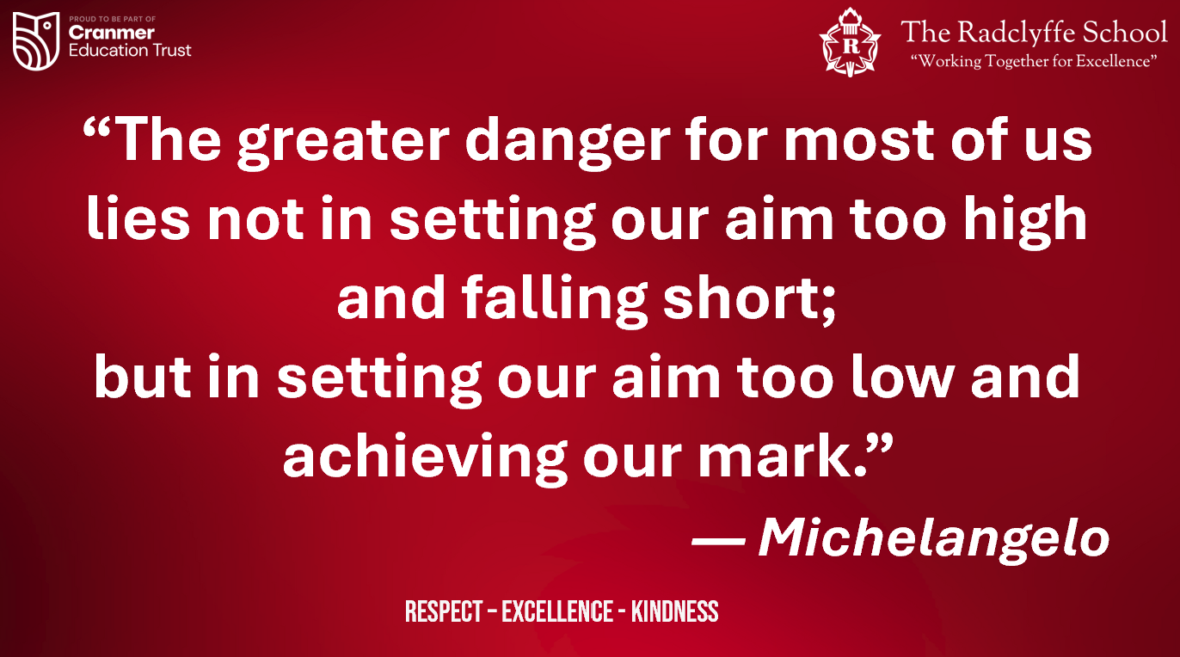

Slide 40

Raising Aspirations
“Empowering Every Child to Aim Higher”
Achieving your goals
Striving for success – even when it’s difficult
Seeing a purpose in learning
Fulfilling our core value of ‘Excellence’
Not settling for what you have
Being inspired by others

Slide 41

Why is aspiration important?
Achieve better results
Become more resilient
Increases motivation
Considerate of their future

Slide 42
What does the research suggest?
Aspirations are positively correlated with higher achievement later in life and are a significant driver of later-life success.
Focusing on building knowledge and skills that support children's existing aspirations is more effective than trying to change the aspirations themselves.
Simply having high aspirations is not enough to achieve potential; children also need the knowledge and skills to pursue their goals.

Slide 43
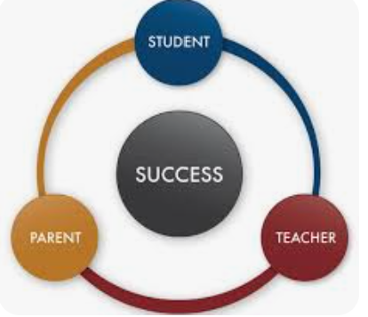
How do we make this happen?

Slide 44
Parental support
Talk positively about the future – even if it’s uncertain
Encourage curiosity – ask your child what they’re passionate about
Help them explore different careers and pathways
Praise effort, progress, and resilience, not just achievement
Stay connected with school and ask about what they’re learning

Slide 45

Encourage your child to attend extra-curricular activities – Science club.
Explore the routes and pathways into becoming a doctor – what GCSEs need to be a focus? Foster strong foundations in these subjects from an early age.
Growth Mindset – Encourage your child to explore Science. Research? Trip?
Create a revision time-table to ensure your child is revising and support them with this.
Nurture skills such as communication, empathy, problem solving and role-play.
Extra reading on different topics, particularly Science.
Research and apply to colleges - explore A-levels in the Sciences
Research and apply to medical school.
Encourage your child to attend extra-curricular activities – Science club.

Slide 46
As a school we will…
Careers education and Independent study from Year 7 onwards
Visits from professionals, universities, and apprenticeship providers
Mentoring and personal development experiences
Setting high expectations and celebrating effort, not just results
Broadening horizons through trips, extra-curricular activities, and cultural experiences
🌍
🎯
🧠
🎓
💼

Slide 47

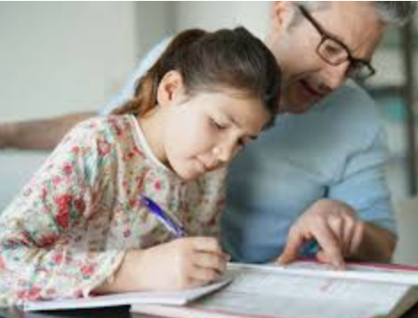

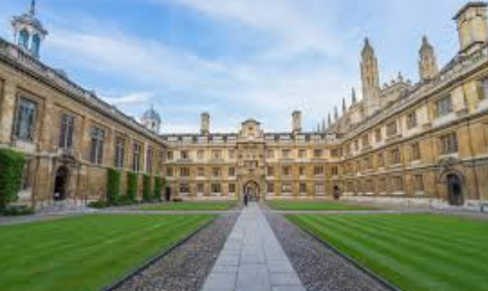
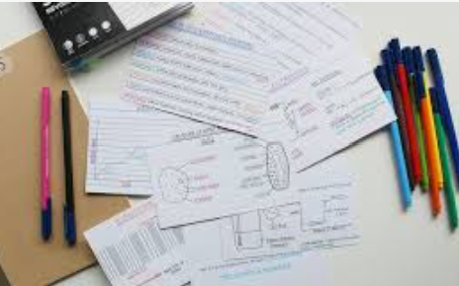

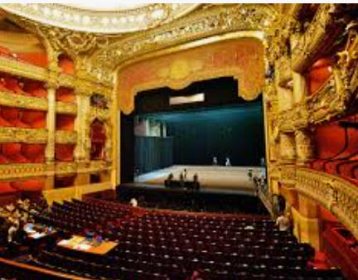


How to raise aspirations

Slide 48
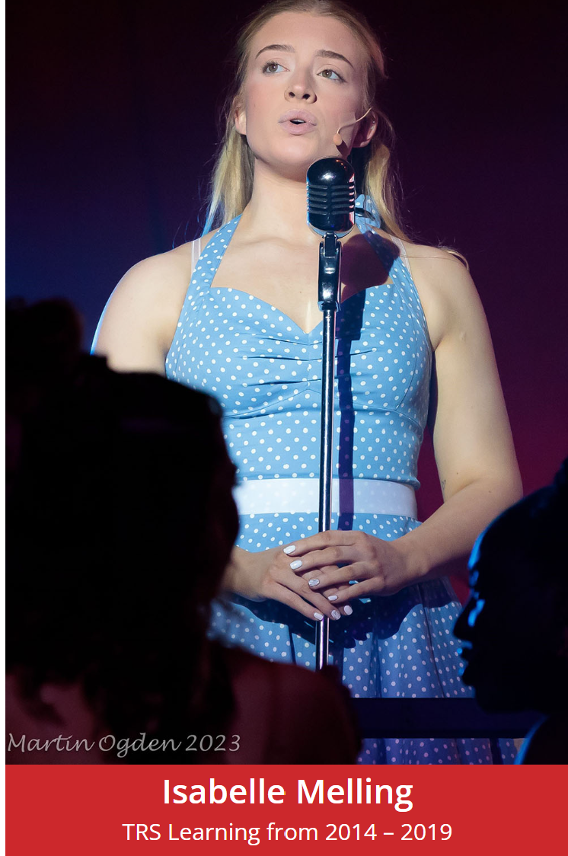
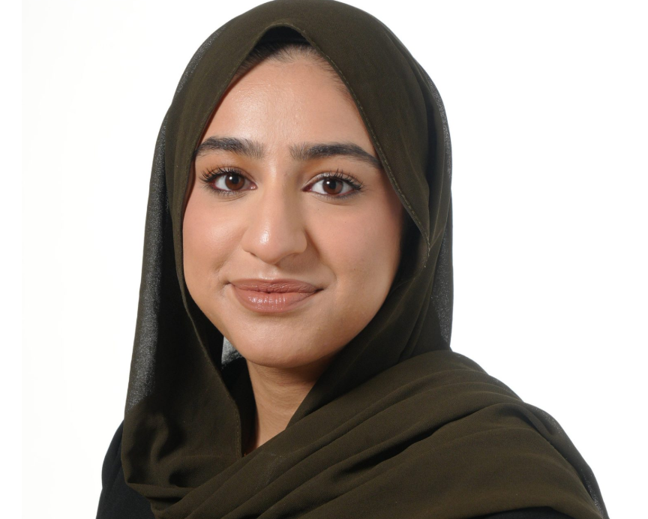
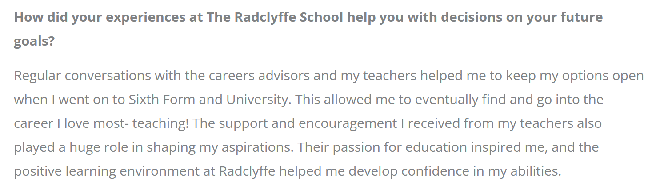
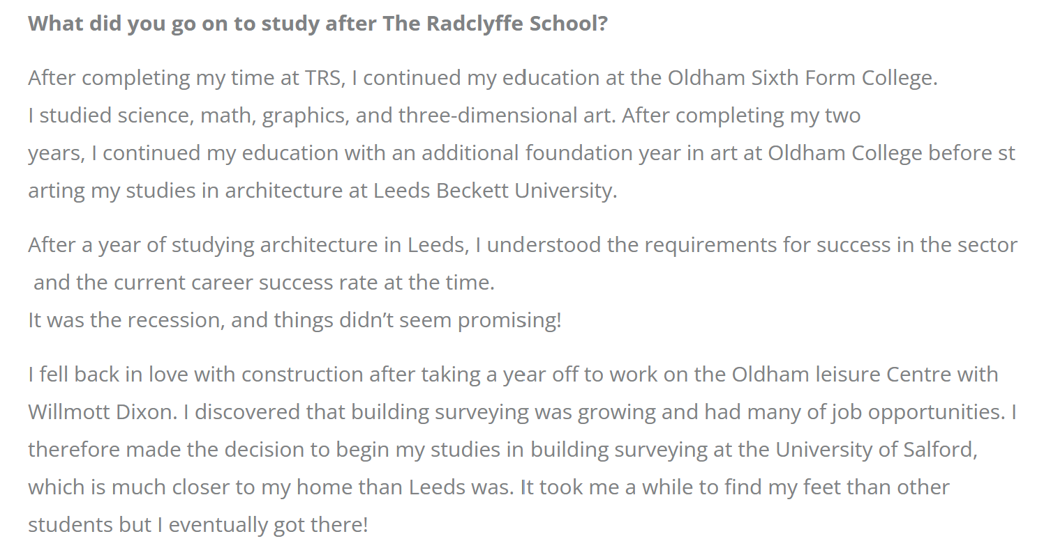
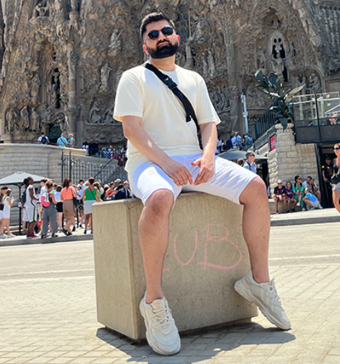
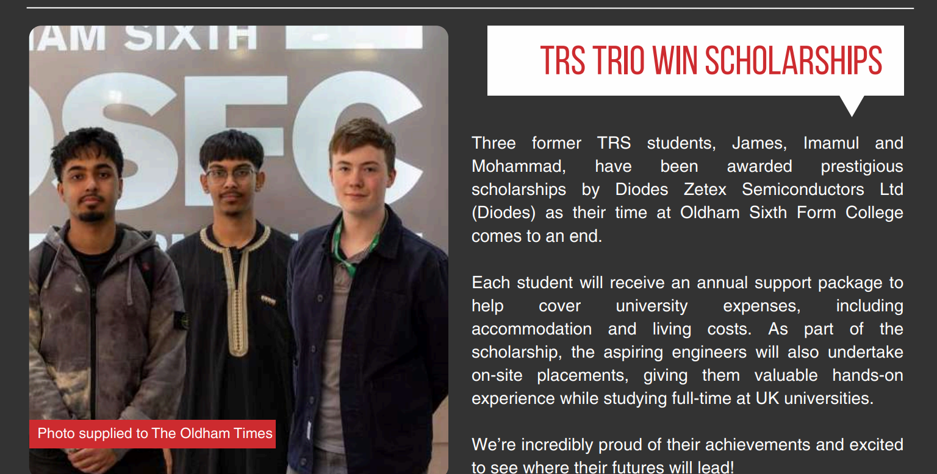
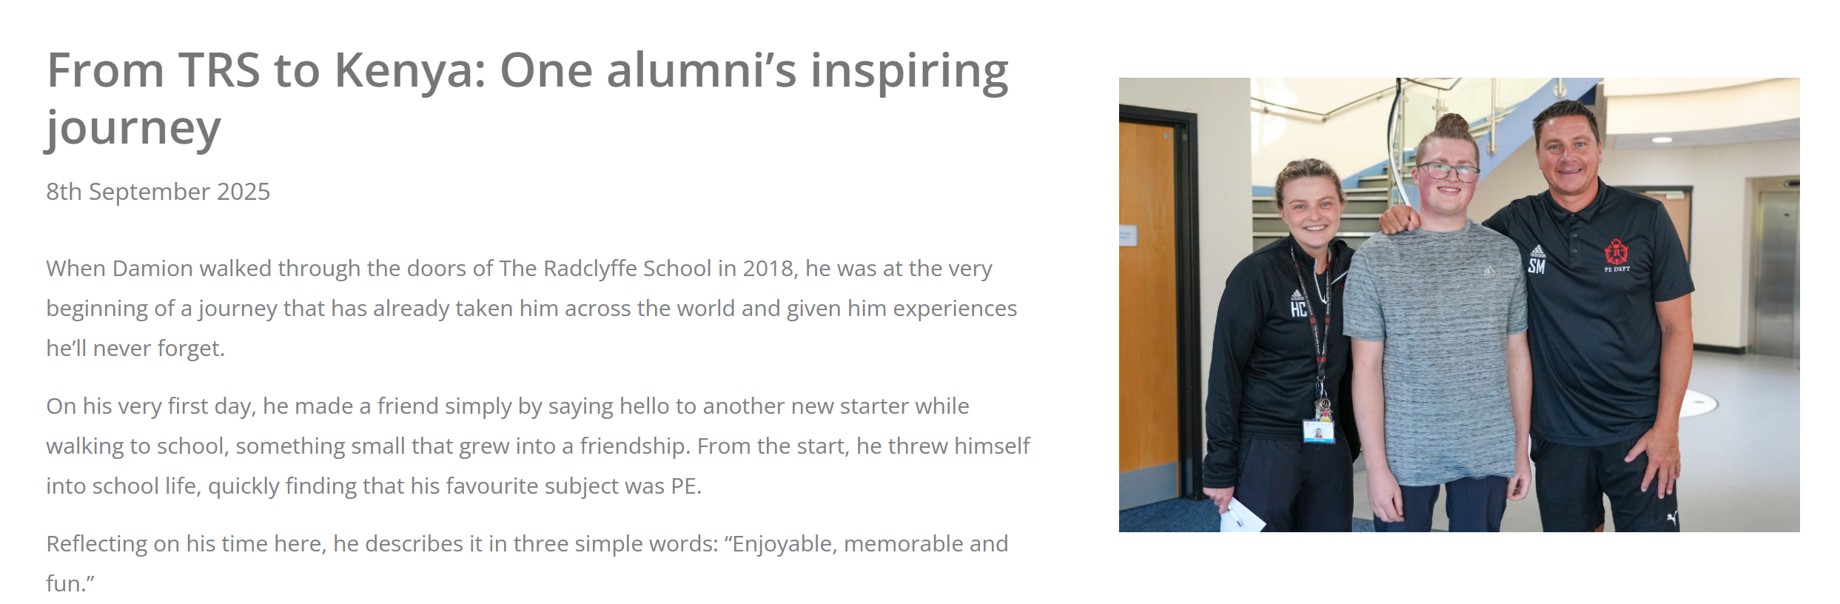

Slide 49

Thank you!
If you have any questions about your child’s education, please contact:
Miss Marks (Acting Year Manager, year 7)
Miss Whybrow (Associate Assistant Headteacher)

