Slide 1



Welcome to the
Year 8 & 9 Curriculum Information Evening

Slide 2

Mr cregg
Headteacher

Slide 3
tonight’s presentations
Curriculum, Teaching & Learning, Home Learning & Independent Study : Miss Catlow
Science: Mrs Begum
English: Miss Khaliq
Mathematics: Miss Holt
Literacy: Mrs Hamilton

Slide 4
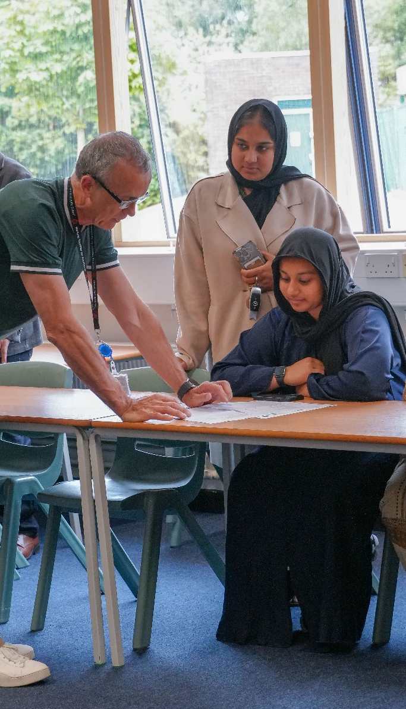
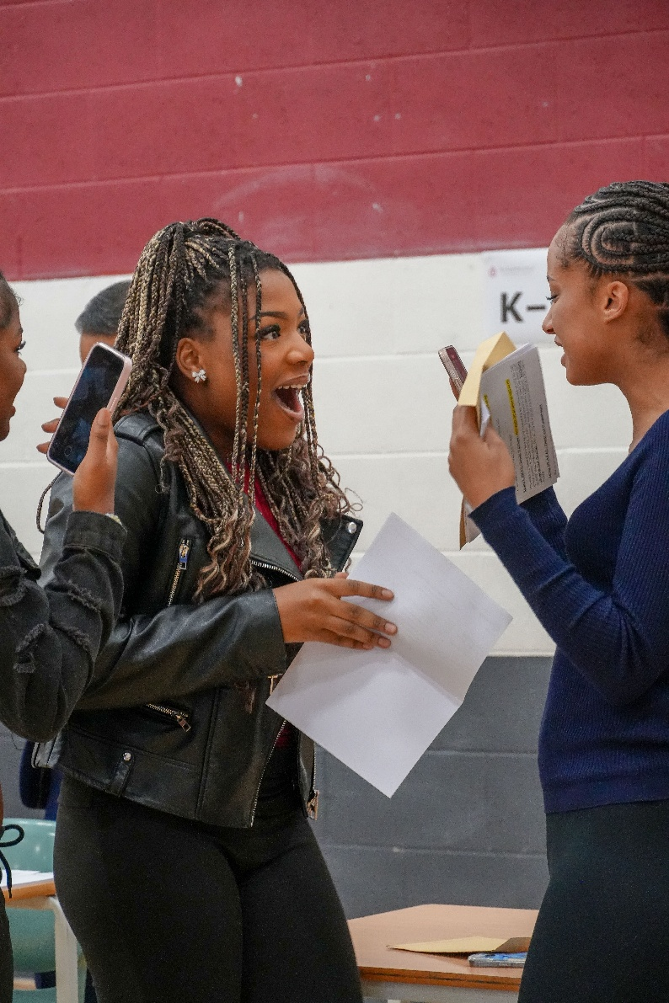
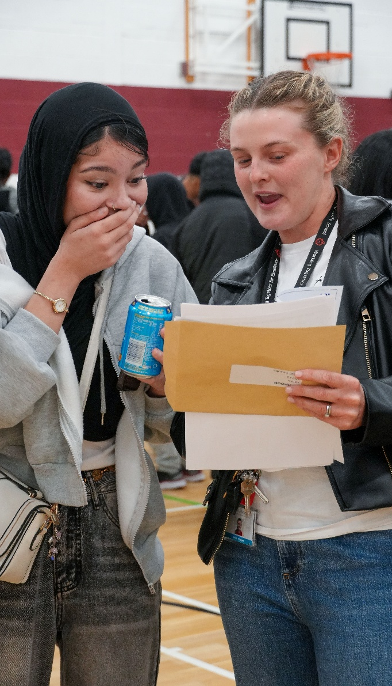
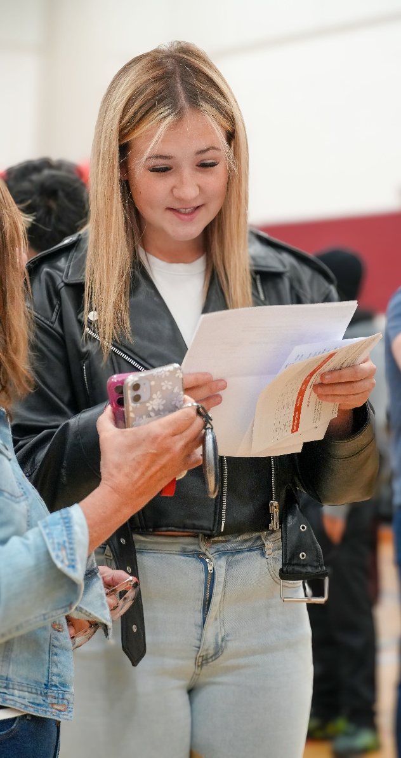
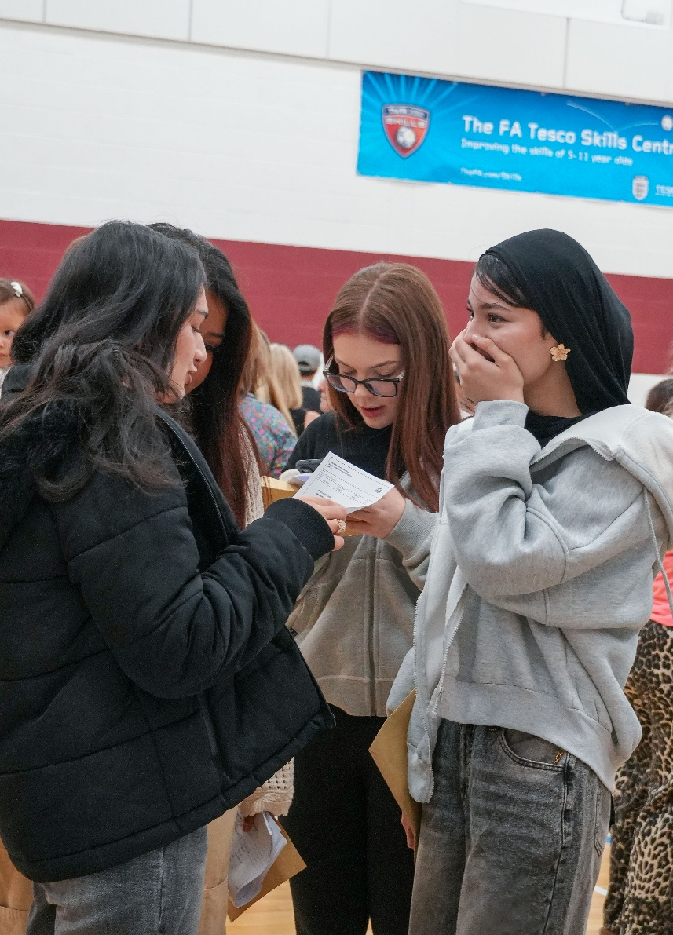
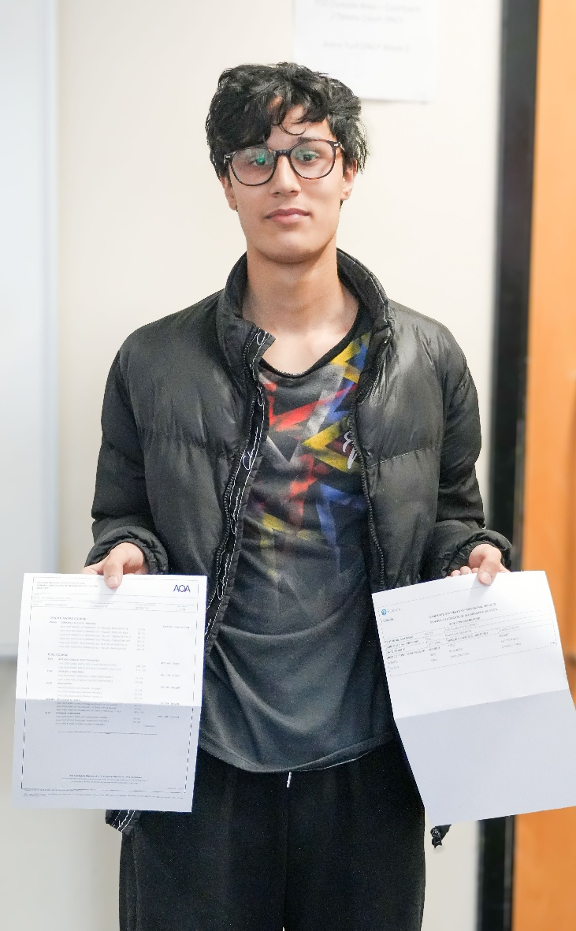
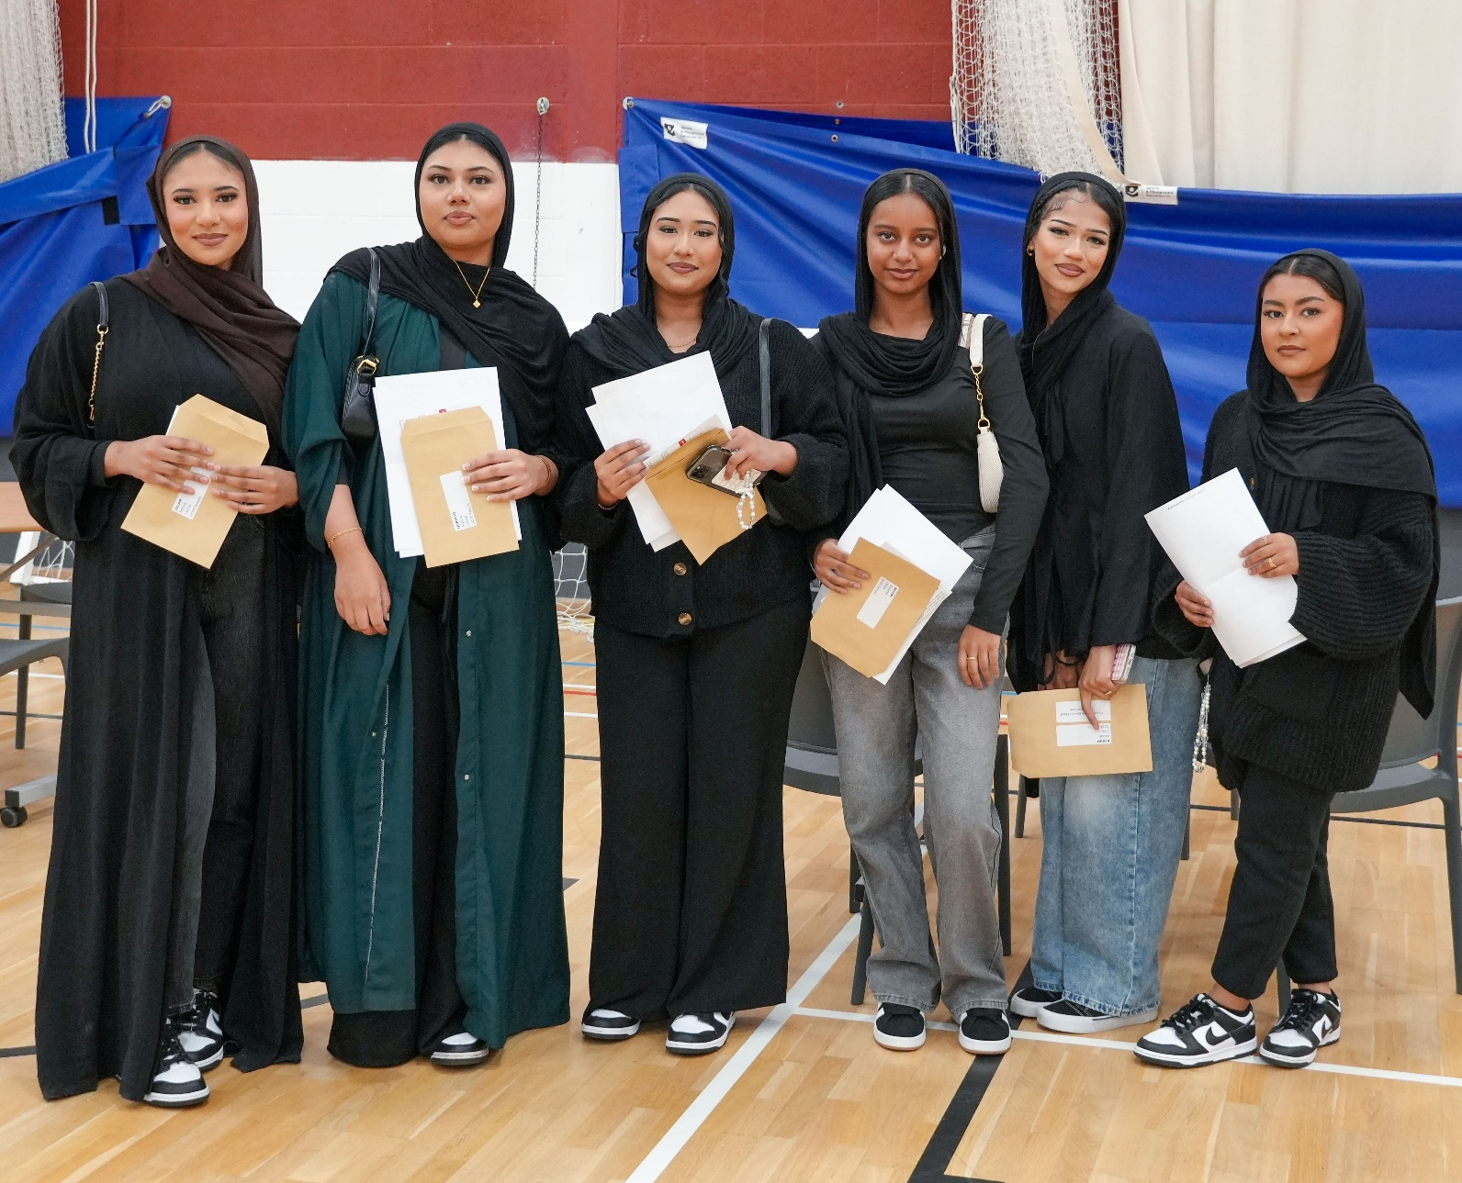
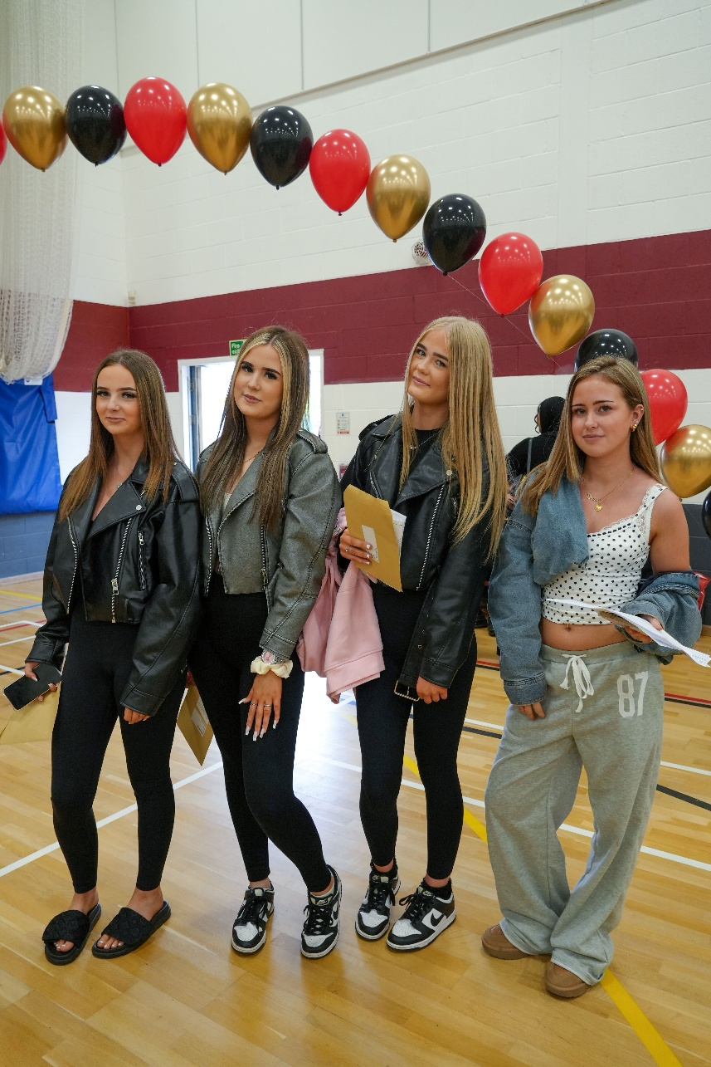
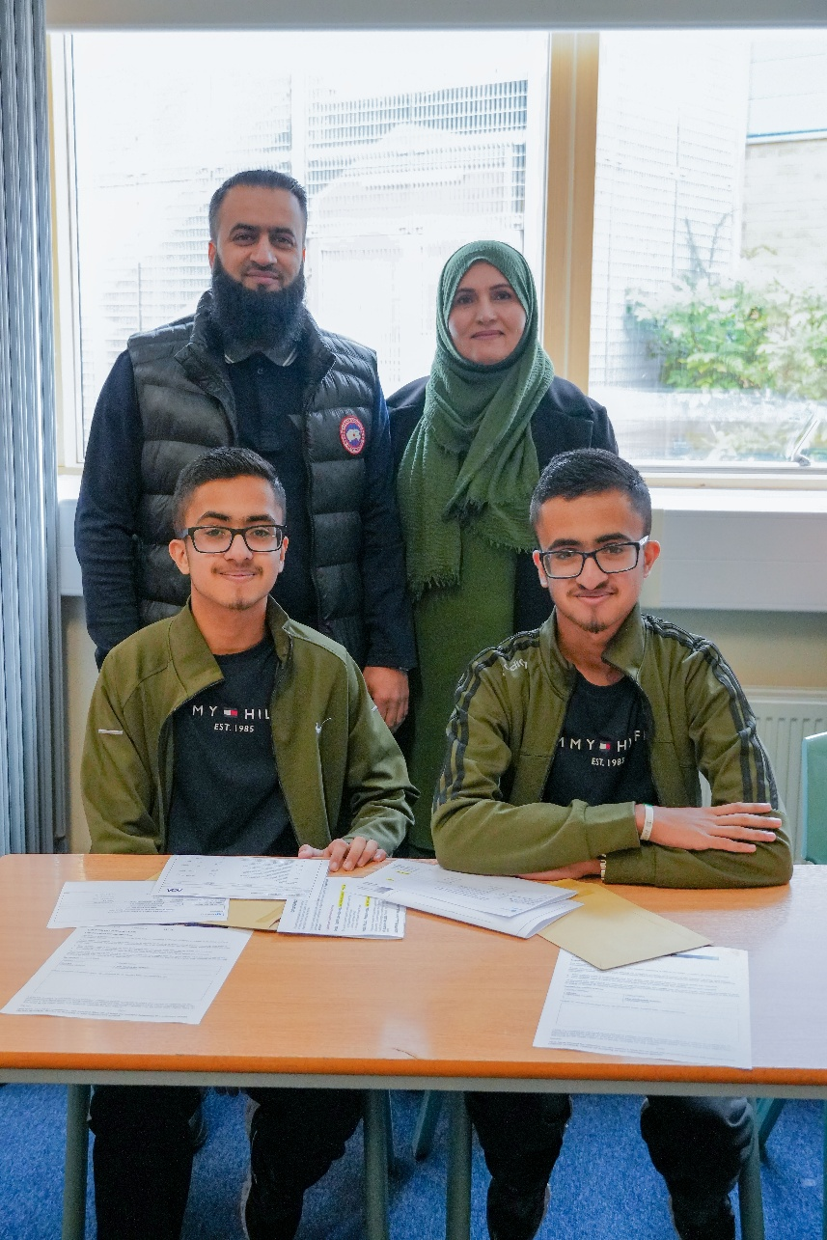
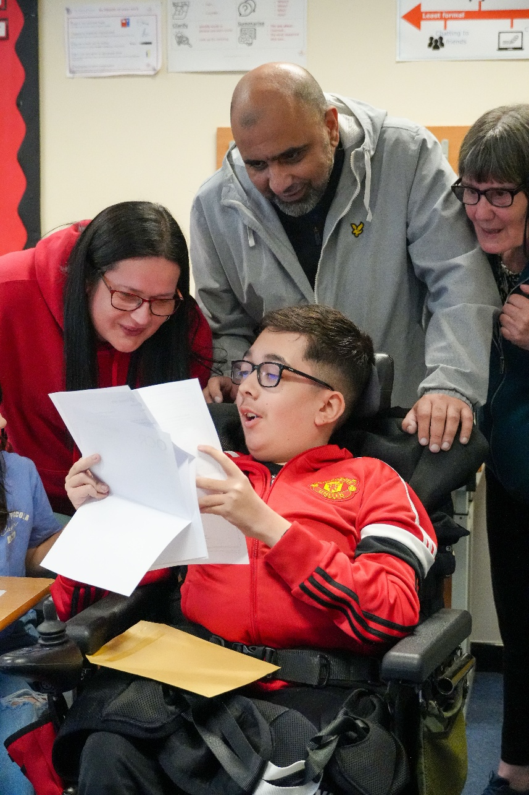

Slide 5
GCSE Outcomes 2025
Attainment 8 42.42
9-7 in English & Maths 6.9%
9-5 in English & Maths 37.0%
9-4 in English & Maths 58.4%
(No Progress 8 measure this year)

Slide 6

miss catlow
Deputy Headteacher
Quality of Education

Slide 7
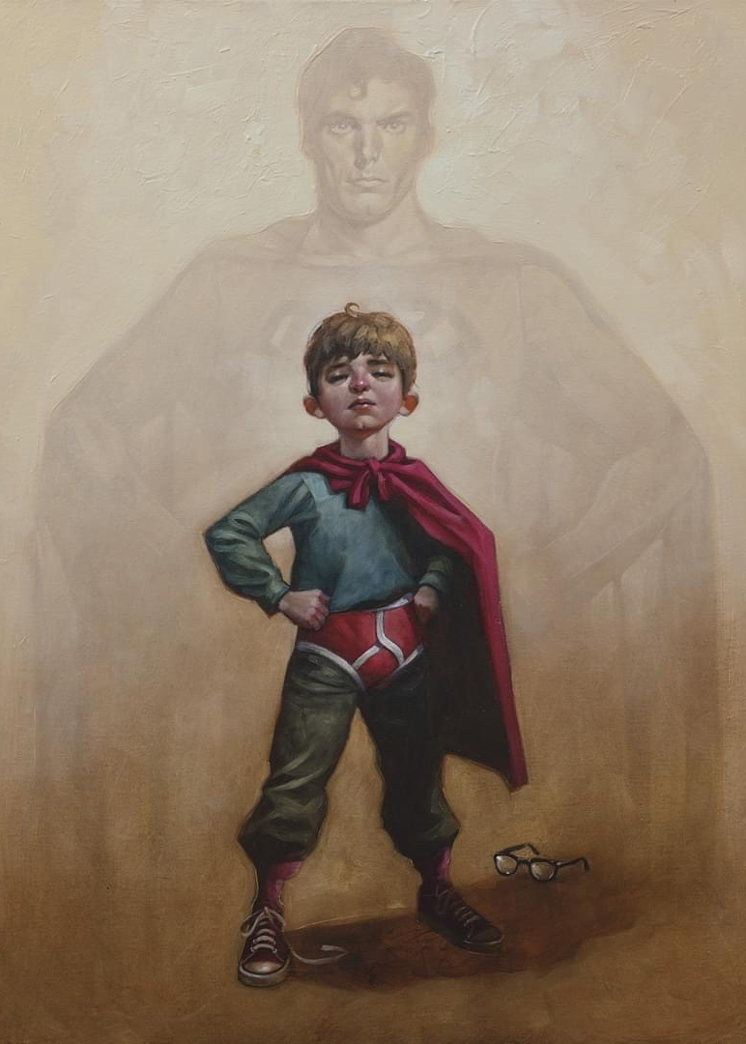
The Curriculum: Our vision
We are committed to providing young people with the highest quality of education for them to achieve their personal excellence.
KNOWLEDGE
TACKLING SOCIAL INEQUALITY
BEST POSSIBLE CHANCE OF SUCCESS
well qualified, resilient, independent and confident young adults
highly positive contribution to their community and wider society

Slide 8
The Curriculum: Our intent
purposeful and rich curriculum
deep subject knowledge
broad range of subjects
acquire and retain the core knowledge
literacy, numeracy, spiritual, moral, social and cultural development

Slide 9
The Curriculum: Organisation
Students are split into two ‘blocks’ and each has six groups.
The blocks are equal in terms of prior attainment, as set out by their performance in their Maths and English exams at Key Stage 2.

Slide 10
The Curriculum: Organisation
Most subjects: 5 mixed attainment plus one support.
English: 1 ‘top set’
Drama, Music, Art, DT: 6 equal mixed attainment
PE: 6 mixed attainment, single gender
All students have access to the full and broad curriculum, and literacy development is prioritised through standalone reading and grammar lessons throughout Years 7-9.
Students follow a two-week timetable.

Slide 11
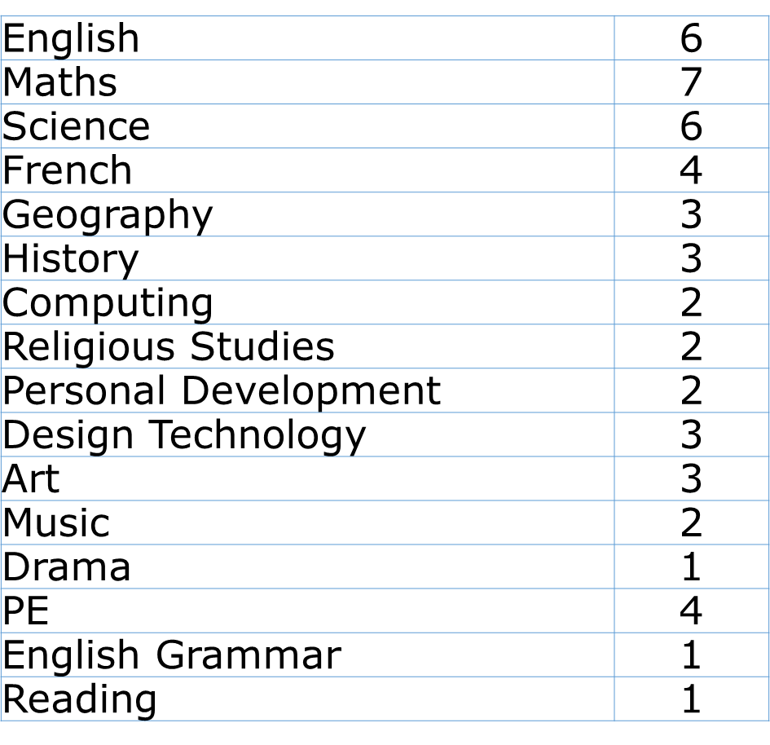
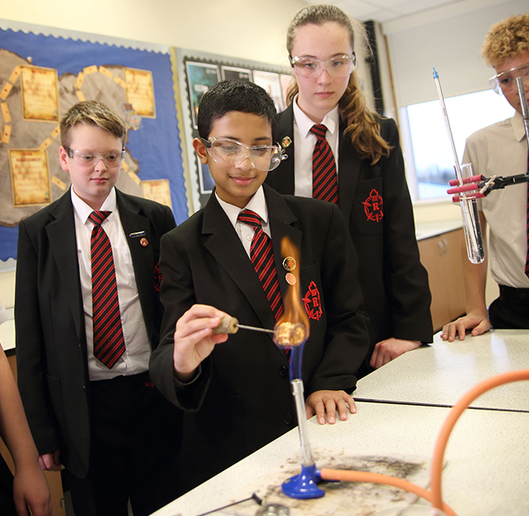
The Curriculum: Subject Learning Hours

Slide 12
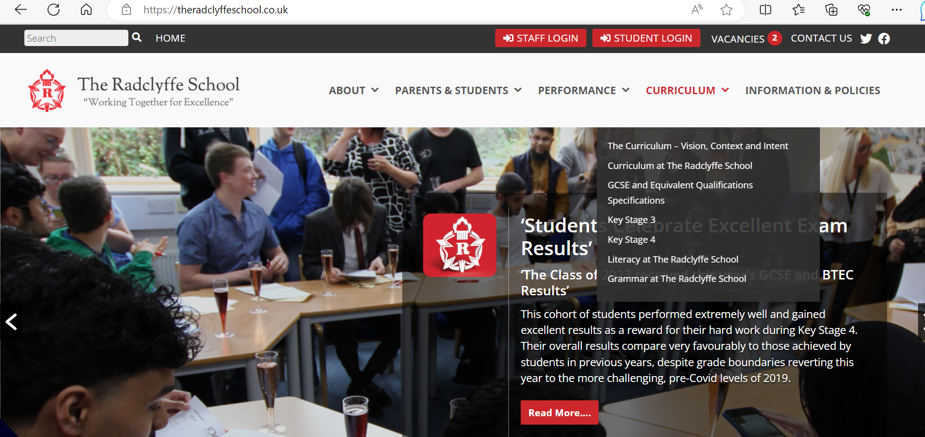
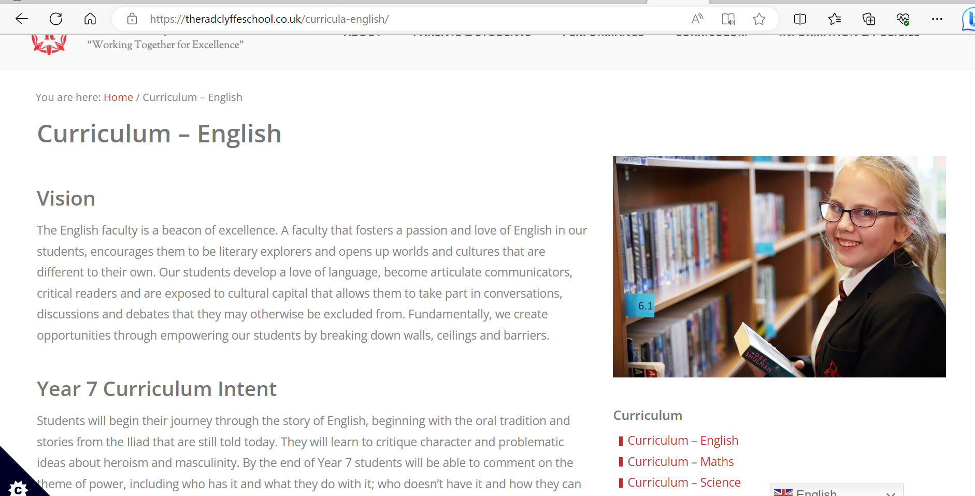
https://theradclyffeschool.co.uk/

Slide 13
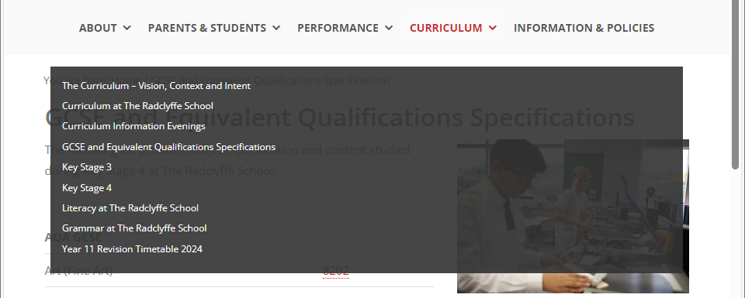
https://theradclyffeschool.co.uk/

Slide 14

TEACHING &
LEARNING

Slide 15
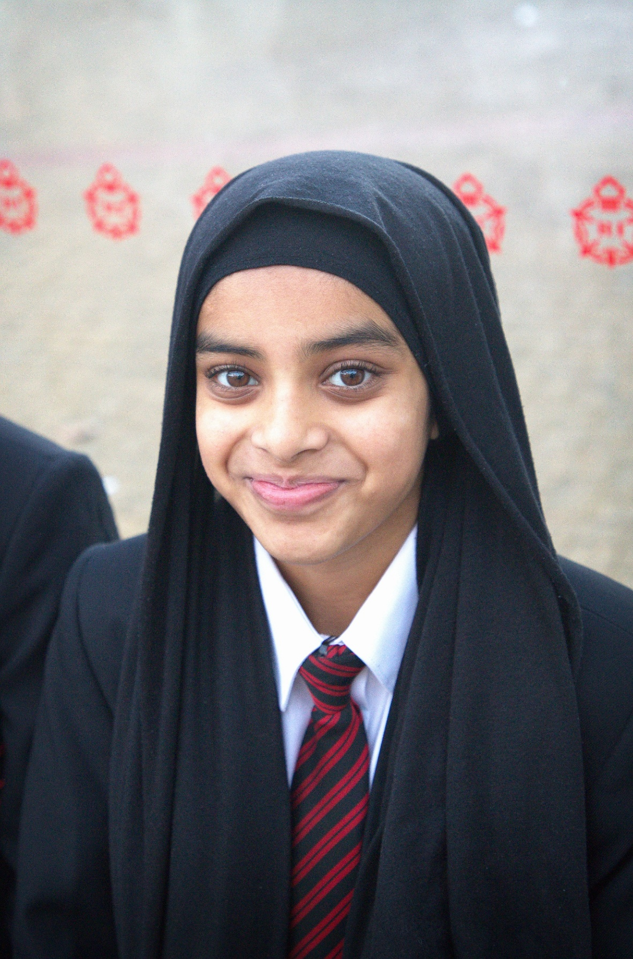
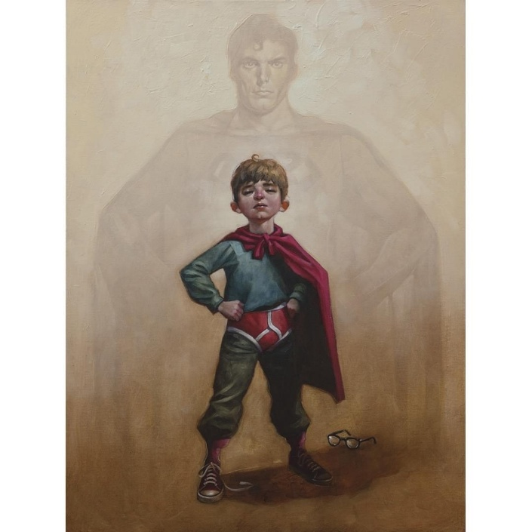

High Quality Teaching and Learning
The best available evidence indicates that great teaching is the most important lever schools have to improve pupil attainment. Ensuring every teacher is supported in delivering high-quality teaching is essential to achieving the best outcomes for all pupils.
Mrs Black Halls – Deputy Headteacher - Curriculum
Notes:
EEF state that mastery learning approaches, individualized instruction and collaborative learning approaches have a huge impact in terms of boosting students outcomes.

Slide 16
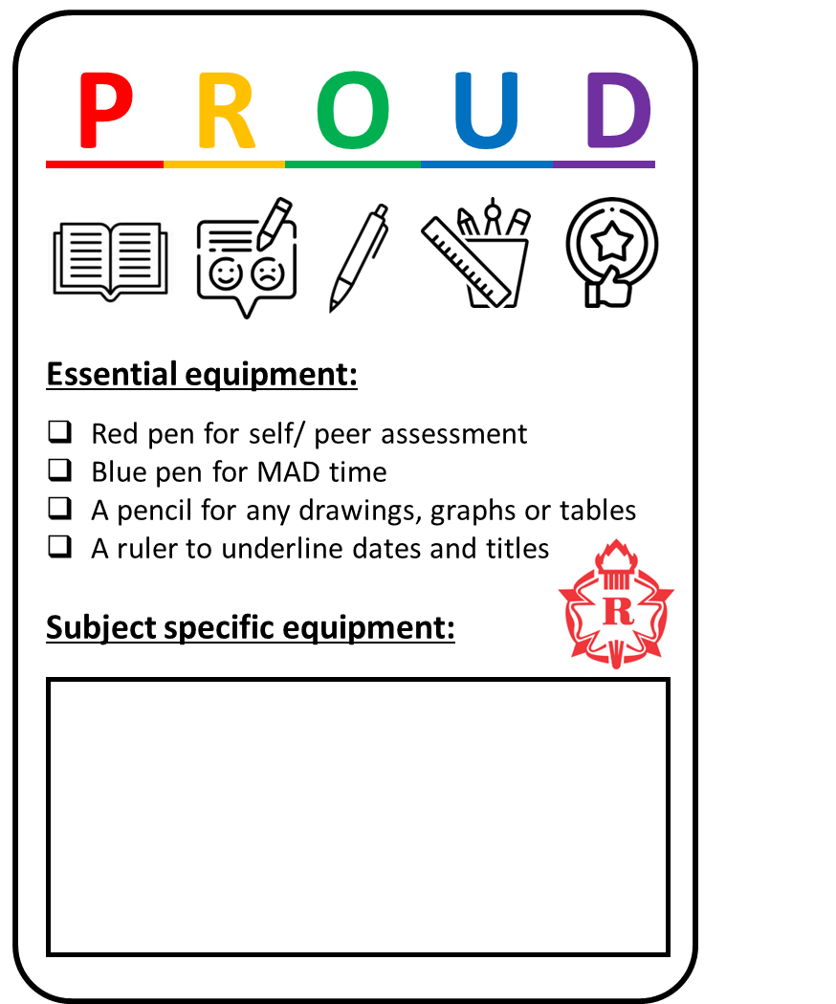



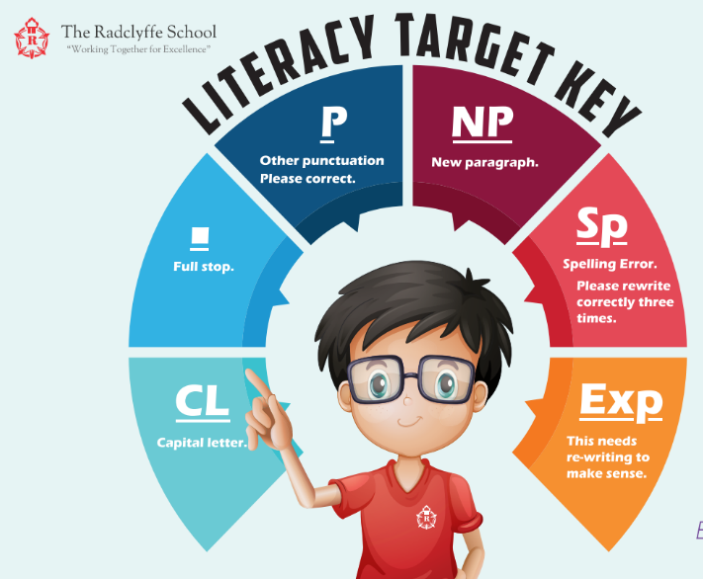

Learning at The Radclyffe School
Self and Peer Assessment
Formative Assessment and checking for understanding must be an integral part of every lesson.
Self or peer assess work as instructed by your teacher. This should be completed in red pen.
Your Learning
Respect your own learning and complete your work to the best of your ability. Always be PROUD of your work.
Teacher Feedback
You will receive feedback from your teacher every lesson through live modelling, live marking, whole class feedback or individual feedback.
MAD (Make-A-Difference Time)
Use teacher feedback to make improvements to your work using a blue pen.
This is important for you to make progress.
Literacy
Your teachers will share important vocabulary with you each lesson, model reading and support you with developing writing.
Learning at Home
Complete all home learning that is set by your teacher on Satchel One.

Slide 17
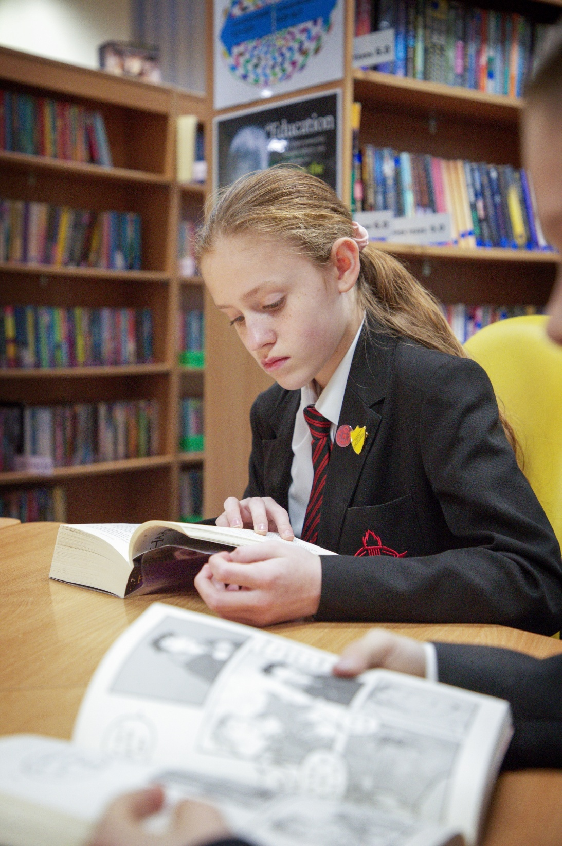
Lesson Structure- what to expect
1.Lessons are carefully planned to deliver the curriculum, with adaptations to offer both challenge and support to all students.
2.We follow the Accelerated learning cycle: all lessons will include a connect, activate, demonstrate and consolidate phase.
3. Students will be sat in an up to date seating plan that supports a cohesive school community.
4. Staff are at the door to greet students in a positive manner and direct them to start the lesson.
5. The Protected Learning (PL) system is used effectively and consistently.
6. Students are equipped for the lesson.
Mrs Black – Deputy Headteacher - Curriculum

Slide 18
Classroom Climates
What are the classroom climates?
Classroom climates help us to understand how students and teachers should behave in the classroom. The three climates we are introducing are not brand new and should not be surprising – we are simply making expectations clear for everyone in the school.
The climates will provide opportunities for teacher talk, class discussion, paired work, group tasks, and silent work. All of these are important to our learning and will support everyone in achieving their best.

Slide 19





Climate 1
One voice
Focus on the speaker
Track the speaker
Listen carefully
Be calm and respectful
Sub title
Bullet point
Bullet point
Bullet point
Bullet point

Slide 20

Climate 2
Learning through talk
Work in pairs or groups
Share ideas
Take turns
Ask questions
Active – not silent
Sub title
Bullet point
Bullet point
Bullet point
Bullet point

Slide 21

Climate 3
Learning independently
Space to think
Challenging work
Working hard
Showing resilience
Making connections to the wider world
Sub title
Bullet point
Bullet point
Bullet point
Bullet point

Slide 22
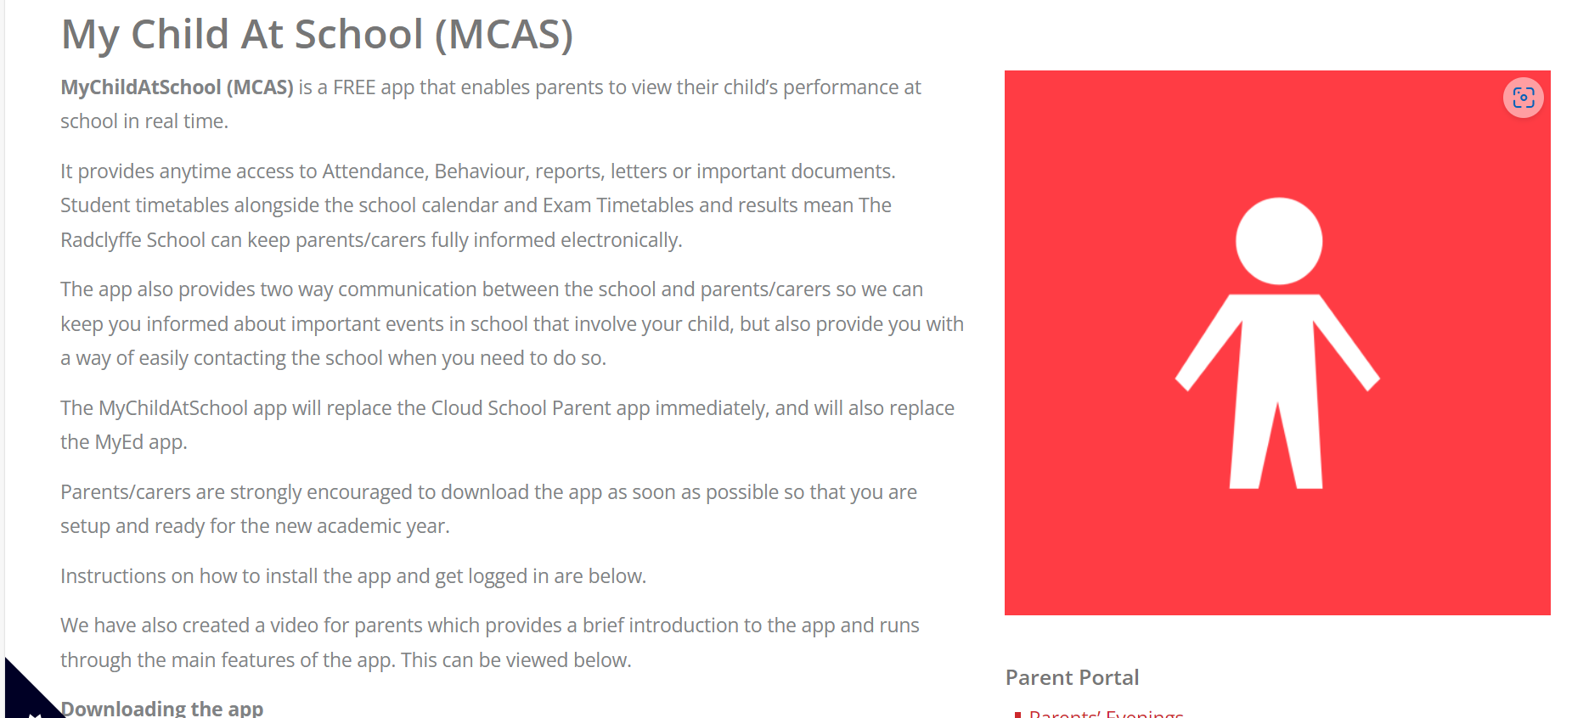
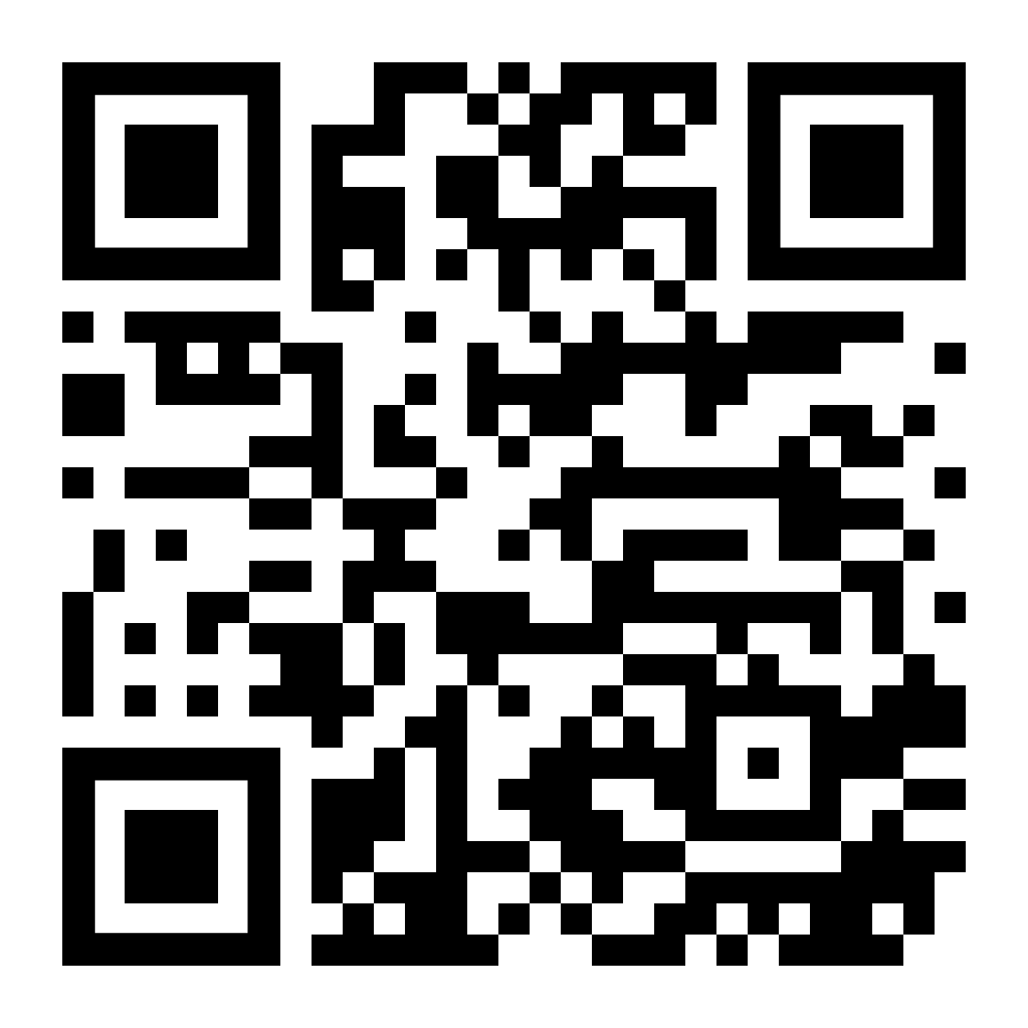
Mychildatschool (MCAS) is a FREE app that enables parents to view their child’s performance at school in real time.
It provides anytime access to attendance, behaviour, reports, letters or important documents. Student timetables alongside the school calendar and exam timetables and results mean the Radclyffe School can keep parents/carers fully informed electronically. This is where parents and carers will be able to view your child’s options choices

Slide 23
mrs robinson
Assistant Headteacher
Learning & Teaching

Slide 24
INDEPENDENCE
MAKE EVERY MINUTE COUNT

Slide 25

MAKE EVERY MINUTE COUNT
INDEPENDENT LEARNERS
Take personal responsibility
Subject strengths and weaknesses
Plan and complete Home Learning
Studying at home for all your assessments
Utilise the teachers in your subjects

Slide 26
miss arnold
MAKE EVERY MINUTE COUNT
Assistant Headteacher
Intervention &
Raising Standards

Slide 27

Mrs begum
KS3 Science
Curriculum Lead

Slide 28
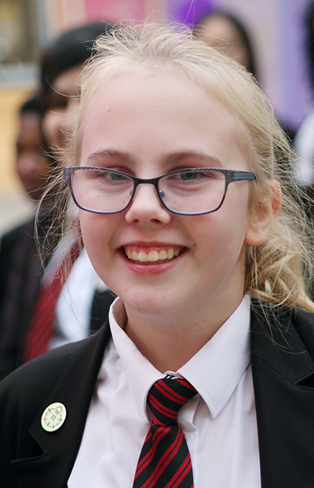
The Year 8 – The Science Curriculum
Curriculum coverage:
Sound
Light
Understanding Chemical Reactions
Digestion
Electricity
Acids and Alkali
Heating and Cooling
Rocks
Forces
Biochemistry
Mrs Begum – KS3 Science Curriculum Lead
Respect – excellence - kindness

Slide 29
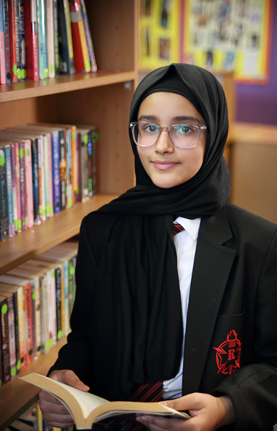
The Year 9 – The Science Curriculum
Curriculum coverage:
Periodic Table
Magnets and Electromagnets
Genes, Inheritance and Evolution
Earths Atmosphere and Resources
Energy
Health and Diseases
Solar System and Beyond
Respect – excellence - kindness

Slide 30
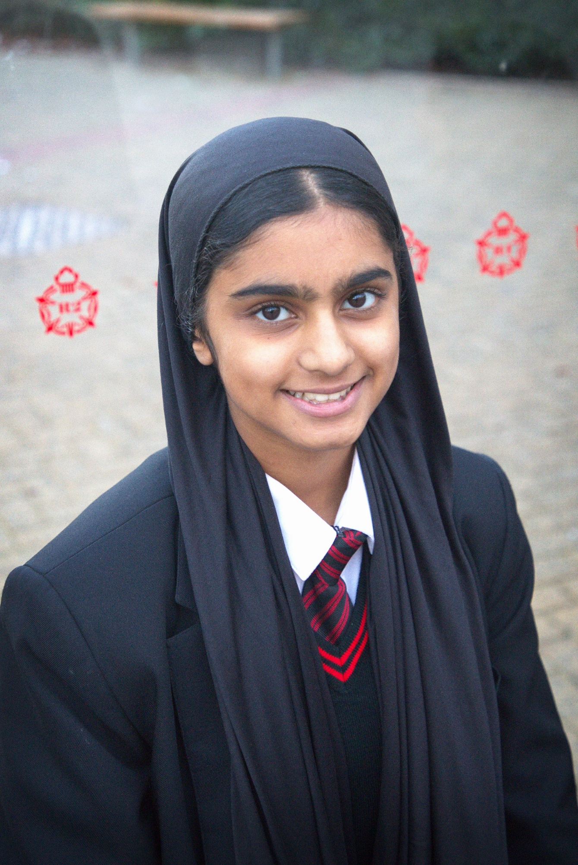
The Science Curriculum
Assessment:
All students will undertake informal assessments throughout the year. The outcomes of this work will simply be to inform the teacher of areas of strength and weaknesses that need to be addressed.
All students will take formal tests every half term. Students will also sit an exam at the end of the year.
Miss Zulfiqar – KS4 Science Curriculum Lead

Slide 31
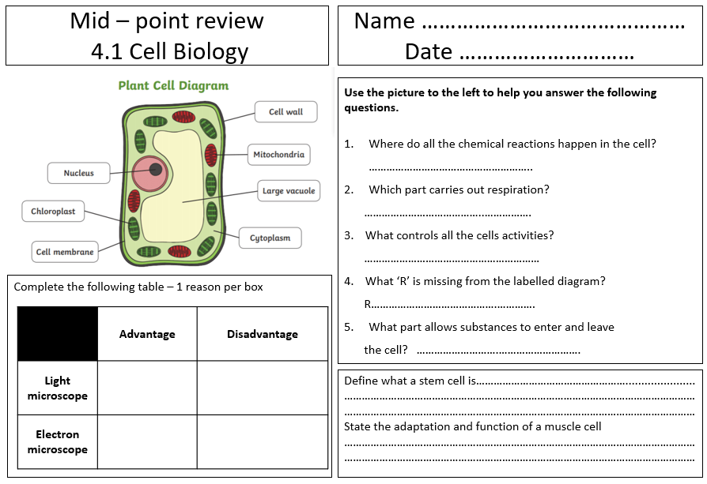
KS3 Science
Respect – excellence - kindness

Slide 32
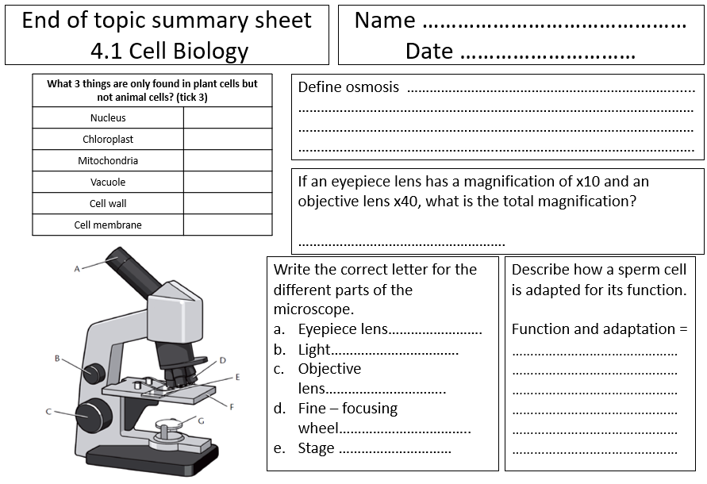
KS3 Science
Respect – excellence - kindness

Slide 33
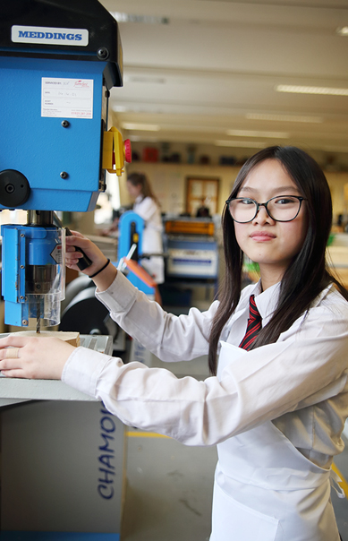
The Science Curriculum
Learning at home:
Home learning is set online.
Sparx Science which students can access on a variety of devices.
Home learning set on Mondays.
Due in the following Monday.
Approximately 30 minutes.
Miss Zulfiqar – KS4 Science Curriculum Lead
Respect – excellence - kindness
33

Slide 34
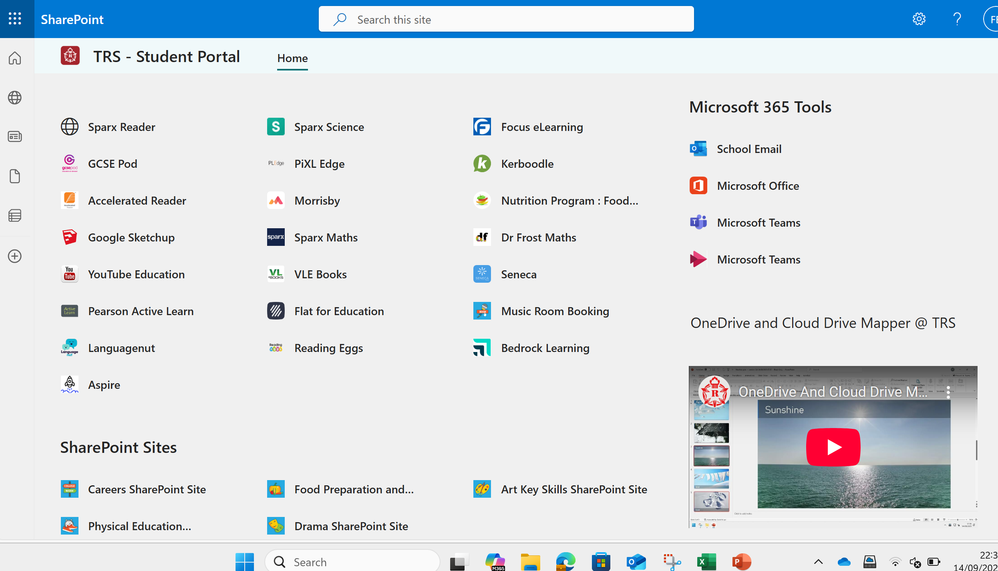
The Science Curriculum
Learning at home:
Miss Zulfiqar – KS4 Science Curriculum Lead
Respect – excellence - kindness
34

Slide 35
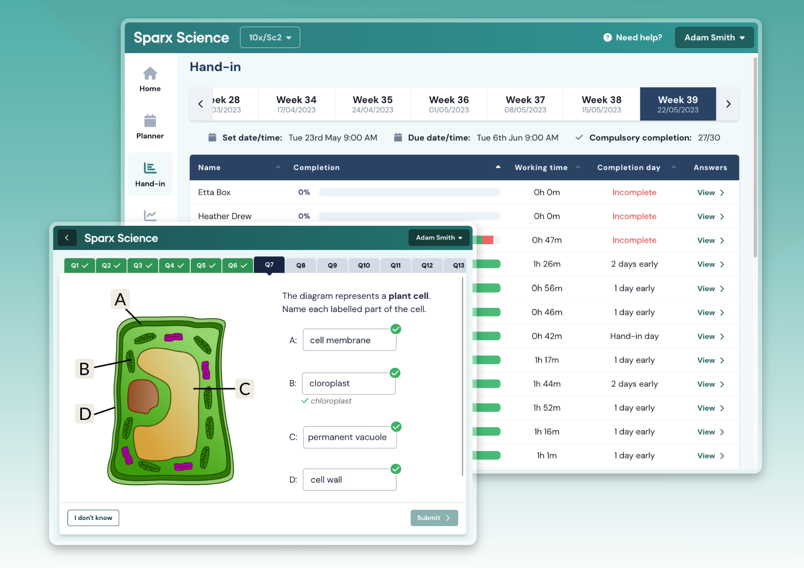
The Science Curriculum
Learning at home:
Miss Zulfiqar – KS4 Science Curriculum Lead
Respect – excellence - kindness
35

Slide 36
The Science Curriculum
Literacy in Science
Literacy sheet with key vocabulary and definitions.
Science reading comprehension.
Respect – excellence - kindness

Slide 37
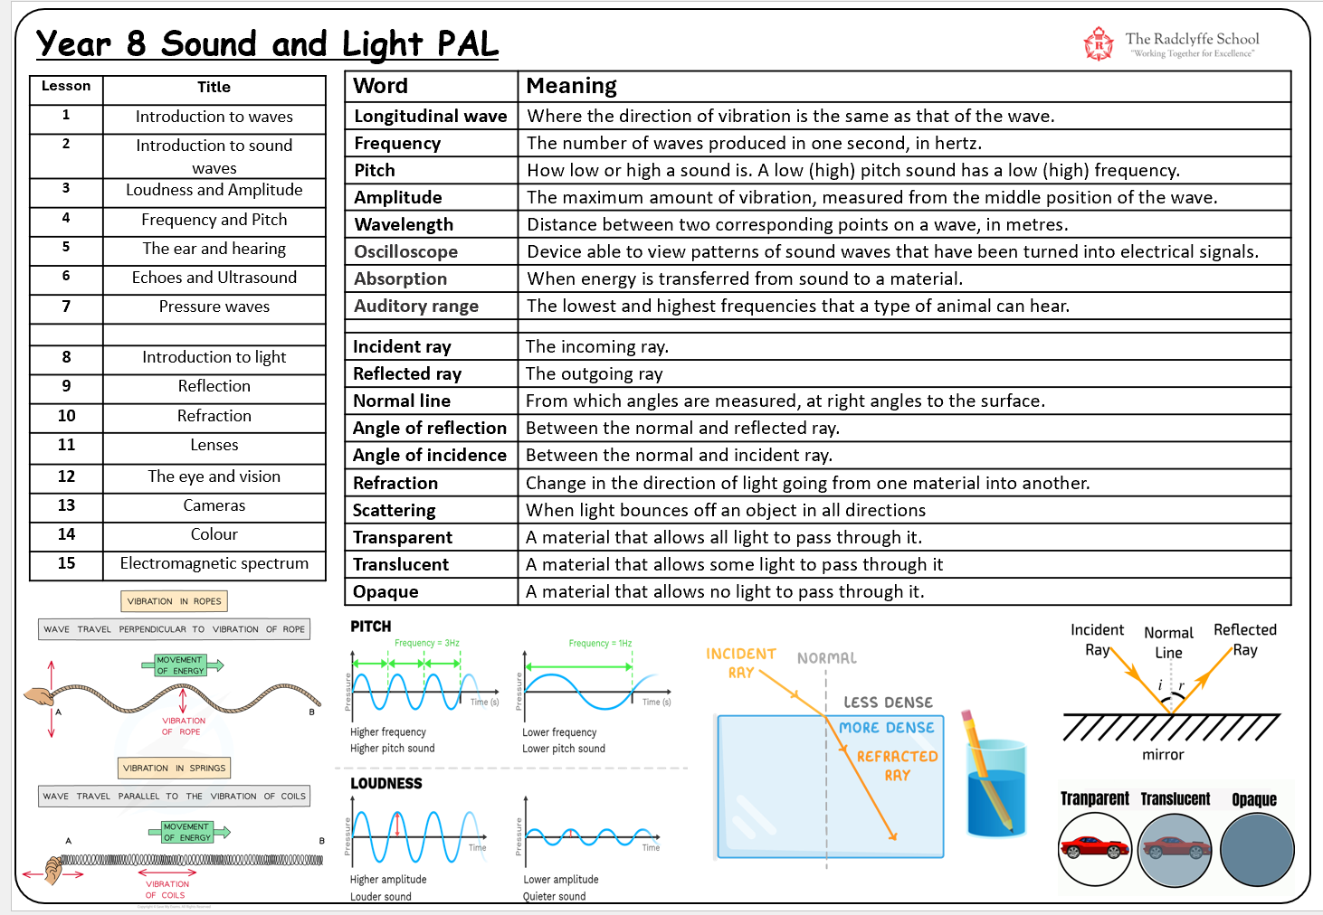
KS3 Science - Literacy
Respect – excellence - kindness

Slide 38
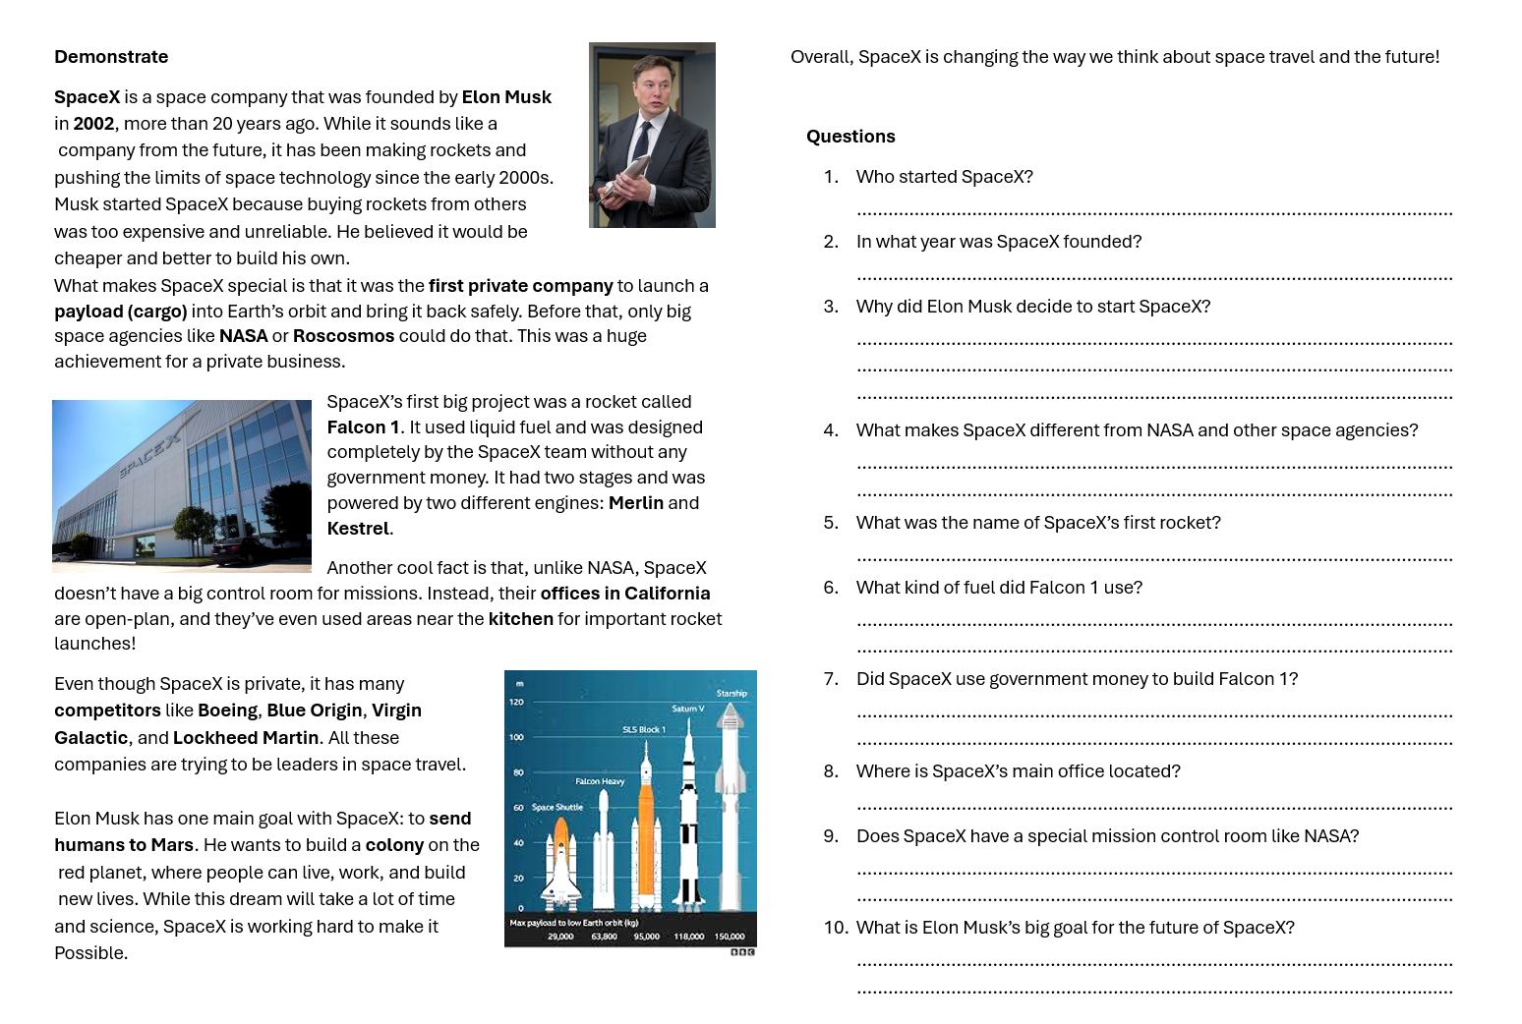
KS3 Science - Literacy
Respect – excellence - kindness

Slide 39
The Science Curriculum
How you can help
Home learning.
Revision – cue cards, posters
Online resources
Exercise book
Reminder sent home
Science in the news
Films and documentaries
Respect – excellence - kindness

Slide 40
Science Club
Every Wednesday lunchtime
Respect – excellence - kindness

Slide 41

Miss Khaliq
Head of English

Slide 42
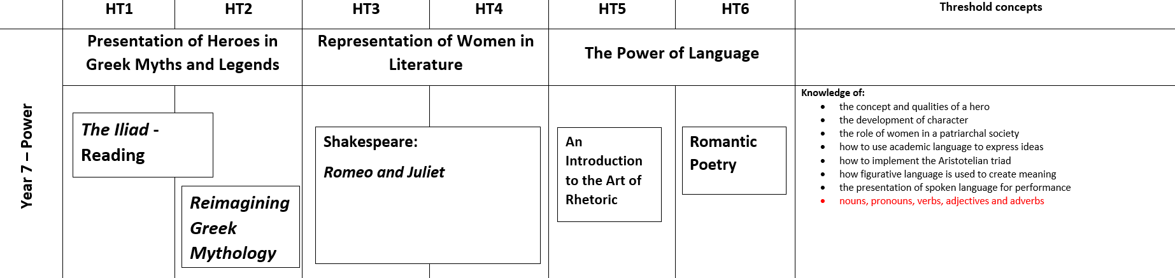
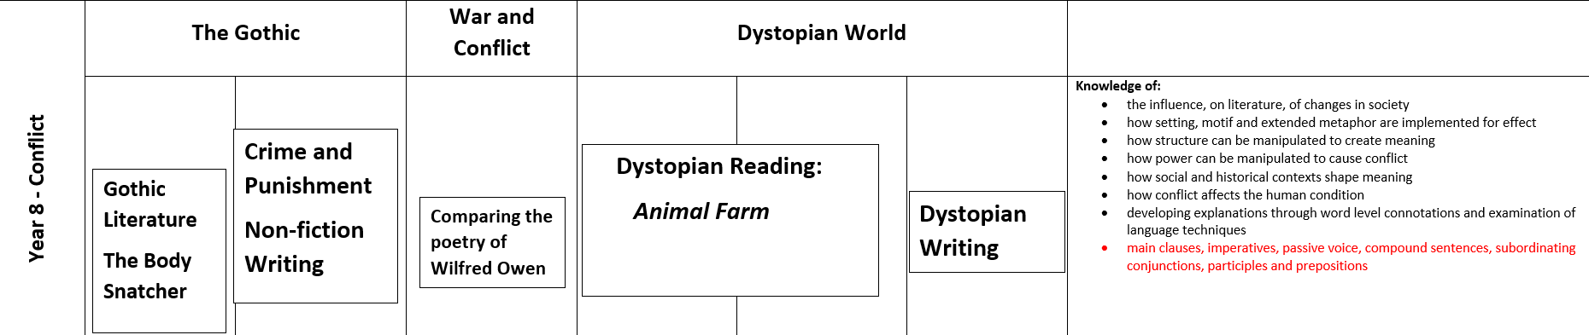
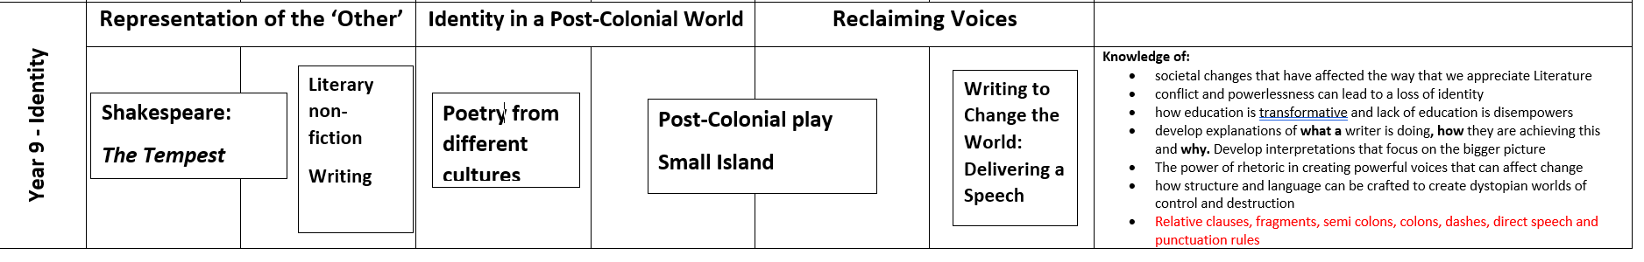
The Curriculum Journey
Vision: The English faculty is a beacon of excellence. A faculty that fosters a passion and love of English in our students, encourages them to be literary explorers and opens up worlds and cultures that are different to their own. Our students develop a love of language, become articulate communicators, critical readers and are exposed to cultural capital that allows them to take part in conversations, discussions and debates that they may otherwise be excluded from. Fundamentally, we create opportunities through empowering our students by breaking down walls, ceilings and barriers.
Ms Khaliq: Head of English

Slide 43
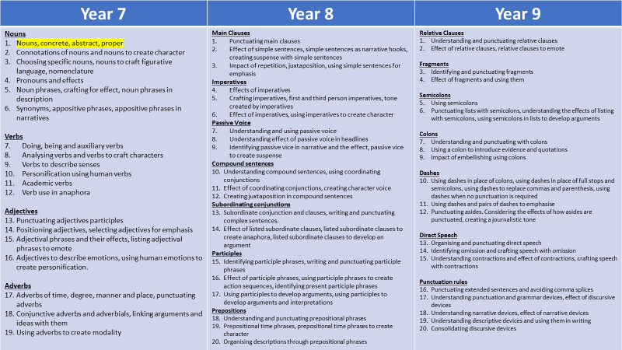
Key Stage 3 – The English Curriculum
Ms Khaliq – Head of English

Slide 44
KS3 – The English Curriculum
Assessment:
Summative Assessments
Formative Assessment
In English, we formatively assess in every lesson; this allows us to address any misconceptions and gaps in knowledge, as well as informing future teaching. This assessment is embedded into lessons in a range of ways including: MCQs, low stake quizzes, Memory Platforms and questioning.
Students will have three summative assessments a year. These will assess students’ Reading and Writing ability. Students will also be given the opportunity to demonstrate their spoken language ability through Speaking and Listening assessments.
Ms Khaliq – Head of English

Slide 45
The English Curriculum
Learning at home:
20 minutes of reading every day
Home learning has been designed to consolidate, extend and enrich the learning that students have developed in class. Both teachers and students identify any gaps and misconceptions in the learning which can then be addressed in class.
Ms Khaliq – Head of English

Slide 46
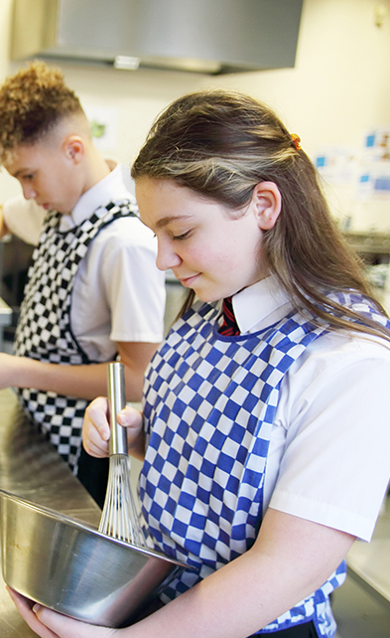
The English Curriculum
How parents can support:
Support and encourage children to be reading at least 20 minutes a day
Make sure that they bring their reading book to school every day
Check that children are learning and testing themselves on their spellings
Contact class teacher if you have any concerns
Ms Khaliq – Head of English

Slide 47

Miss Holt
Curriculum Leader
Mathematics

Slide 48

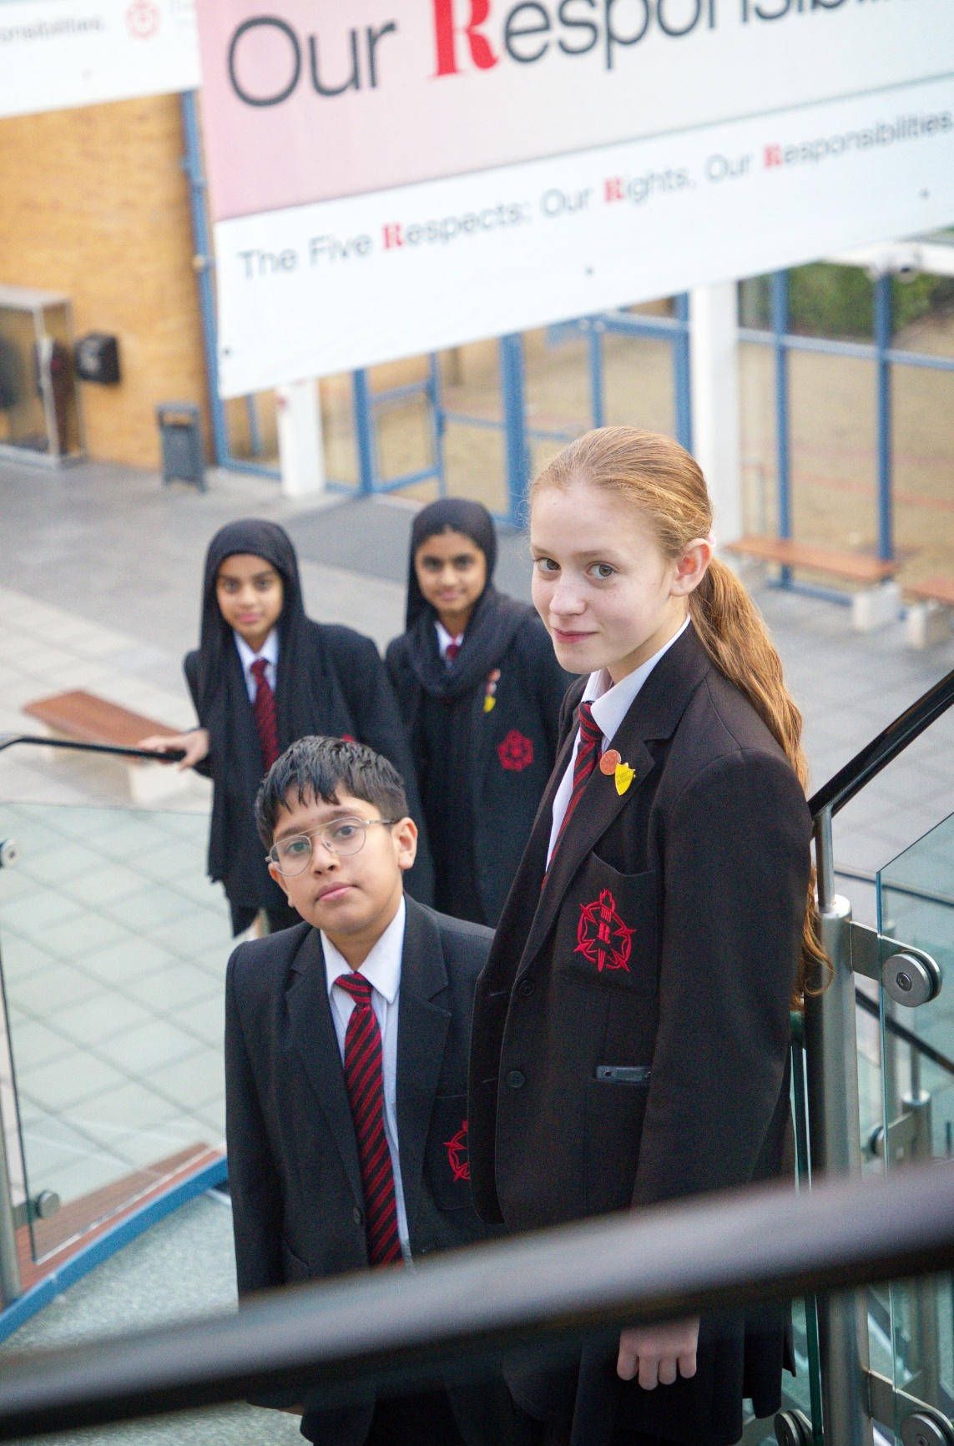

Slide 49

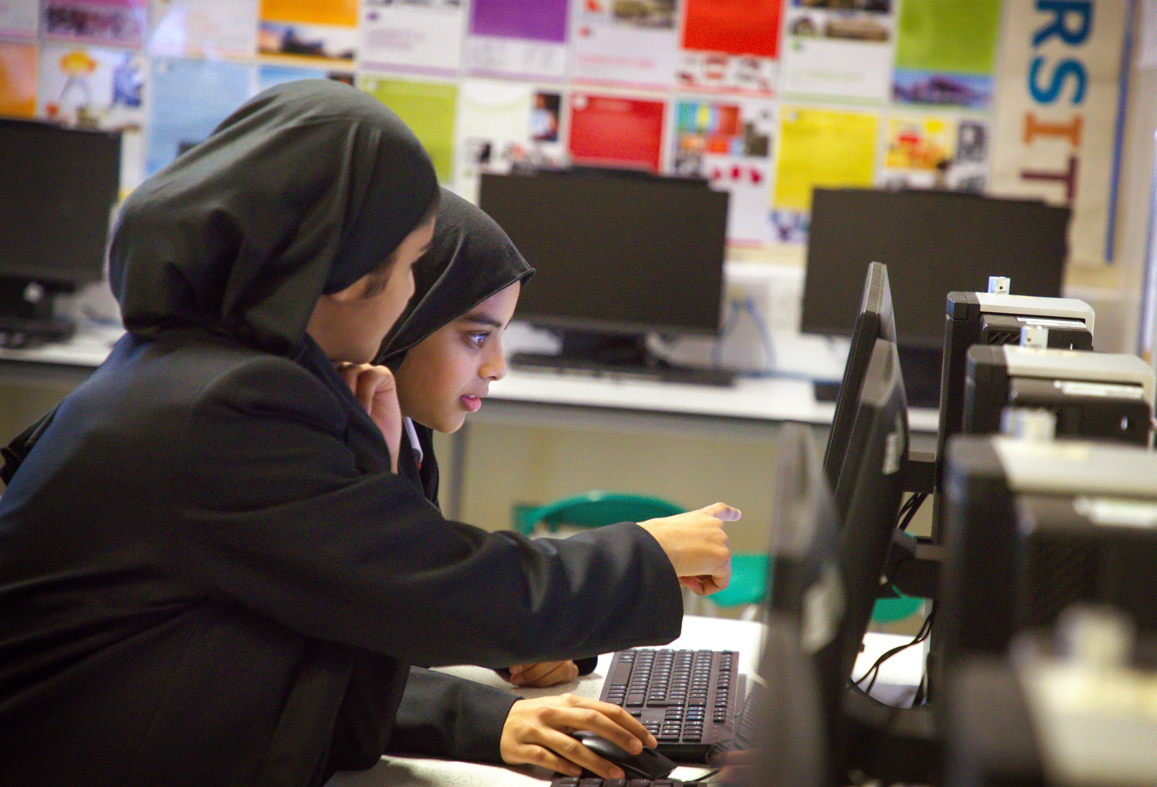

Slide 50
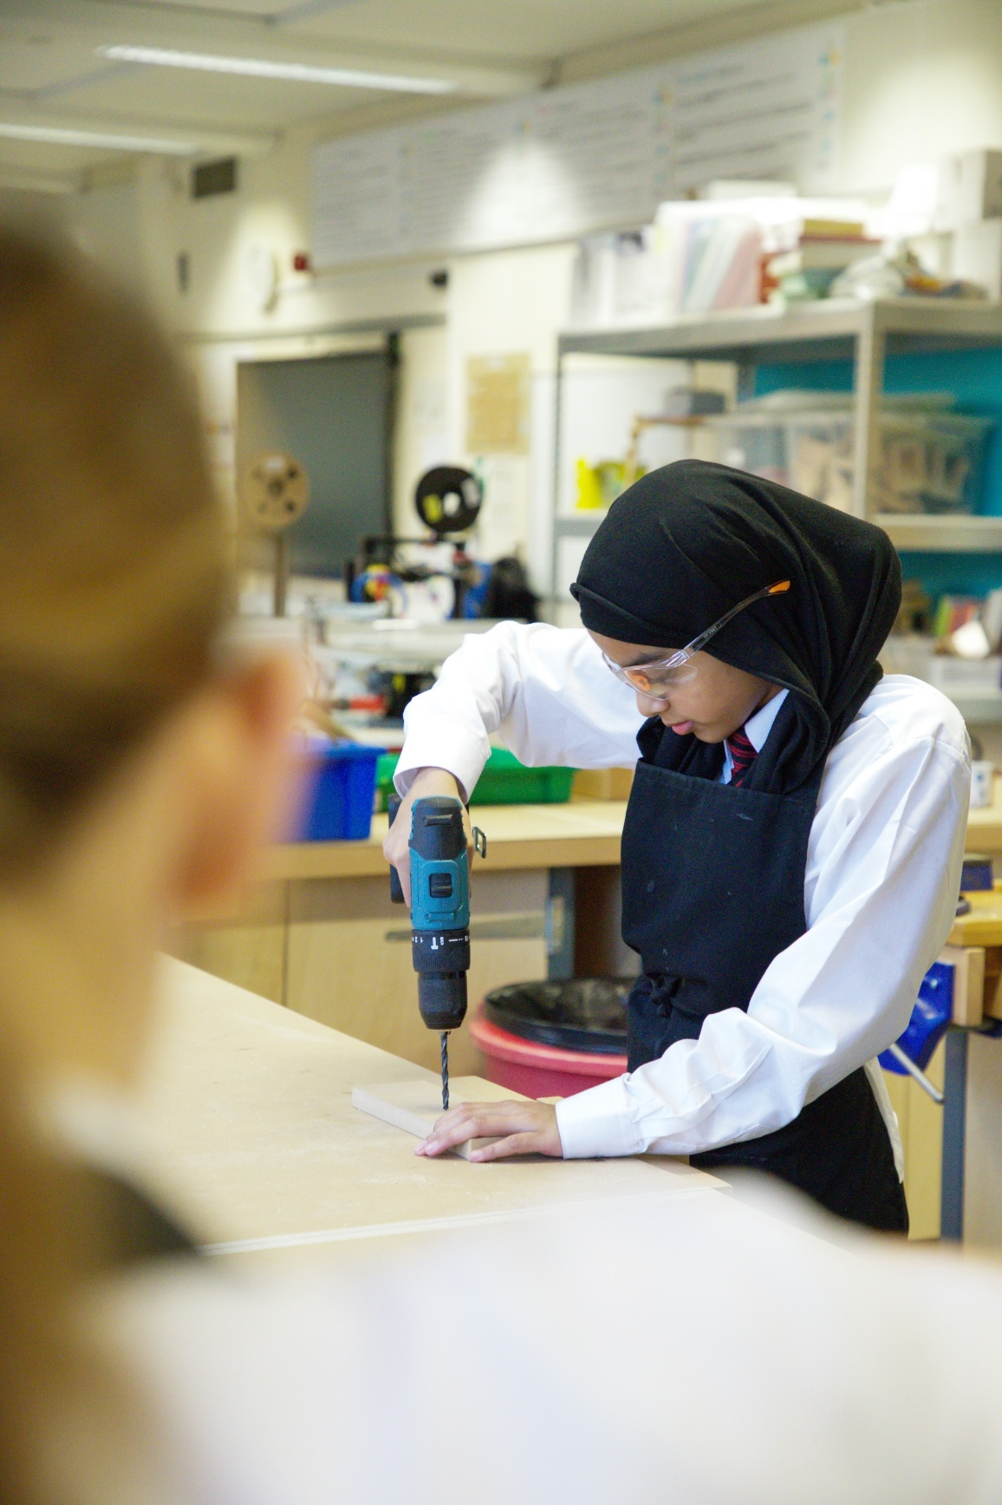
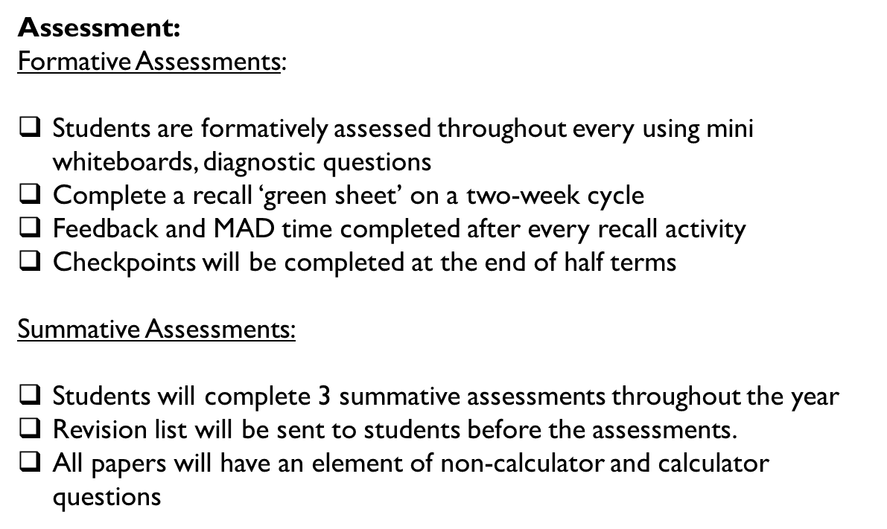
Assessments: The Maths Curriculum

Slide 51

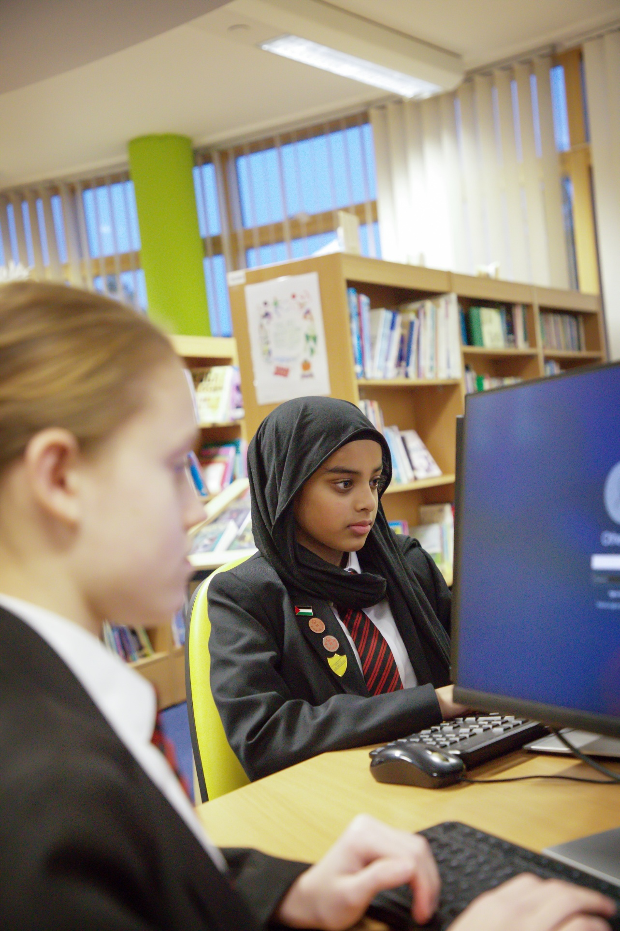
Home Learning
Learning at home:
Over 10,000 support videos
One hour of home learning each week
100% correct!
Personalised
Home learning
  Set on Wednesday
  Due in following Wednesday
  Lunch time club if students need help
Please ensure school has your current email address
Students can reset their
own passwords!

Slide 52
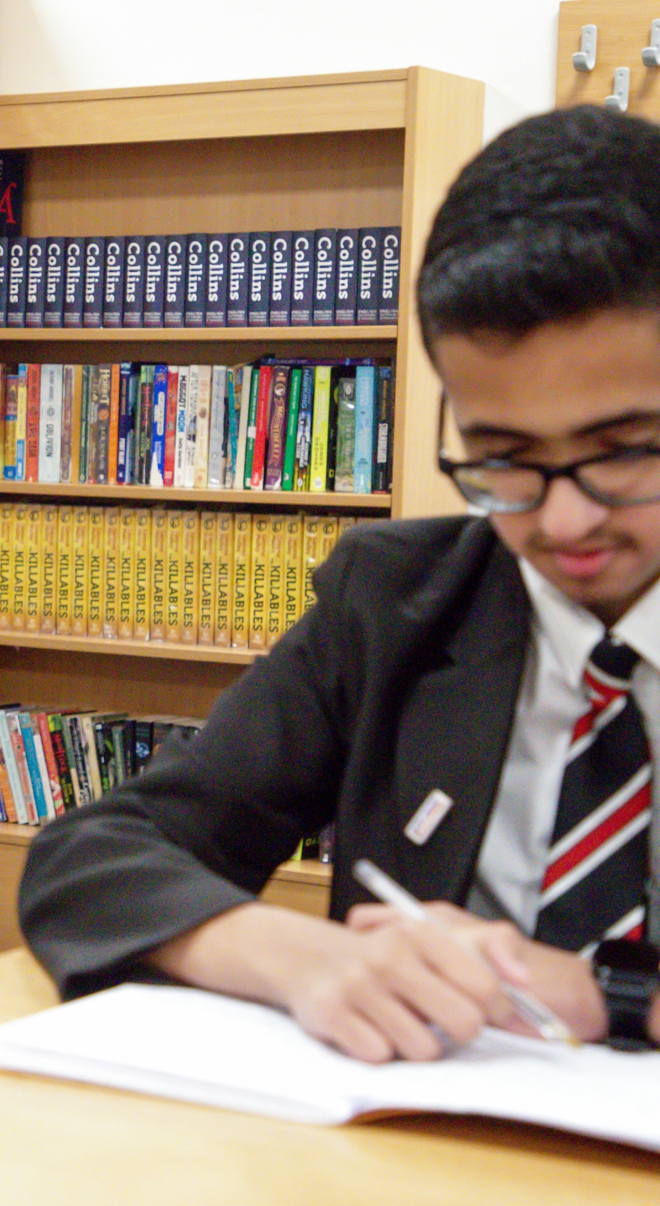
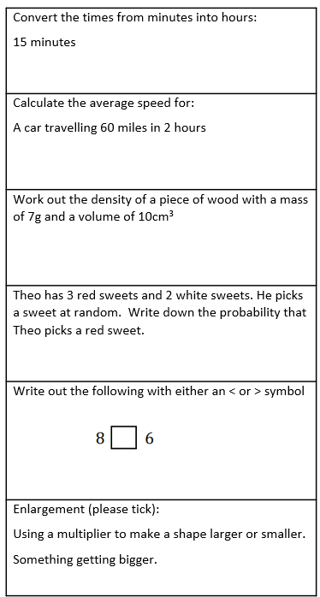
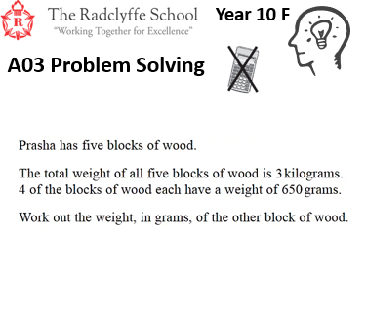
Key Stage 4– The Maths Curriculum
Focus on key words and vocabulary within lessons to ensure students understand and can apply them confidently.
Embed weekly retrieval activities to strengthen retention of mathematical language and concepts.
Regularly practise worded problem-solving questions so students develop resilience and strategies for decoding exam-style tasks.
Encourage students to explain their reasoning verbally and in written form, helping them to practise using precise mathematical language.
Literacy:

Slide 53
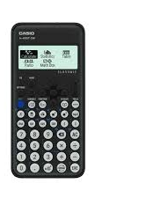
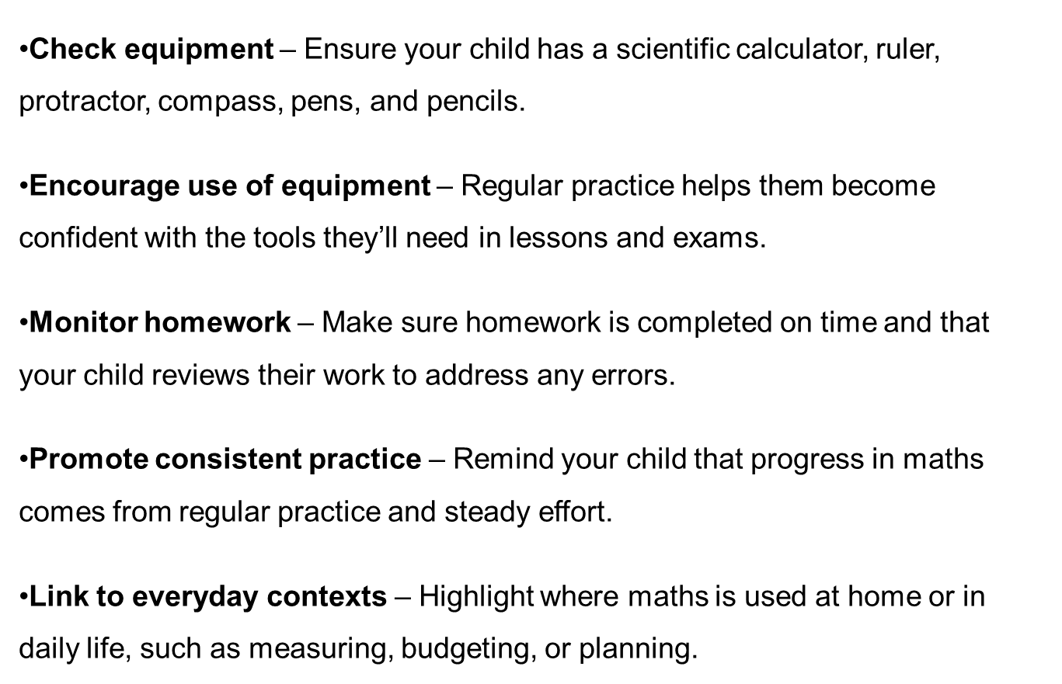
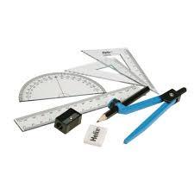
KS4 – The Maths Curriculum
How parents can support:
Ms Adenwala – Head of Mathematics

Slide 54

mrs hamilton
Strategic Lead for
Literacy & RS

Slide 55



Reading fluency is like a golden ticket for your child.

Slide 56

Why should you encourage your child to read?
25% of 15-year-olds have a reading age of 12 or under
1 in 8 disadvantaged children in the UK do not own a single book at home
Children who are weak readers will struggle as much in maths and science at GCSE as they do in English and the arts subjects
Students are less able to learn in school if they do not develop sufficient reading skills
In the words of the DfE, ‘more demanding’ GCSE exams were introduced in 2017
Exams now tend to include wordier questions – problematic for students with a low reading age

Slide 57
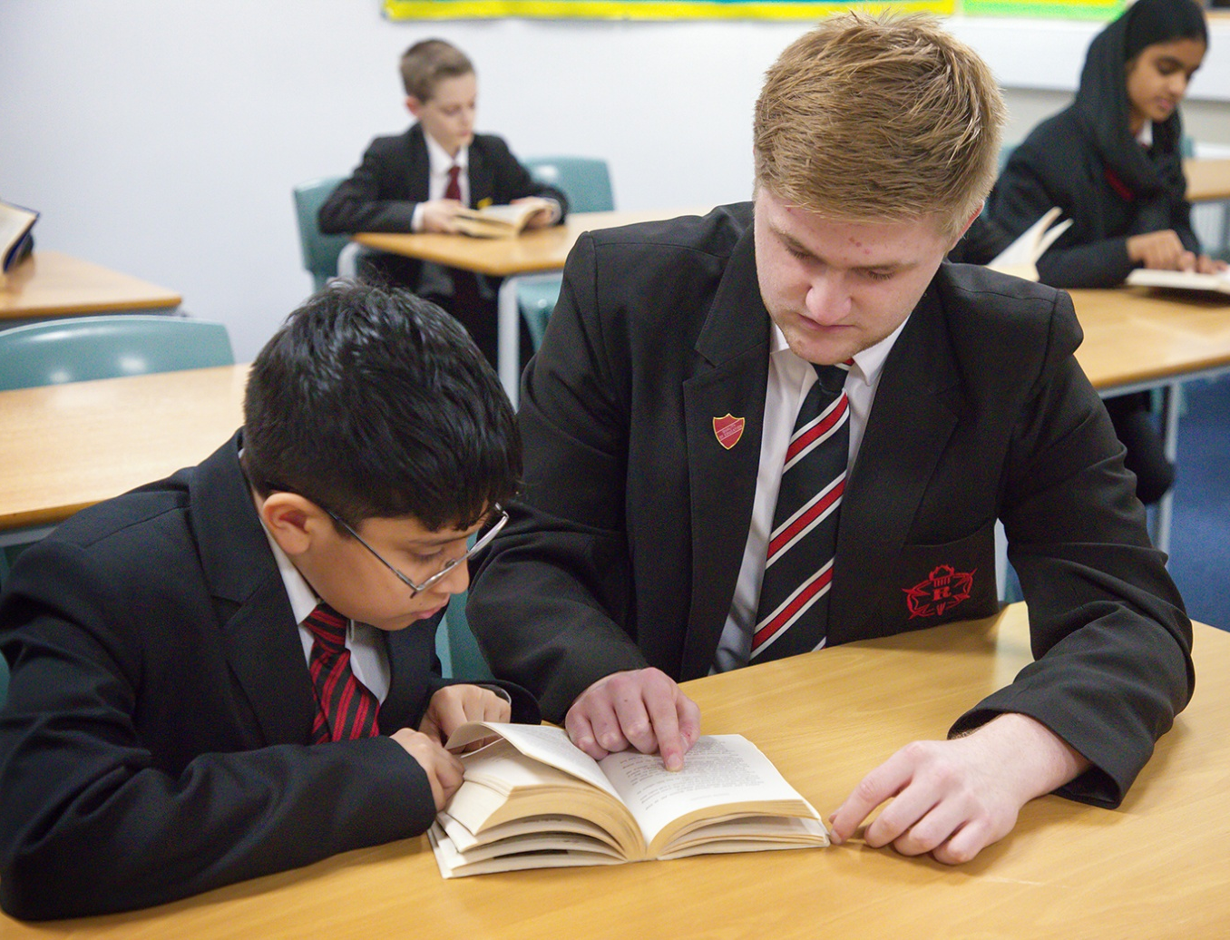
The benefits of reading
Children who read books more than once a week by age 16 gain higher results than those who read less regularly
19% of readers say that reading stops them from feeling lonely.
Regular readers for pleasure reported fewer feelings of stress and depression than non-readers
Studies have shown that those who read for pleasure have higher levels of self-esteem and a greater ability to cope with difficult situations
Reading for pleasure has been found to improve sleeping patterns
Adults who read for just 30 minutes a week are 20% more likely to report greater life satisfaction
People who read for 3.5hours a week (30mins a day) have a 17% higher life expectancy than those who don’t
30mins is 2% of your day

Slide 58


Reading Interventions
We have invested in two new reading programmes:
Sparx Reader
All students will have access
Can be accessed on most devices
Encourages students to read and regularly review their understanding as they go
LexiaPowerUp
A selection of students will be invited to attend (based on need)
Identifies gaps in knowledge and tailors learning to student needs
Adaptive and reflective to ensure rapid progress
Delivered weekly during PLG time (to avoid lost learning in other areas)
What we are doing:
PLG reading
EXACT testing
Literacy explicitly taught in lessons
Access to library at break and lunch
Lexia intervention
Sparx Reader
What you can do:
Encourage them to read 'widely and often'
Read with them/ to them
Support the interventions

Slide 59

Advice:
Check regularly that they have a book and are reading it
Start small (5mins to start and build up)
Encourage them to attend their intervention sessions
Be a role model – stand in the gap
Contact school if you have any questions
Invitation:
Please come up to the library on level 3 straight after this session for light refreshments and to collect a ‘golden ticket’ for your child.

Slide 60

Thank you!
If you have any questions about your child’s education, please contact:
 | Year 8 | Year 9
Year Manager | Miss Clegg | Mrs Ford
Assistant Year Manager | Pastoral Team Support | Miss Prince

Slide 61

Please scan the QR code and complete the feedback!

