Slide 1



KS4 Curriculum Information Evening

Slide 2
Year 10 – Key Dates
Tuesday 16th September: School Photographs
Thursday 22nd January 4.30-7.30: Year 10 Parents’ Evening (in person)
5th-6th February: Year 10 Mock Interviews
20th April-1st May: PPEs
29th June – 3rd July: Work Experience Week
Year 10 Progress Reports:
November
March
June
Year 11 Progress Reports:
October
January
March
Year 11 – Key Dates
Wednesday 8th October: Y11 Careers Fair
Friday 14th November: College application deadline
17th-28th November: PPEs (1)
Thursday 18th December: PPE Results Event
Thursday 8th January 4.30-7.30: Year 11 Parents’ Evening (in person)
2nd-13th February: PPEs (2)
Thursday 12th March: Year 11 Final Push Evening (in person)
Tuesday 5th May: Final GCSE Examinations begin
Wednesday 24th June: Year 11 Prom
Welcome to the KS4 Curriculum Information Evening

Slide 3

Mr cregg
Headteacher

Slide 4
tonight’s presentations
Curriculum: Miss Catlow
Teaching & Learning: Mrs Robinson
Home Learning & Independent Study: Miss Arnold
Science: Mr Watson
English: Mr Kirk
Mathematics: Mrs Richardson
Literacy: Mrs Hamilton

Slide 5
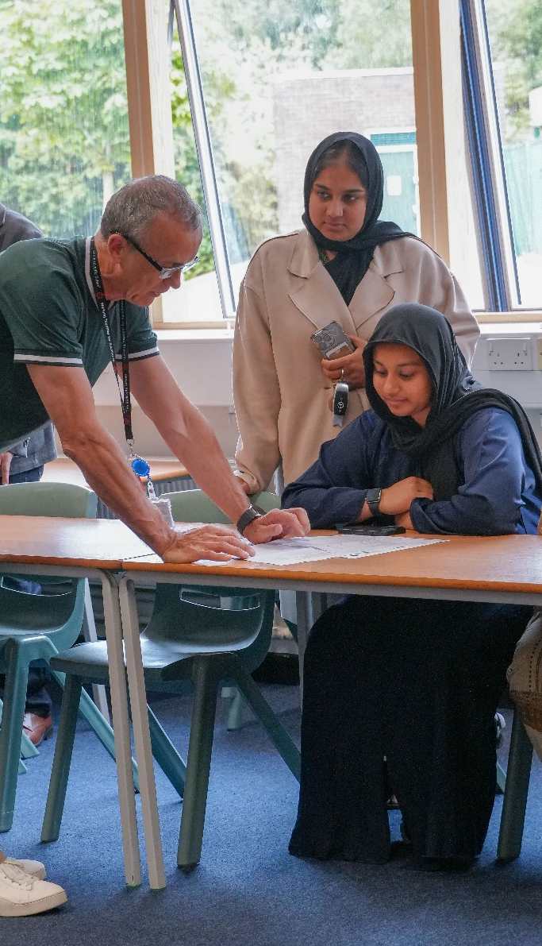
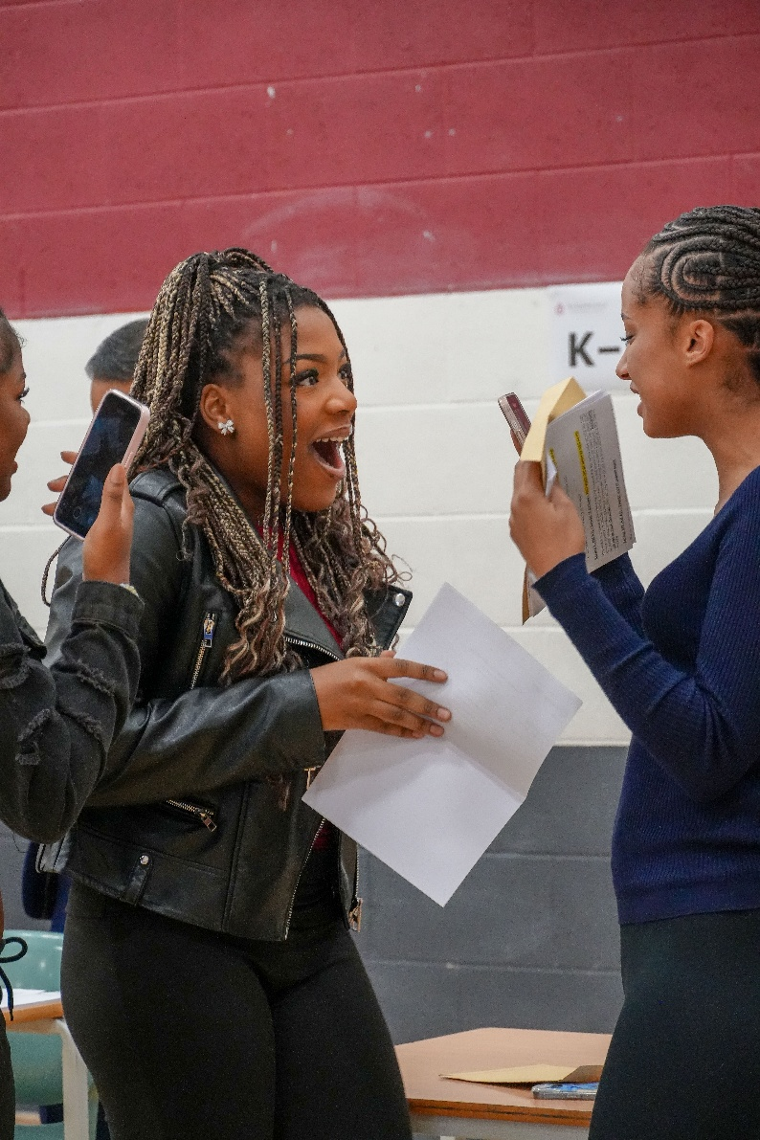
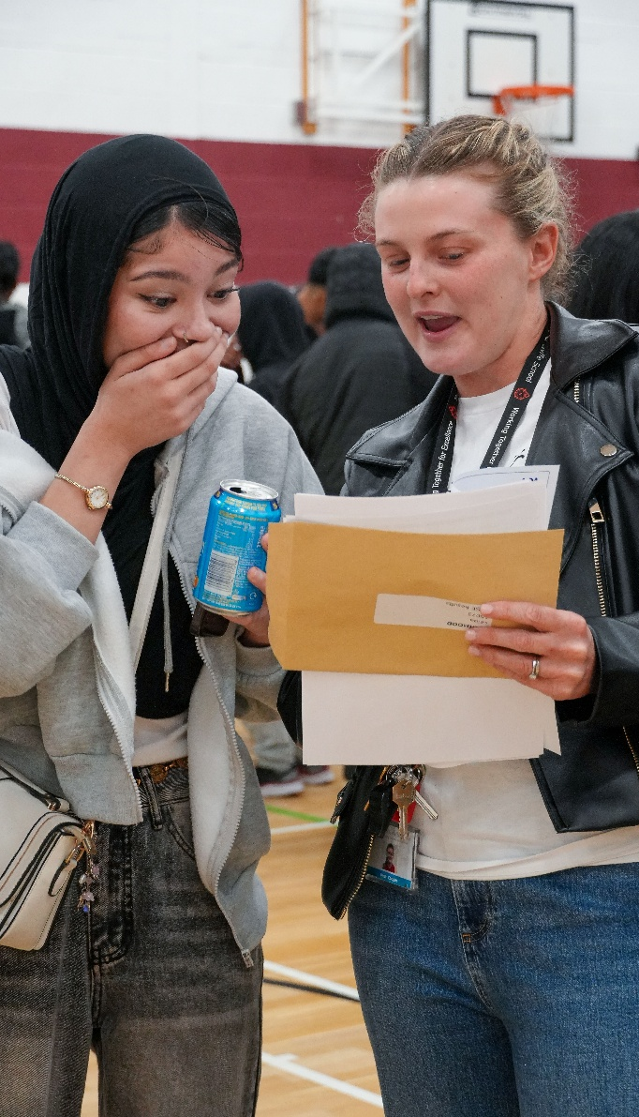
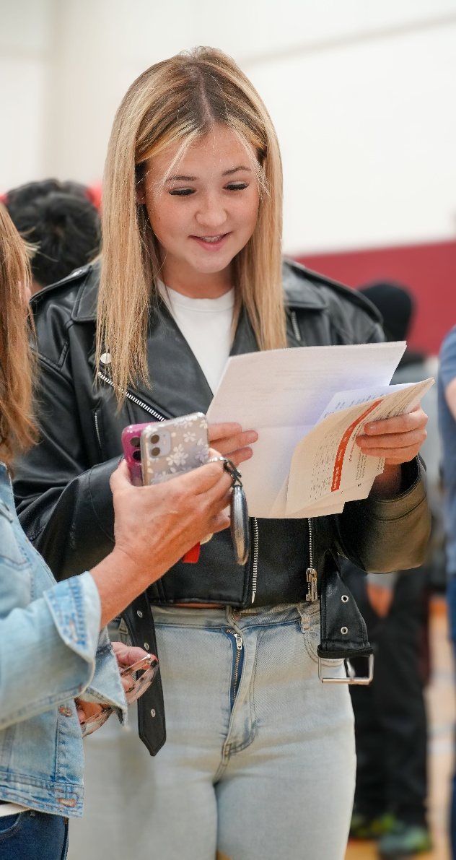
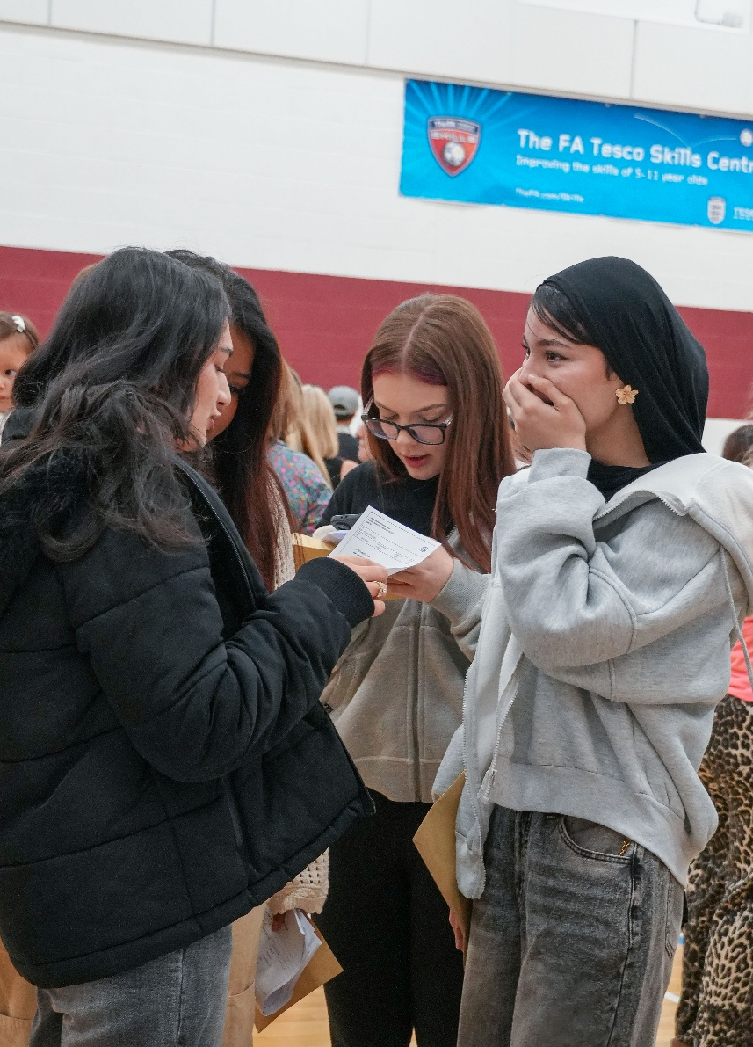
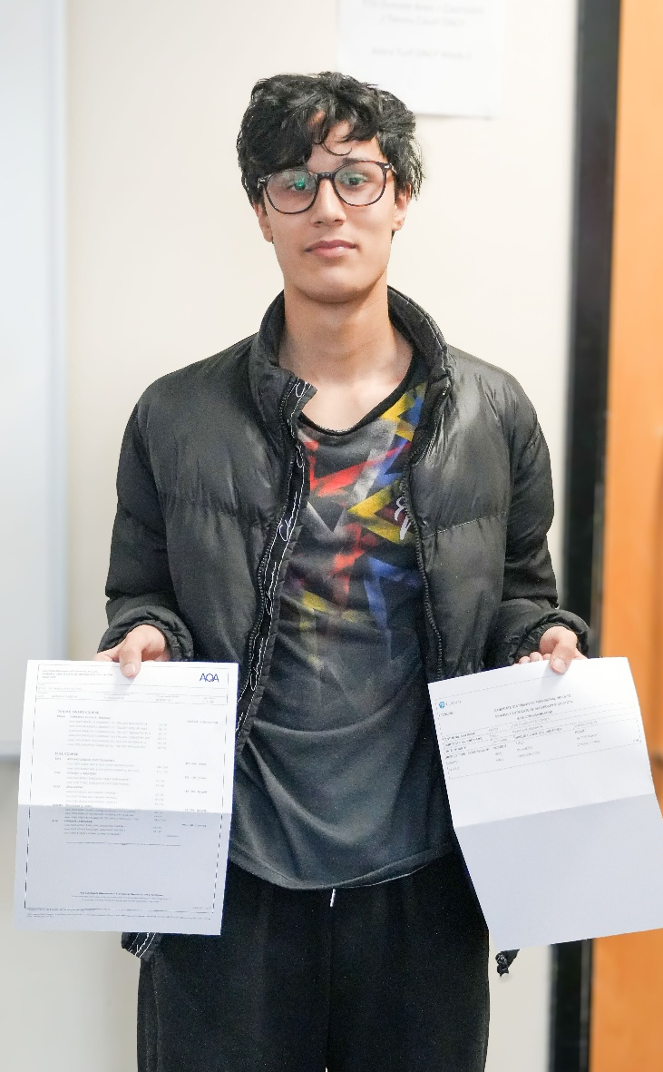
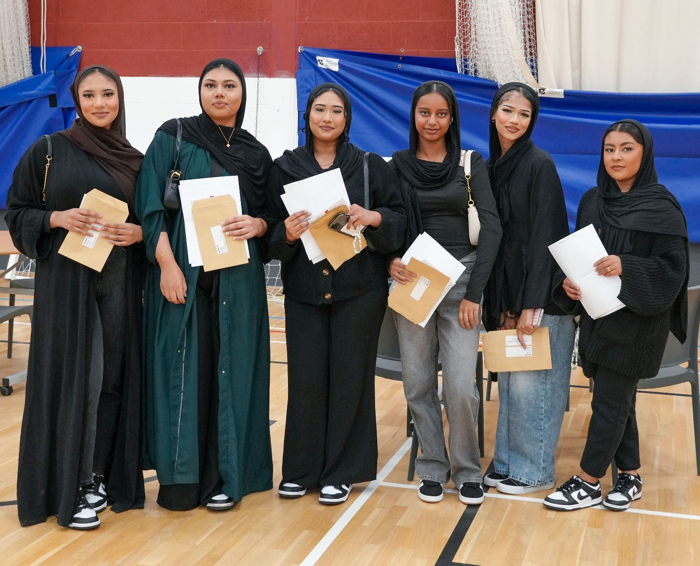
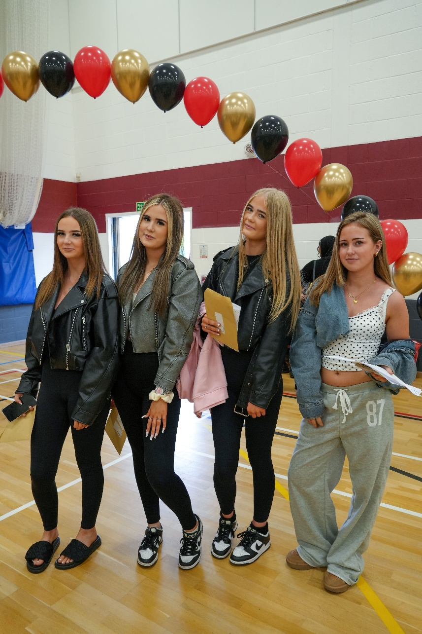
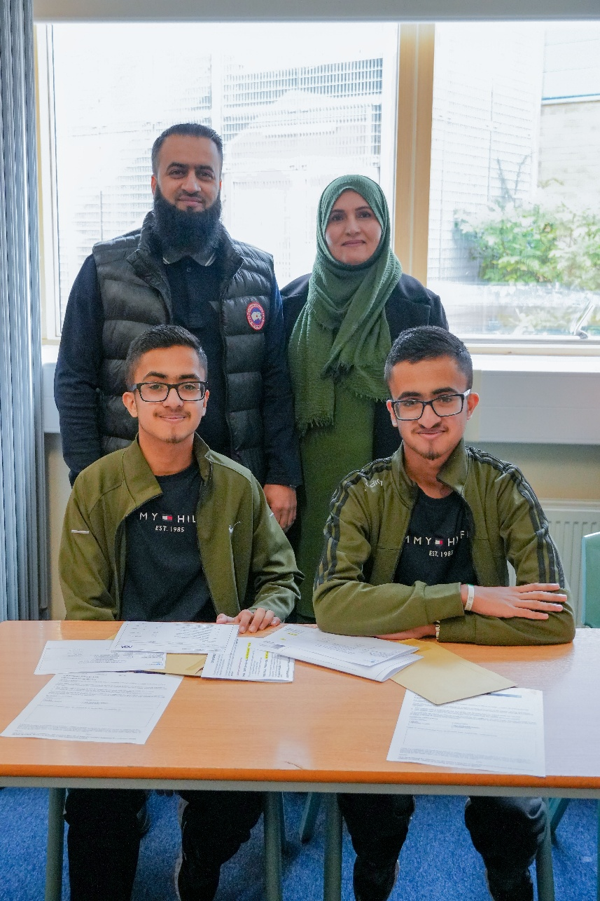
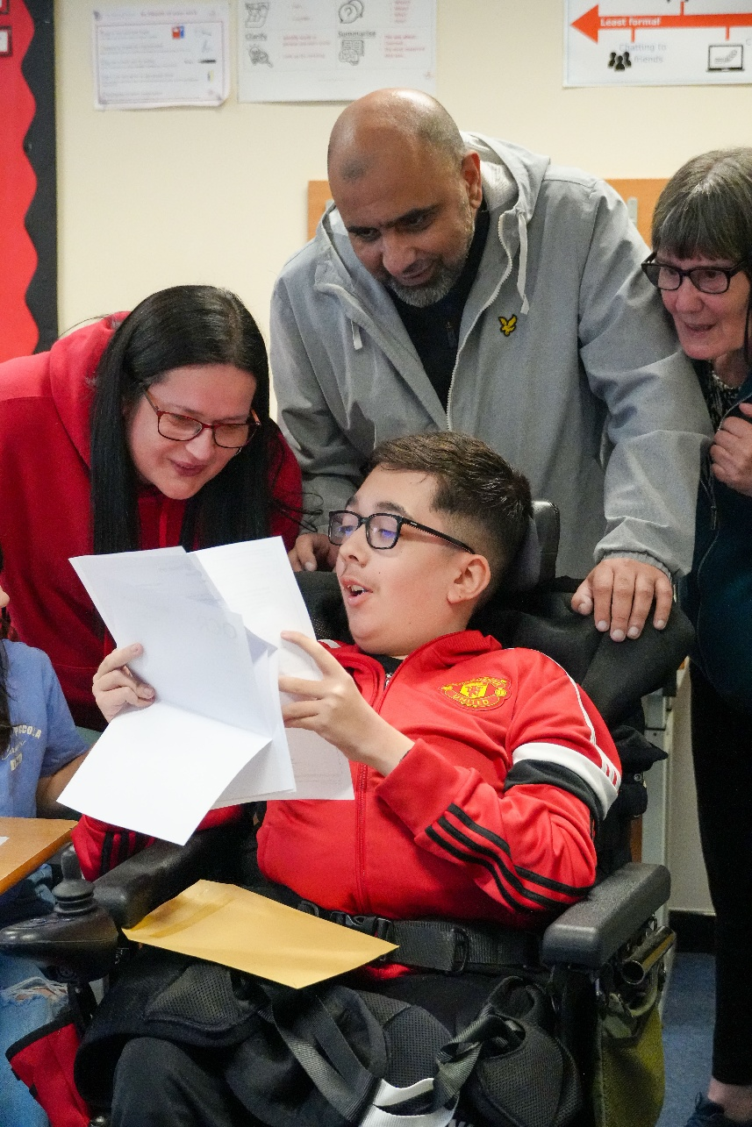

Slide 6
GCSE Outcomes 2025
Attainment 8 42.42
9-7 in English & Maths 6.9%
9-5 in English & Maths 37.0%
9-4 in English & Maths 58.4%
(No Progress 8 measure this year)

Slide 7

miss catlow
Deputy Headteacher
Quality of Education

Slide 8
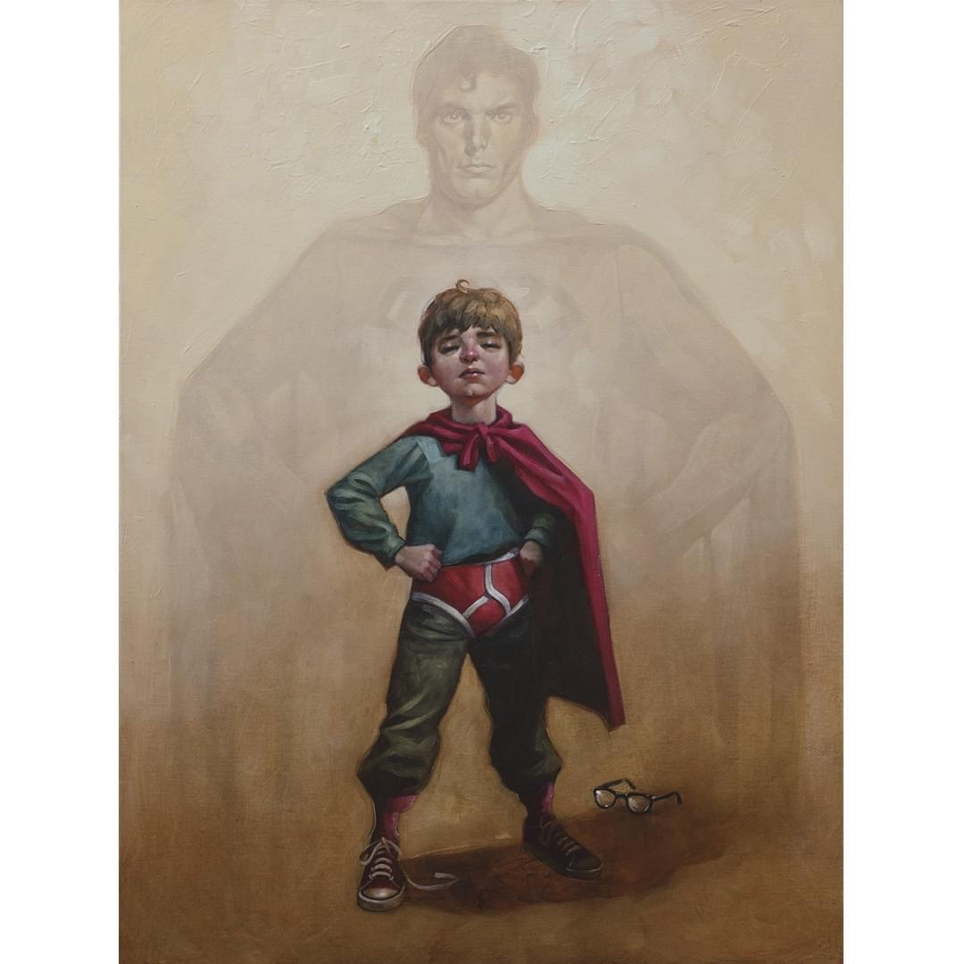
The Curriculum: Our vision
We are committed to providing young people with the highest quality of education for them to achieve their personal excellence.
KNOWLEDGE
TACKLING SOCIAL INEQUALITY
BEST POSSIBLE CHANCE OF SUCCESS
well qualified, resilient, independent and confident young adults
highly positive contribution to their community and wider society

Slide 9
The Curriculum: Our intent
purposeful and rich curriculum
deep subject knowledge
broad range of subjects
acquire and retain the core knowledge
literacy, numeracy, spiritual, moral, social and cultural development

Slide 10
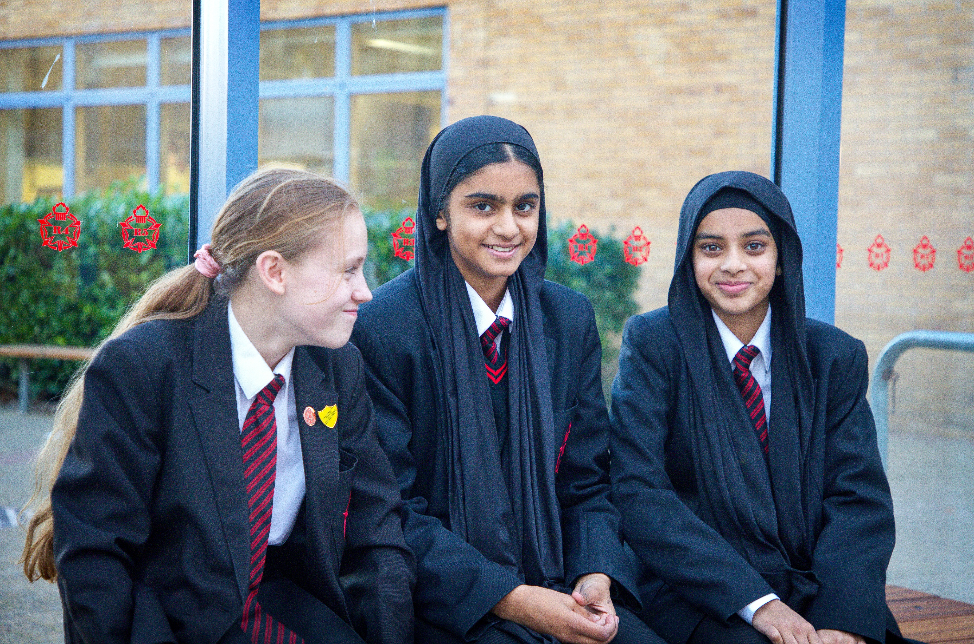
The Curriculum: Organisation
ENGLISH: SET BASED ON END OF KS3 ATTAINMENT
UNTIERED EXAMINATIONS
MATHEMATICS: SET BASED ON END OF KS3 ATTAINMENT
FOUNDATION (Grades 1-5) & HIGHER (Grades 3-9)
COMBINED SCIENCE: SET BASED ON END OF KS3 ATTAINMENT
FOUNDATION (Grades 1-5) & HIGHER (Grades 3-9)
SEPARATE SCIENCES: MIXED ATTAINMENT
(option is available to all students)
FOUNDATION (Grades 1-5) & HIGHER (Grades 3-9)

Slide 11
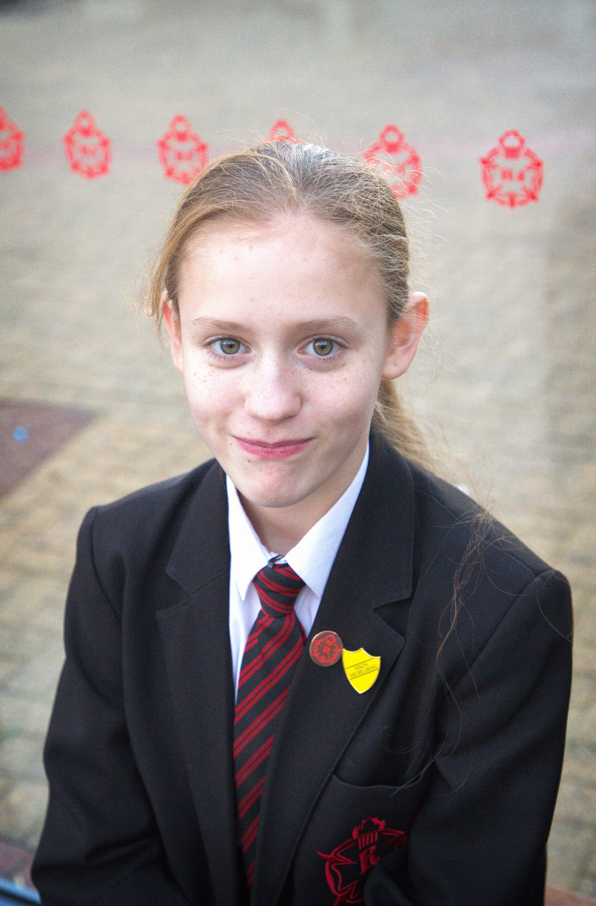
The Curriculum: Organisation
PE: SINGLE GENDER, MIXED ATTAINMENT
PERSONAL DEVELOPMENT: MIXED ATTAINMENT
4 OPTION SUBJECTS: MOSTLY MIXED ATTAINMENT

Slide 12
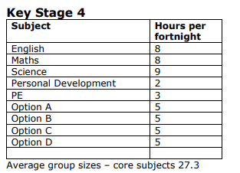
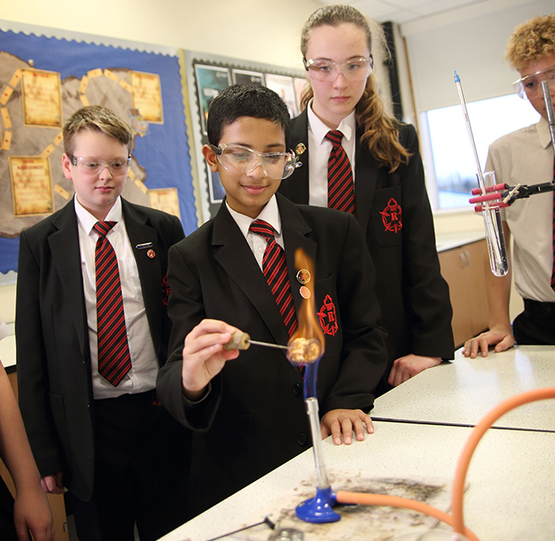
The Curriculum: Subject Learning Hours

Slide 13
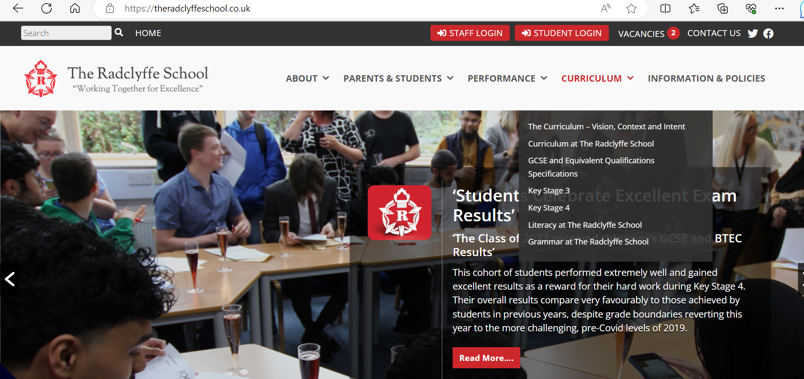

https://theradclyffeschool.co.uk/

Slide 14
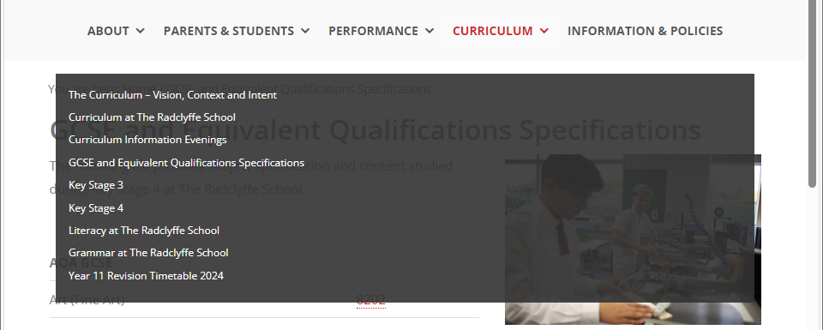
https://theradclyffeschool.co.uk/

Slide 15
Pre-Public Examinations (PPEs)
Give us a snapshot of how well students are doing.
Informs us of any gaps in knowledge to guide next teaching.
Gives students opportunity to experience formal exams, expectations and procedures.
Either full GCSE papers or rigorous ‘Smart’ papers (adapted for timing and taught content)
Year 10: 20th April – 1st May
Year 11: 17th – 28th November
2nd – 13th February

Slide 16

mrs robinson
Assistant Headteacher
Learning & Teaching

Slide 17
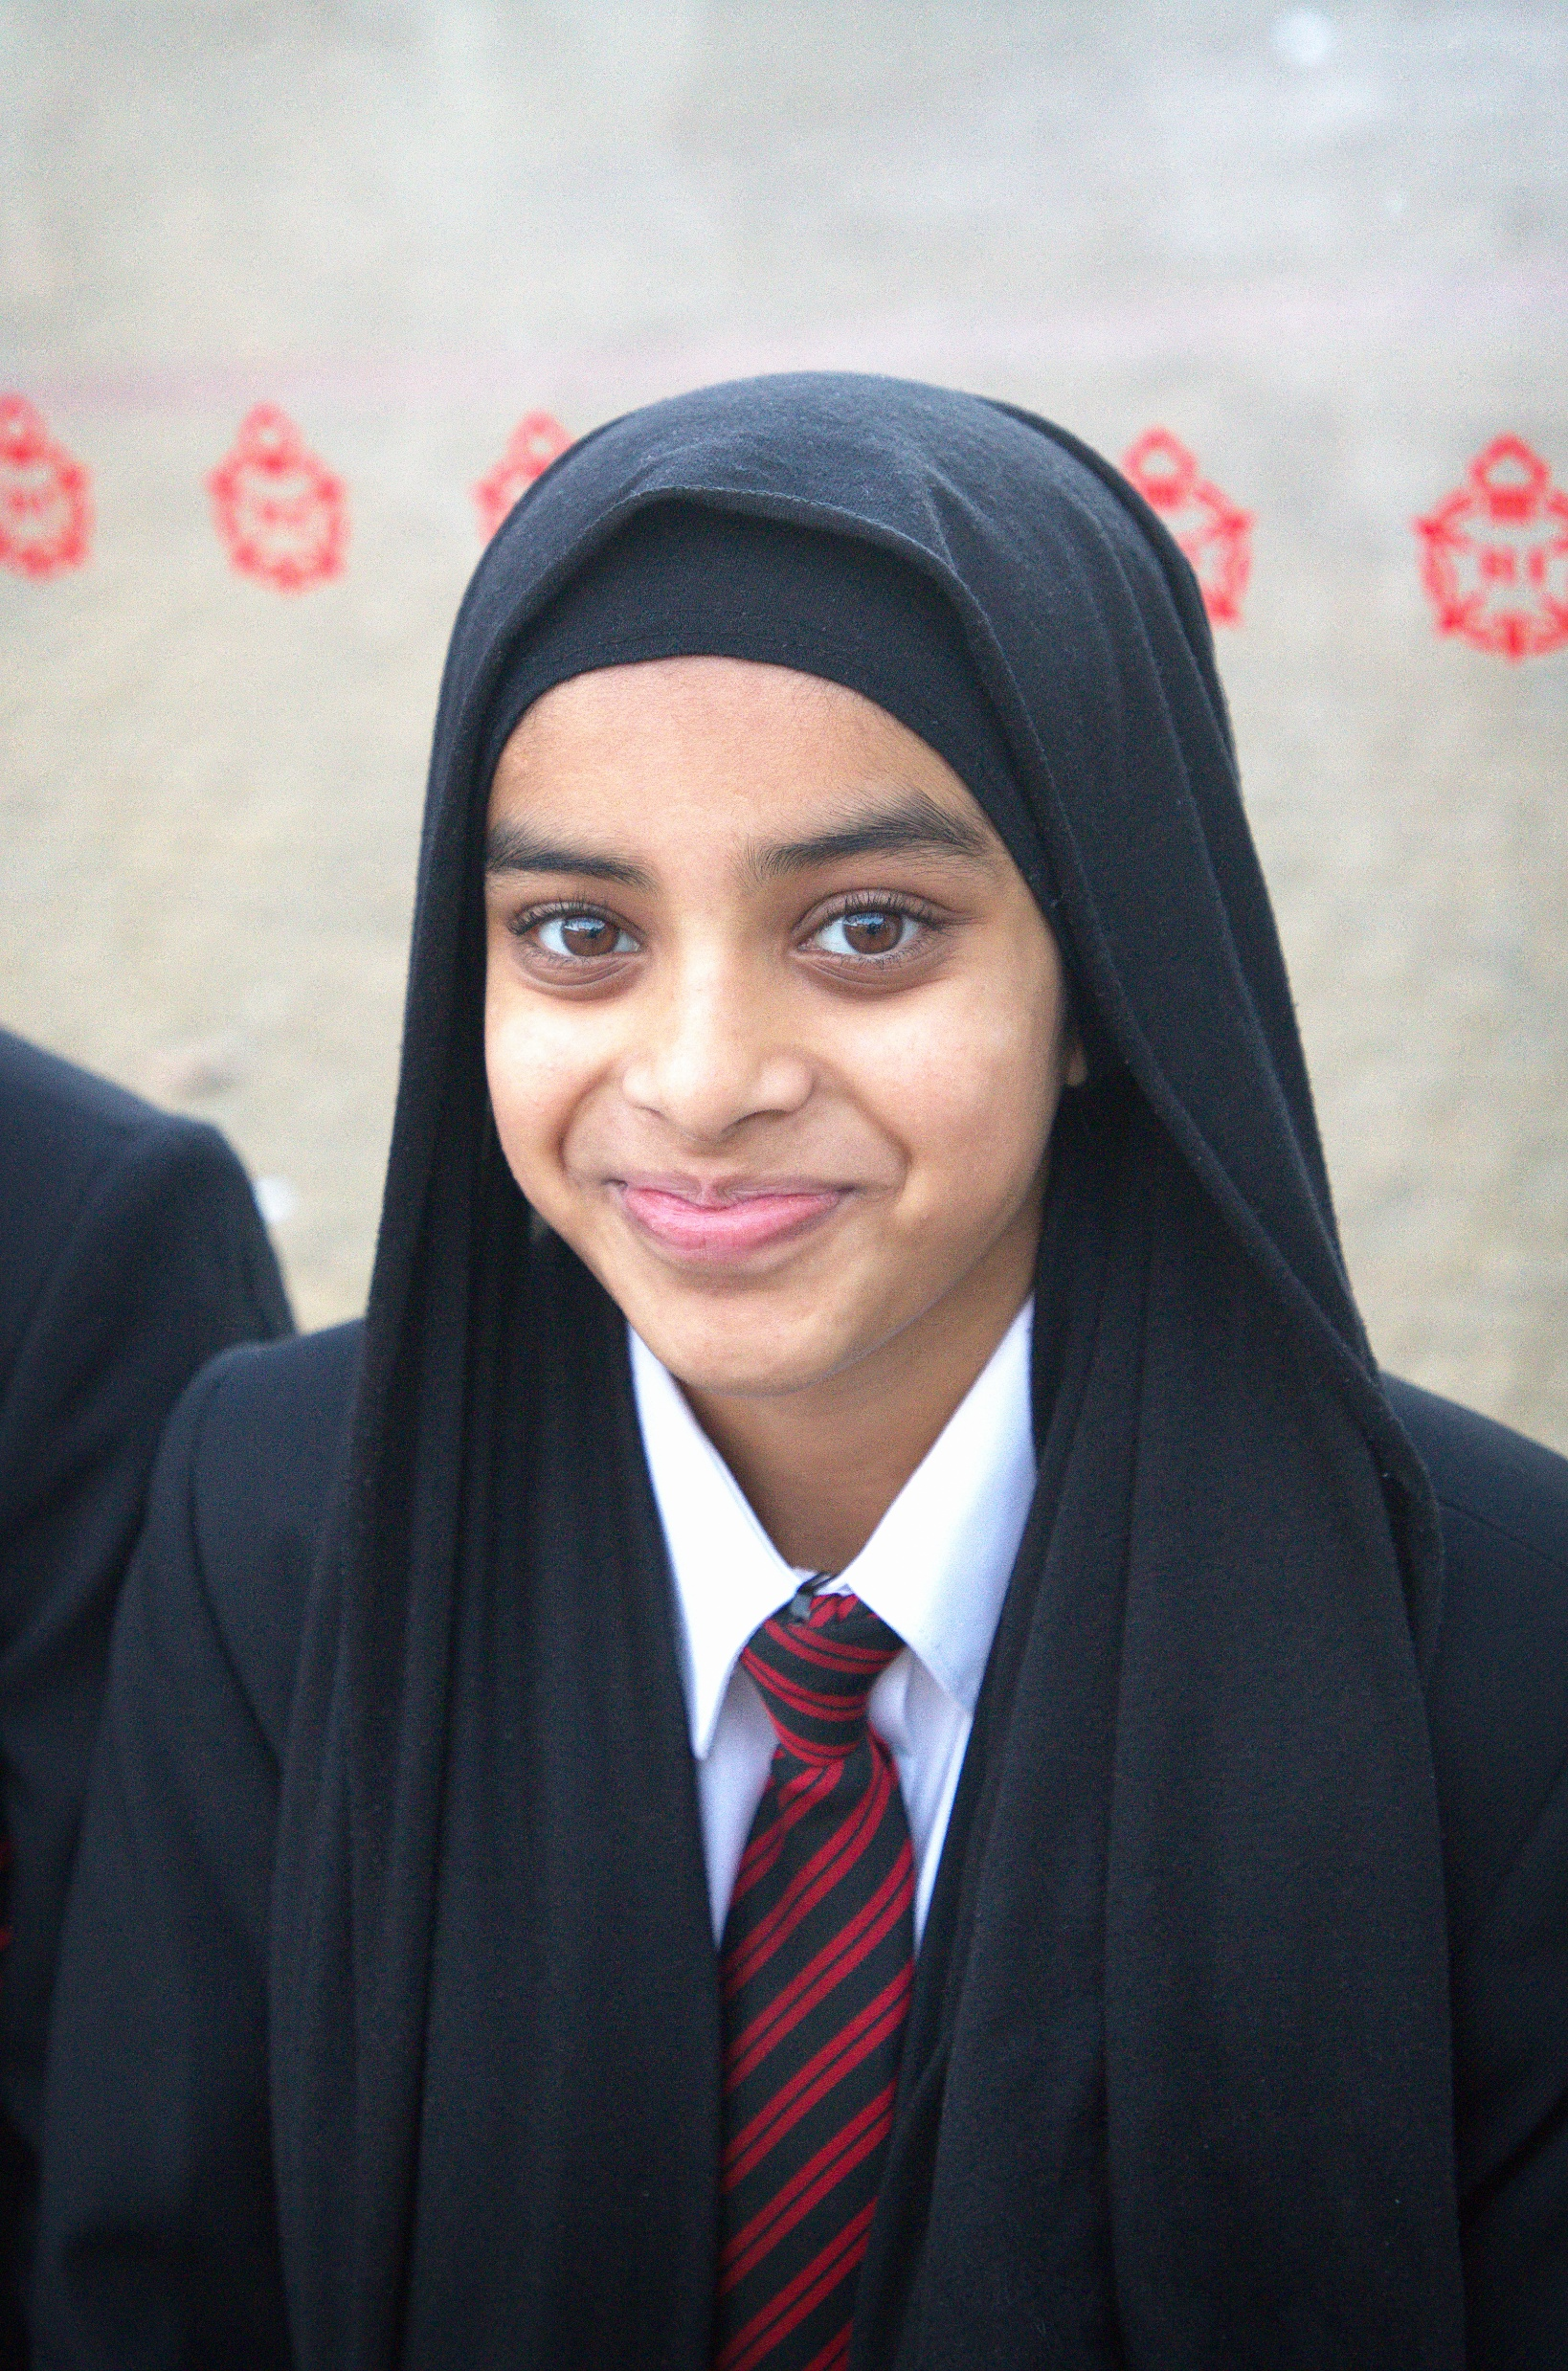

High Quality Teaching and Learning
The best available evidence indicates that great teaching is the most important lever schools have to improve pupil attainment. Ensuring every teacher is supported in delivering high-quality teaching is essential to achieving the best outcomes for all pupils.
Mrs Black Halls – Deputy Headteacher - Curriculum
Notes:
EEF state that mastery learning approaches, individualized instruction and collaborative learning approaches have a huge impact in terms of boosting students outcomes.

Slide 18
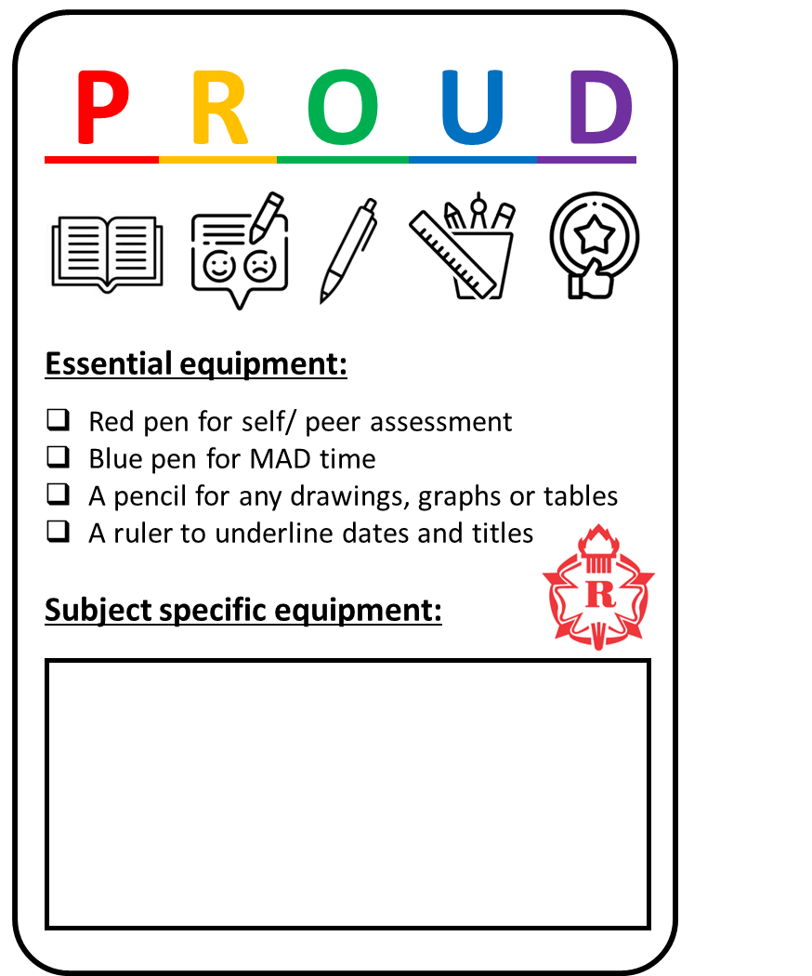





Learning at The Radclyffe School
Self and Peer Assessment Formative Assessment and checking for understanding must be an integral part of every lesson.
Self or peer assess work as instructed by your teacher. This should be completed in red pen.
Your Learning
Respect your own learning and complete your work to the best of your ability. Always be PROUD of your work.
Teacher Feedback You will receive feedback from your teacher every lesson through live modelling, live marking, whole class feedback or individual feedback.
MAD (Make-A-Difference Time) Use teacher feedback to make improvements to your work using a blue pen.
This is important for you to make progress.
Literacy Your teachers will share important vocabulary with you each lesson, model reading and support you with developing writing.
Learning at Home Complete all home learning that is set by your teacher on Satchel One.

Slide 19
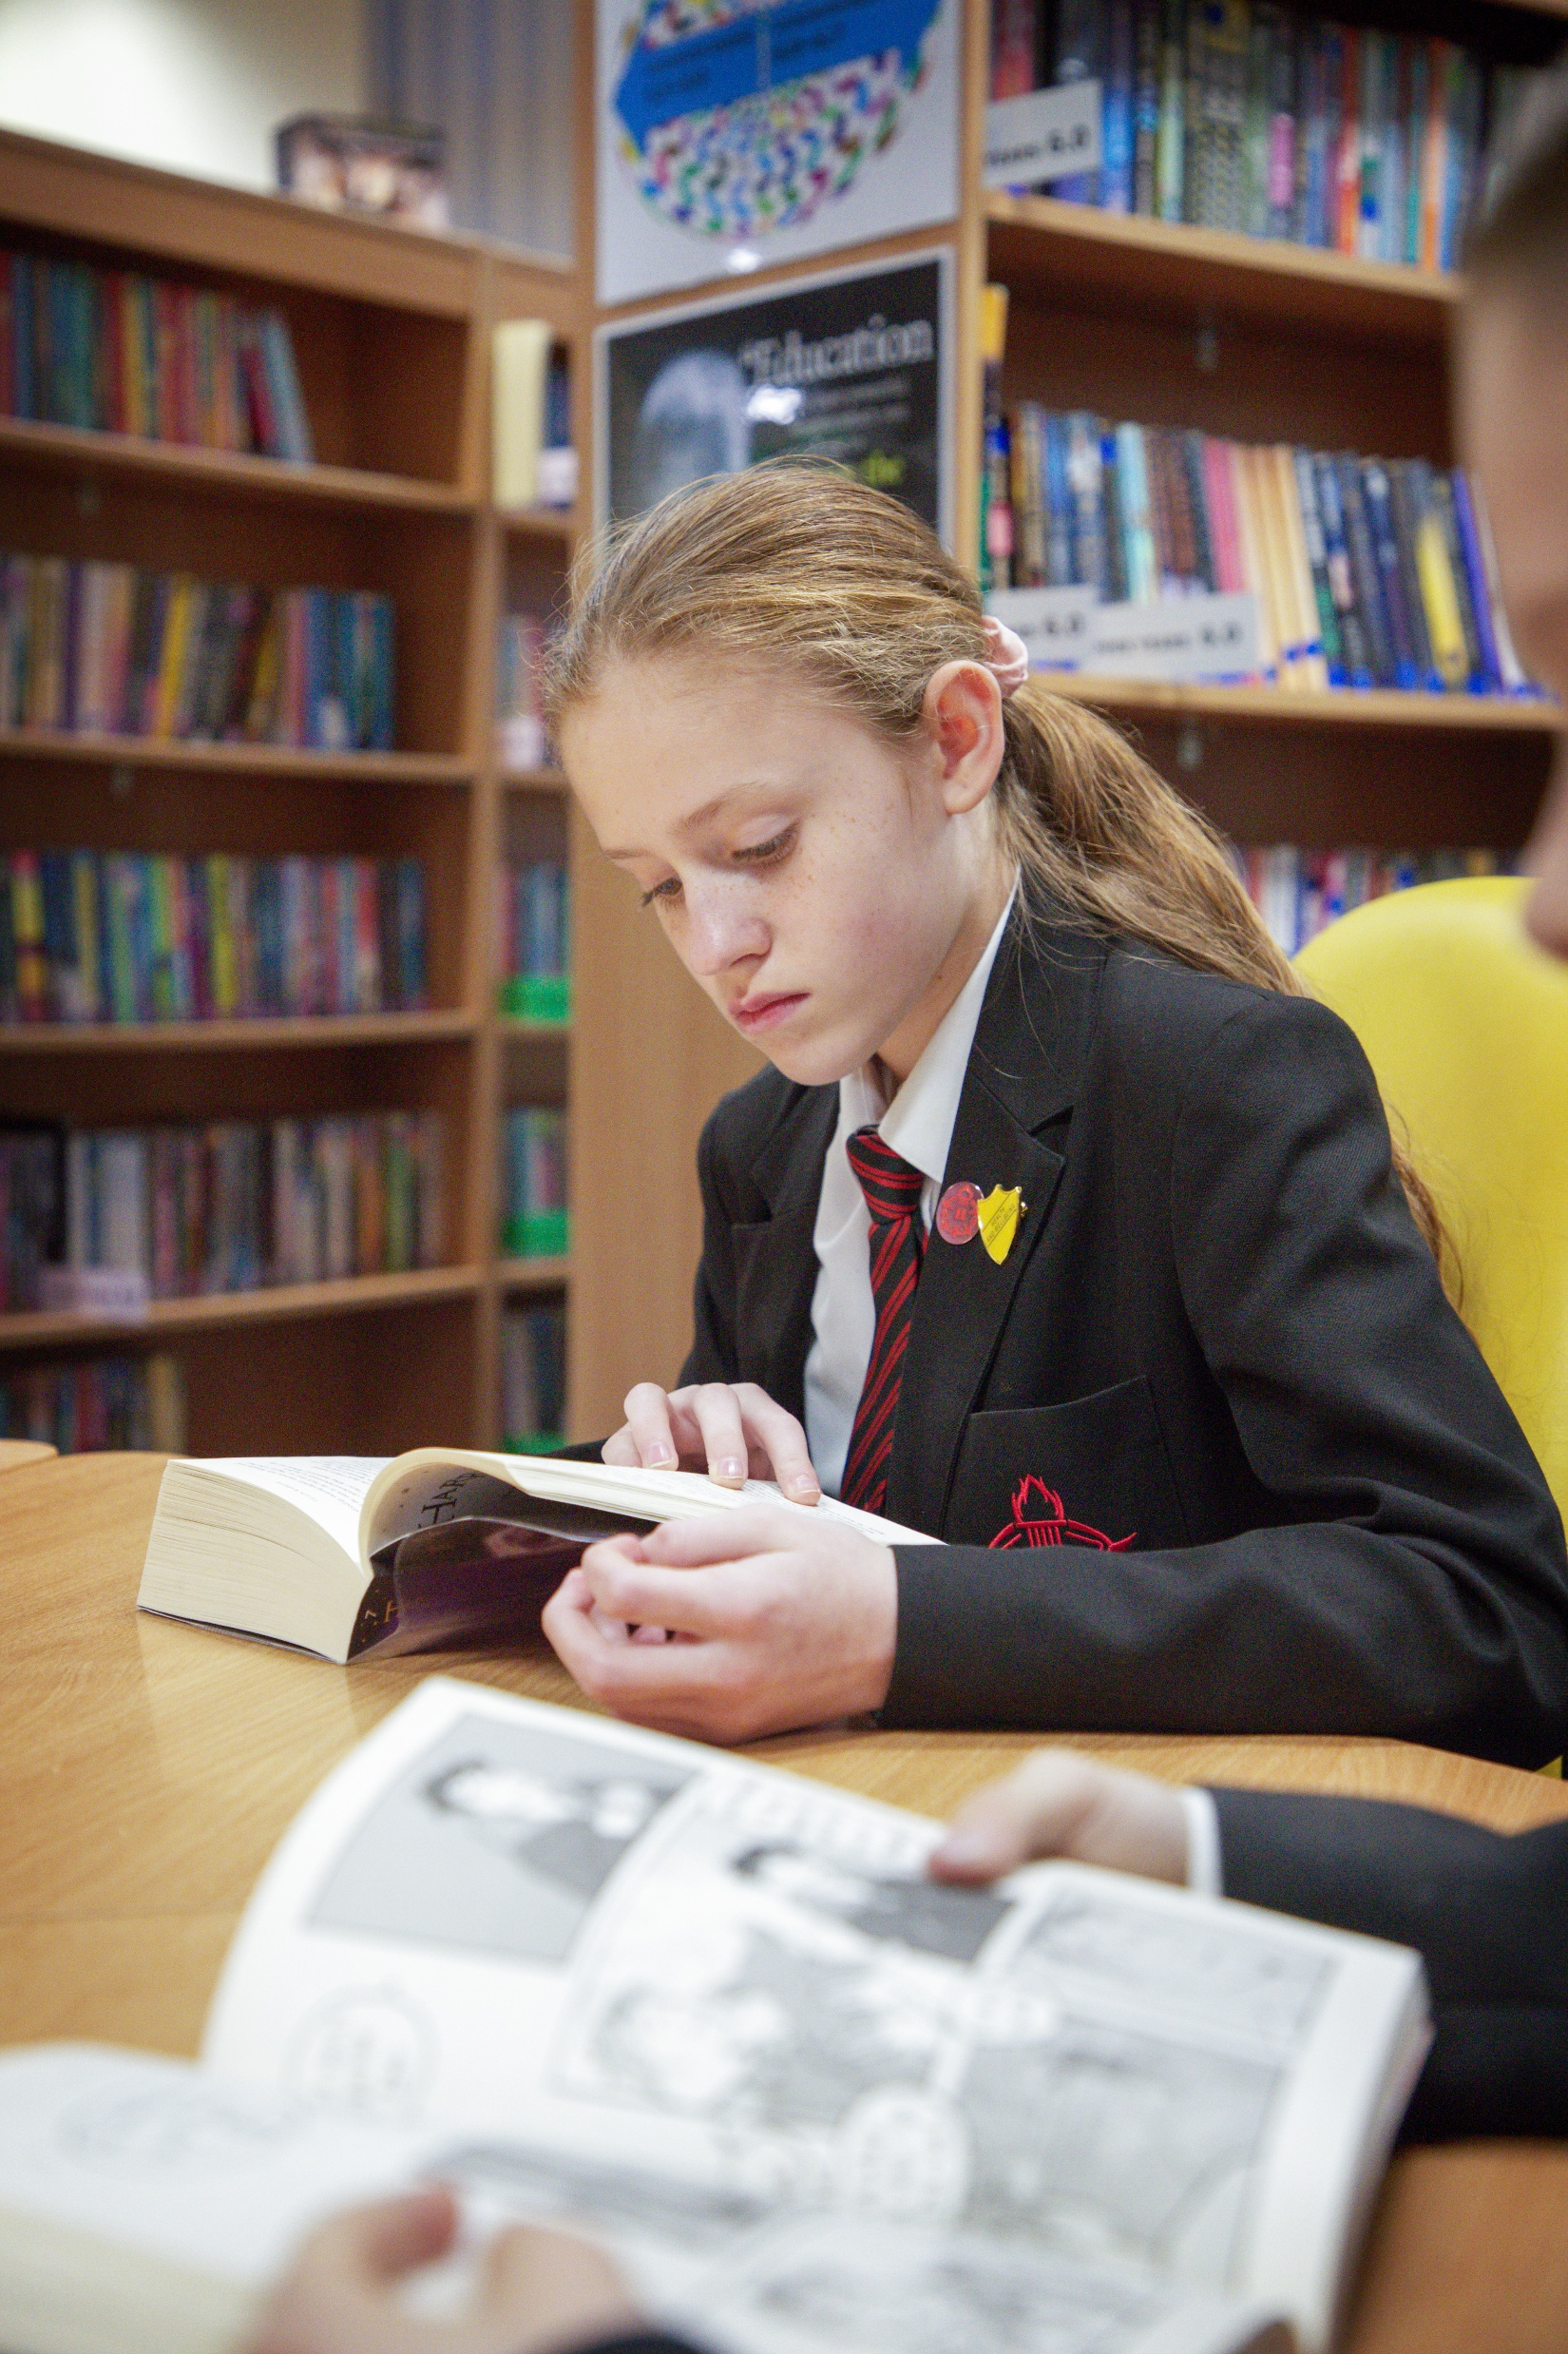
Lesson Structure- what to expect
1.Lessons are carefully planned to deliver the curriculum, with adaptations to offer both challenge and support to all students.
2.We follow the Accelerated learning cycle: all lessons will include a connect, activate, demonstrate and consolidate phase.
3. Students will be sat in an up to date seating plan that supports a cohesive school community.
4. Staff are at the door to greet students in a positive manner and direct them to start the lesson.
5. The Protected Learning (PL) system is used effectively and consistently.
6. Students are equipped for the lesson.
Mrs Black – Deputy Headteacher - Curriculum

Slide 20
Classroom Climates
What are the classroom climates?
Classroom climates help us to understand how students and teachers should behave in the classroom. The three climates we are introducing are not brand new and should not be surprising – we are simply making expectations clear for everyone in the school.
The climates will provide opportunities for teacher talk, class discussion, paired work, group tasks, and silent work. All of these are important to our learning and will support everyone in achieving their best.

Slide 21





Climate 1
One voice
Focus on the speaker
Track the speaker
Listen carefully
Be calm and respectful
Sub title
Bullet point
Bullet point
Bullet point
Bullet point

Slide 22

Climate 2
Learning through talk
Work in pairs or groups
Share ideas
Take turns
Ask questions
Active – not silent
Sub title
Bullet point
Bullet point
Bullet point
Bullet point

Slide 23

Climate 3
Learning independently
Space to think
Challenging work
Working hard
Showing resilience
Making connections to the wider world
Sub title
Bullet point
Bullet point
Bullet point
Bullet point

Slide 24
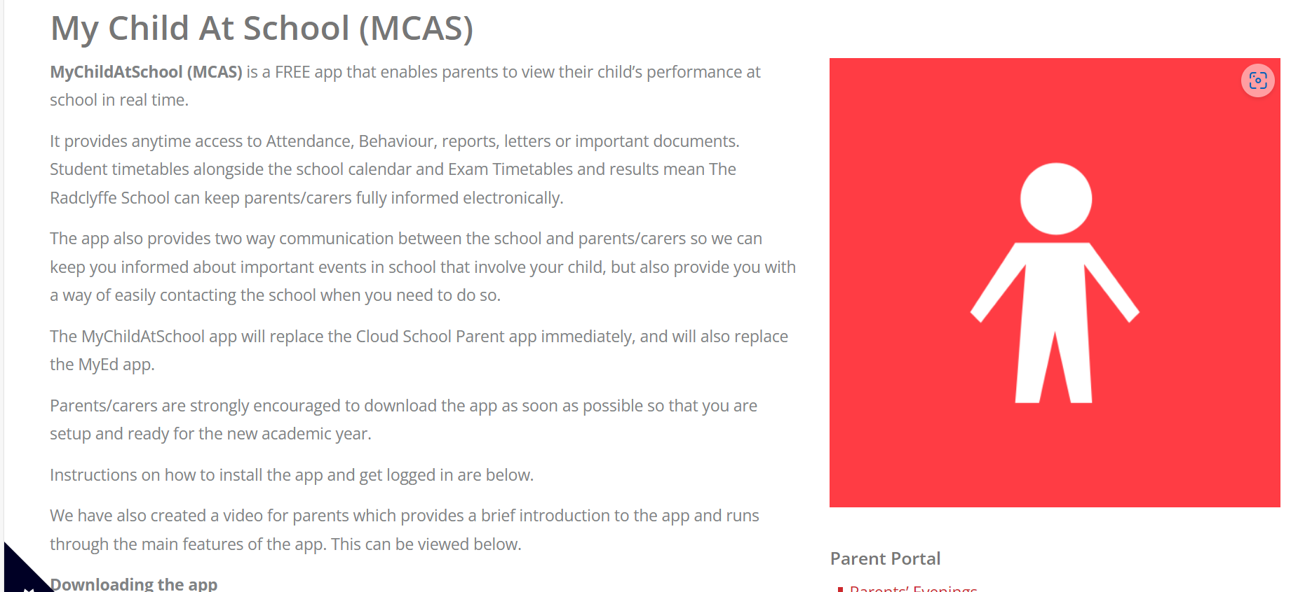

Mychildatschool (MCAS) is a FREE app that enables parents to view their child’s performance at school in real time.
It provides anytime access to attendance, behaviour, reports, letters or important documents. Student timetables alongside the school calendar and exam timetables and results mean the Radclyffe School can keep parents/carers fully informed electronically. This is where parents and carers will be able to view your child’s options choices

Slide 25
miss arnold
MAKE EVERY MINUTE COUNT
Assistant Headteacher
Intervention &
Raising Standards

Slide 26

MAKE EVERY MINUTE COUNT
INDEPENDENT LEARNERS
Personal responsibility – Create good habits
Subject strengths and weaknesses
Plan a study timetable - Study at home
Use revision guides and educational websites
GOLDEN TICKET – Free revision guide
Utilise the experience of staff in school
YEAR 7 BELONG | YEAR 8 EXPLORE | YEAR 9 CHOICES | YEAR 10 INDEPENDENCE | YEAR 11 MOVING ON

Slide 27




MAKE EVERY MINUTE COUNT
KS4 OPPORTUNITIES
Home Learning
PLG Study Skills
Interventions
Revision/Coursework
Half term boosters
Saturday boosters
Tutoring

Slide 28

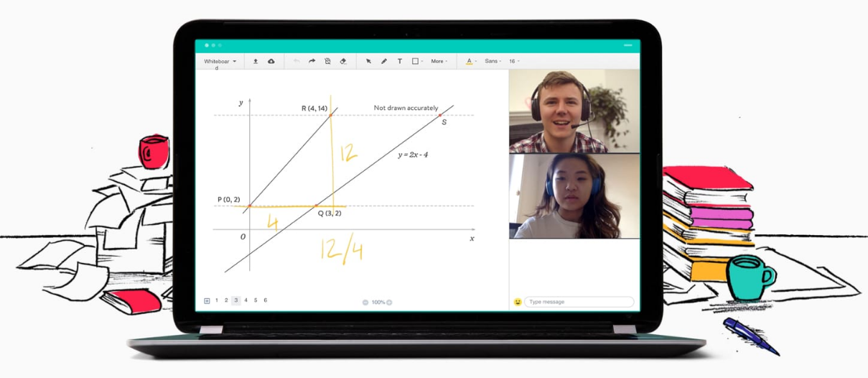
MAKE EVERY MINUTE COUNT
FREE KS4 TUTORING
www.tlclive.com
REGISTER YOUR INTEREST

Slide 29
MAKE EVERY MINUTE COUNT
FREE KS4 TUTORING
Free online 1:1 tutoring from home
Sessions start in January after Year 11 PPEs
Sessions start at either 4pm, 5pm or 6pm. Tuesday-Thursday
Weekly sessions for one hour x 10 weeks
Subject - English OR Mathematics
Feedback – Previous students made an improvement on their knowledge, understanding and confidence
Any questions can be directed to Mrs Radcliffe [MFL PPA room]

Slide 30

Mr Watson
Curriculum Leader:
Science

Slide 31
The Science curriculum
Year 10 and 11
Mr Watson
Head of Faculty - Science

Slide 32
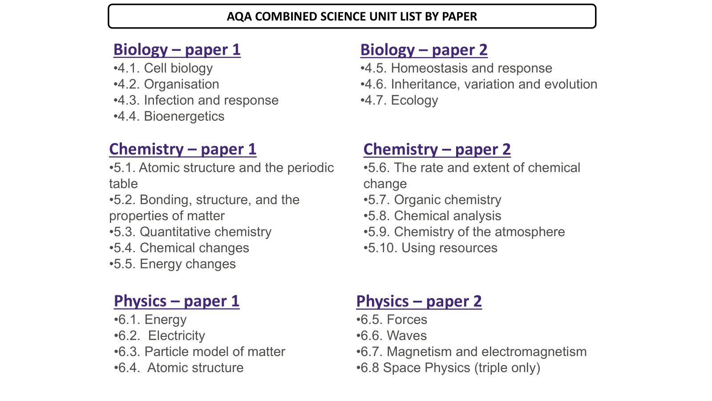

Slide 33
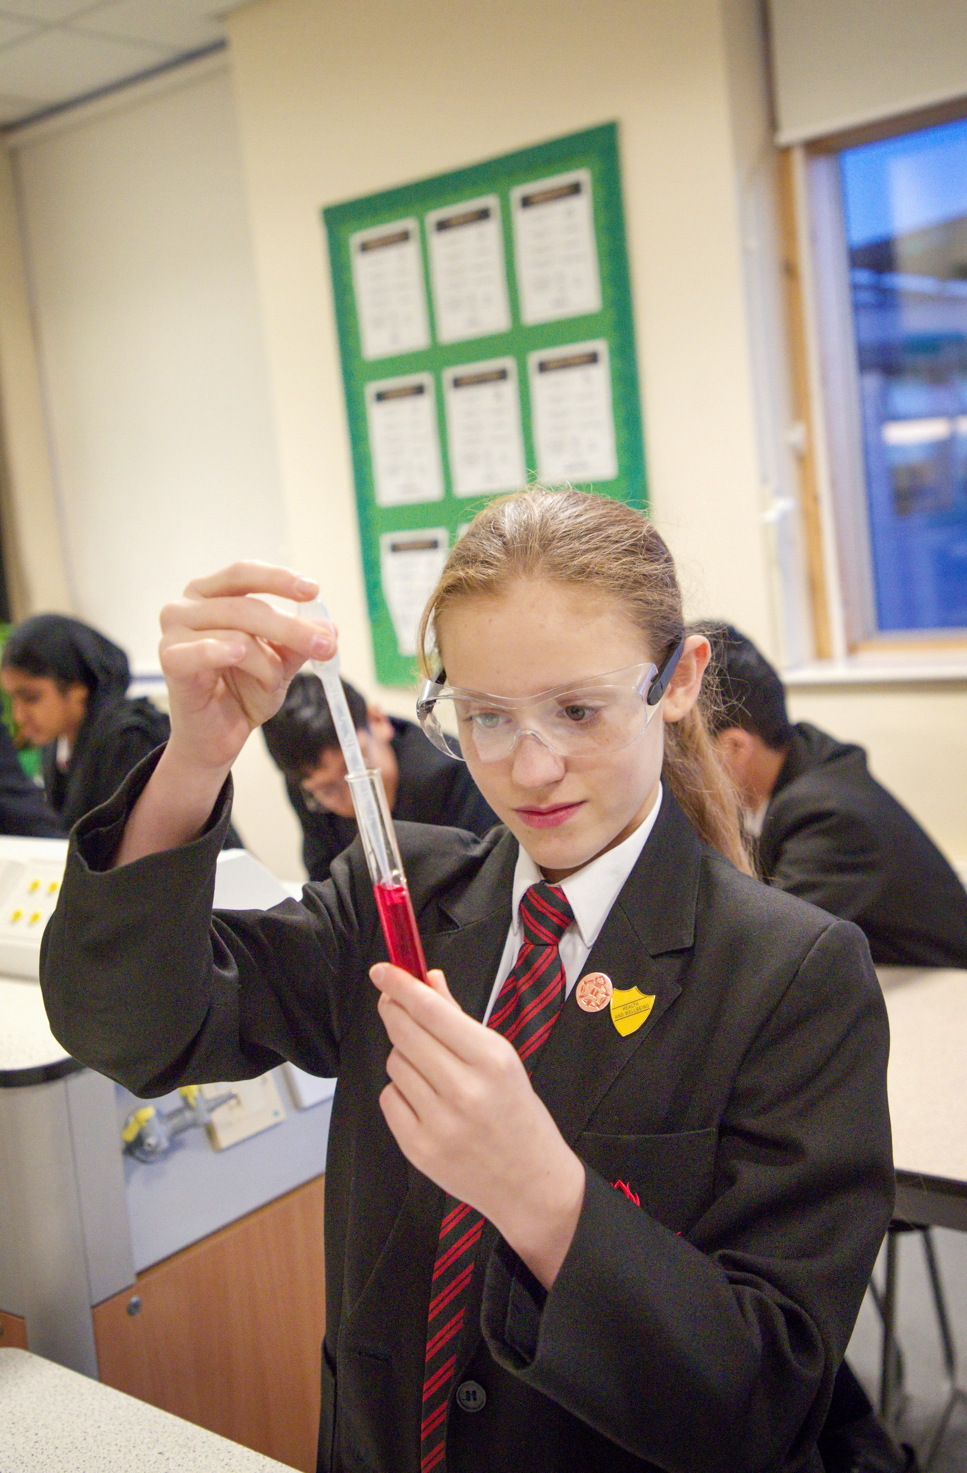
The Year 10 – The Science Curriculum
Curriculum coverage:
Cell biology
Organisation
Infection and response
Bioenergetics
Atomic structure and the periodic table
Bonding, structure and the properties of matter
Quantitative chemistry
Chemical changes
Energy changes
Energy
Particle model
Electricity
Homeostasis and response

Slide 34

The Year 11 – The Science Curriculum
Curriculum coverage:
Inheritance
Variation and evolution
Ecology
Rates of reactions
Organic Chemistry
Chemical analysis
Chemistry of the atmosphere
Using resources
Forces
Waves
Magnetism and electromagnetism
Space physics (triple only)
Miss Zulfiqar – KS4 Science Curriculum Lead

Slide 35
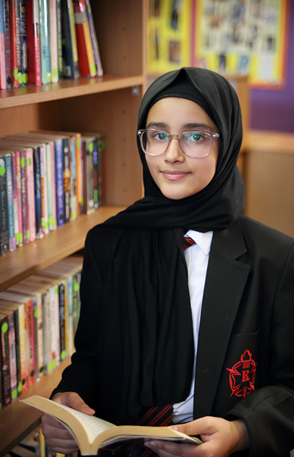
The Science Curriculum
Assessment:
All students will undertake informal assessments throughout the year. The outcomes of this work will simply be to inform the teacher of areas of strength and weaknesses that need to be addressed.
All students will take formal tests every half term. Students will also sit an exam at the end of the year. These will be used to assign the grades given in reports and at parents evening. Exam tiers are also based off this data.
Miss Zulfiqar – KS4 Science Curriculum Lead

Slide 36
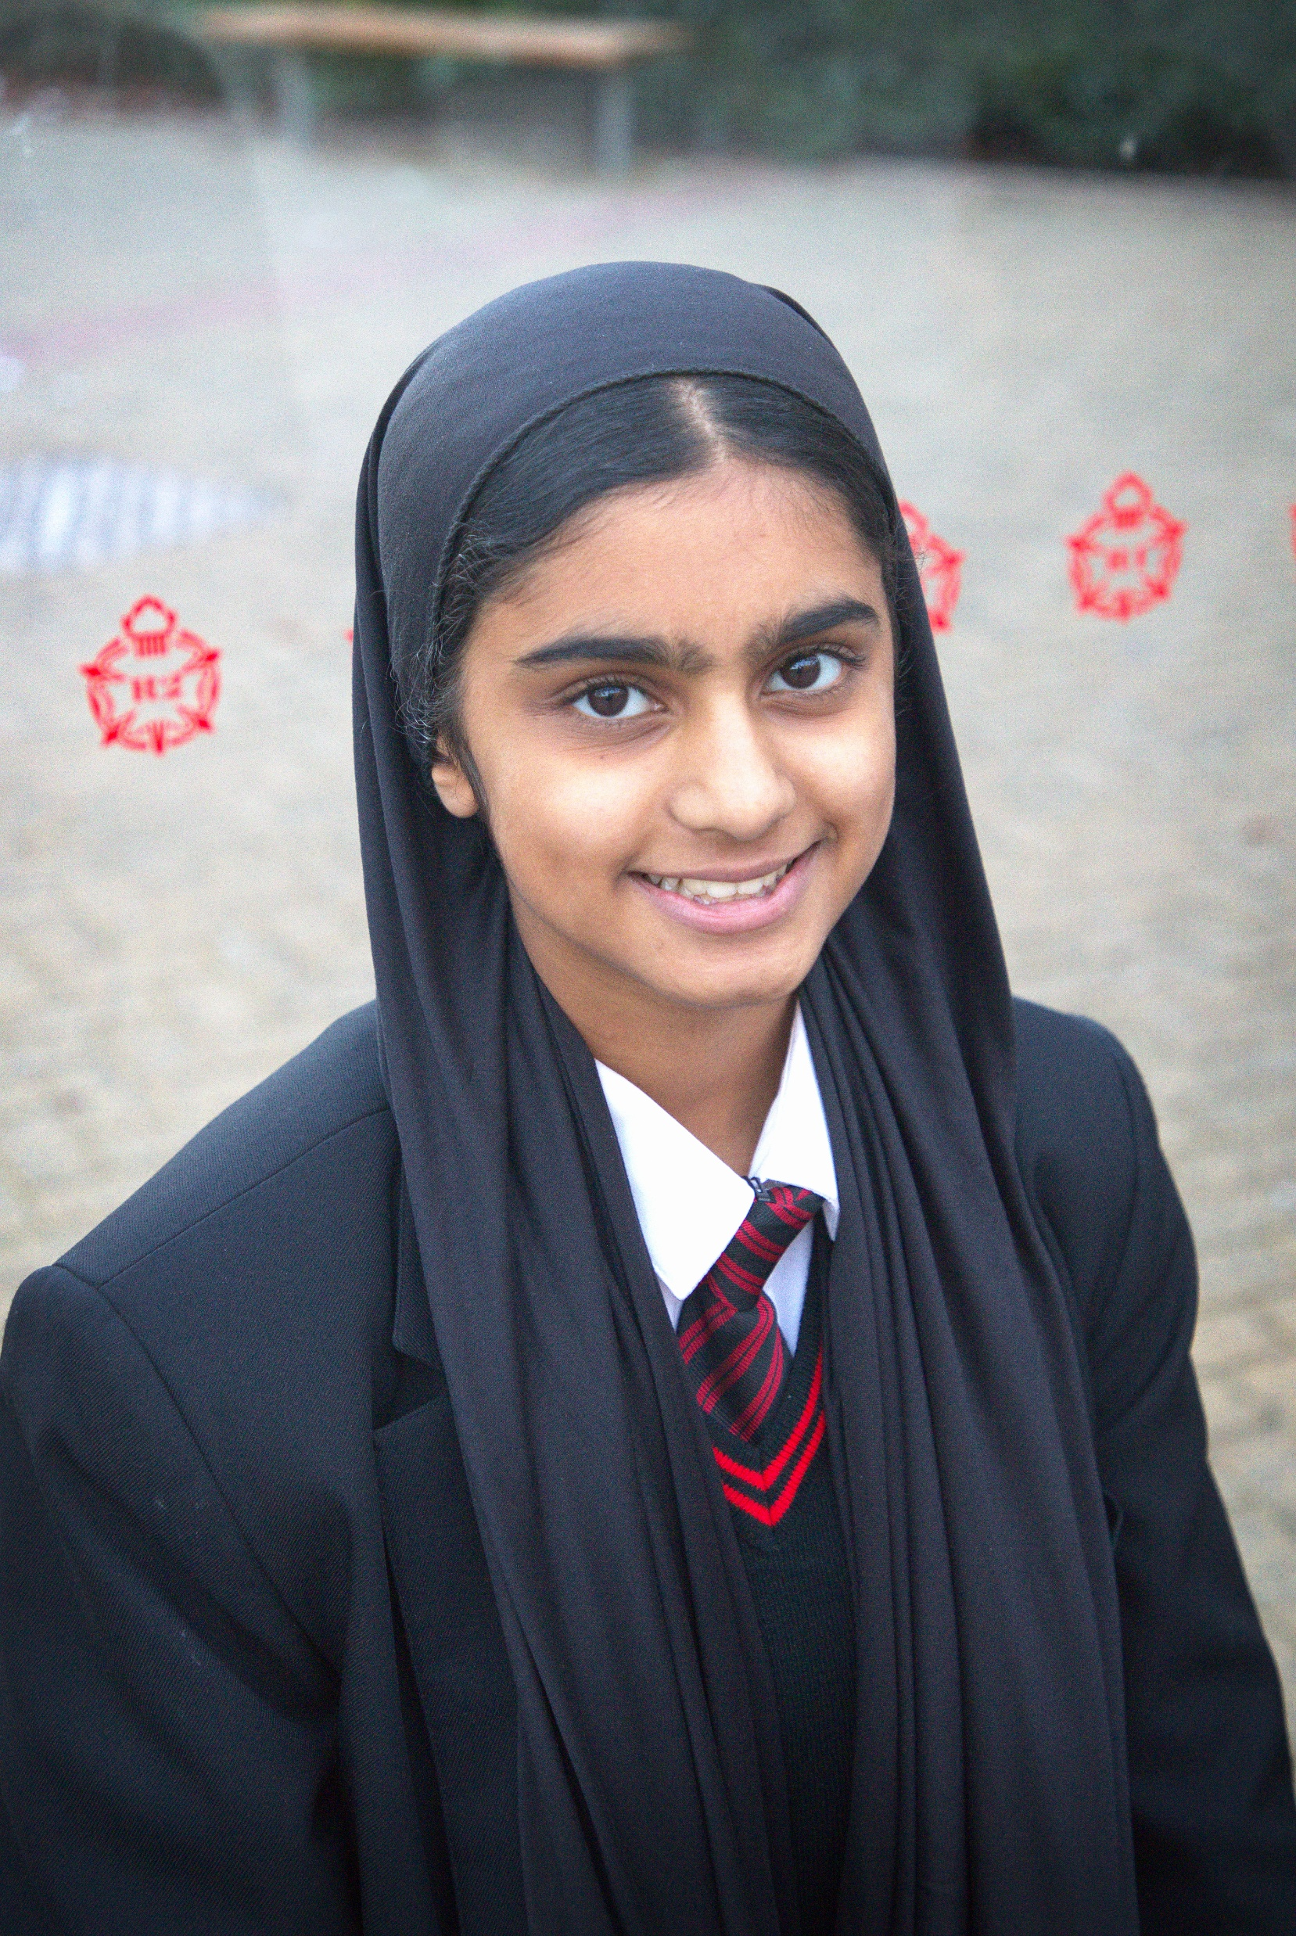

The Science Curriculum
Assessment:
Year 10
7 internal end of topic assessments throughout the year – used for reporting and correct tiering for actual GCSE exams sat in year 11.
PPE exams – combined will complete a B1 and a C1 paper in Apr/May.
Separates will complete a B1, C1 and a P1 paper.
Miss Zulfiqar – KS4 Science Curriculum Lead

Slide 37

The Science Curriculum
Assessment:
Year 11
2 internal end of topic assessments throughout the year – used for reporting and correct tiering for actual GCSE exams sat in year 11.
PPE exams – combined will complete in December Exams – B1,C1,P1 and B2. In Feb exams they will complete C2.
Separates will complete a B1,C1 and P1 in December exams. In Feb exams they will complete B2,C2 and P2.
Miss Zulfiqar – KS4 Science Curriculum Lead

Slide 38
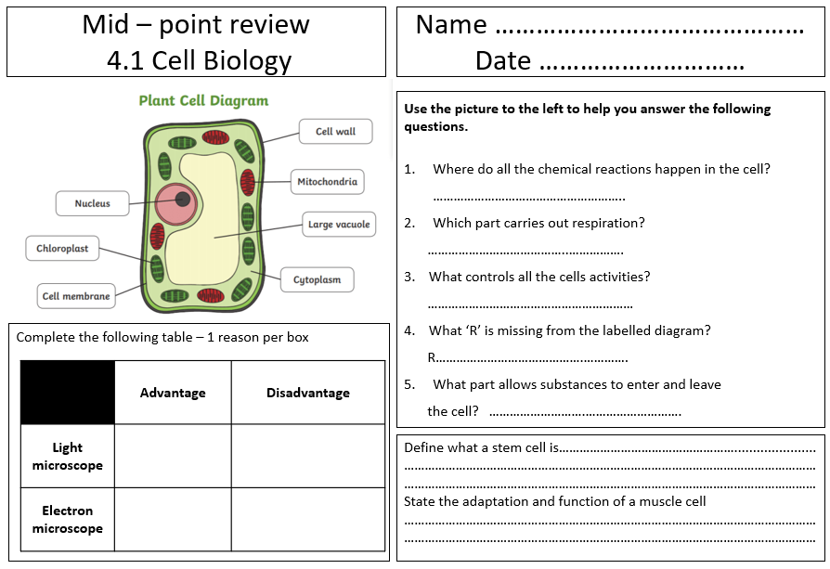
KS4 Science

Slide 39
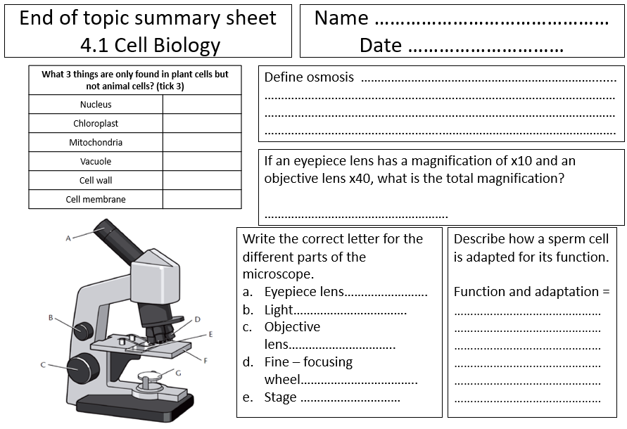
KS4 Science

Slide 40

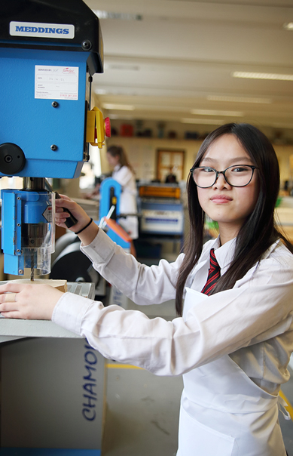
The Science Curriculum
Learning at home:
Homework will be set weekly. There will be a wide variety of different activities. Many will be revisiting the work done in class to offer extra practise.
Homework will be on an online platform – Sparx science which students can access on a variety of devices.
As exams come closer the students will be supported with revision material to work with at home.
Miss Zulfiqar – KS4 Science Curriculum Lead

Slide 41

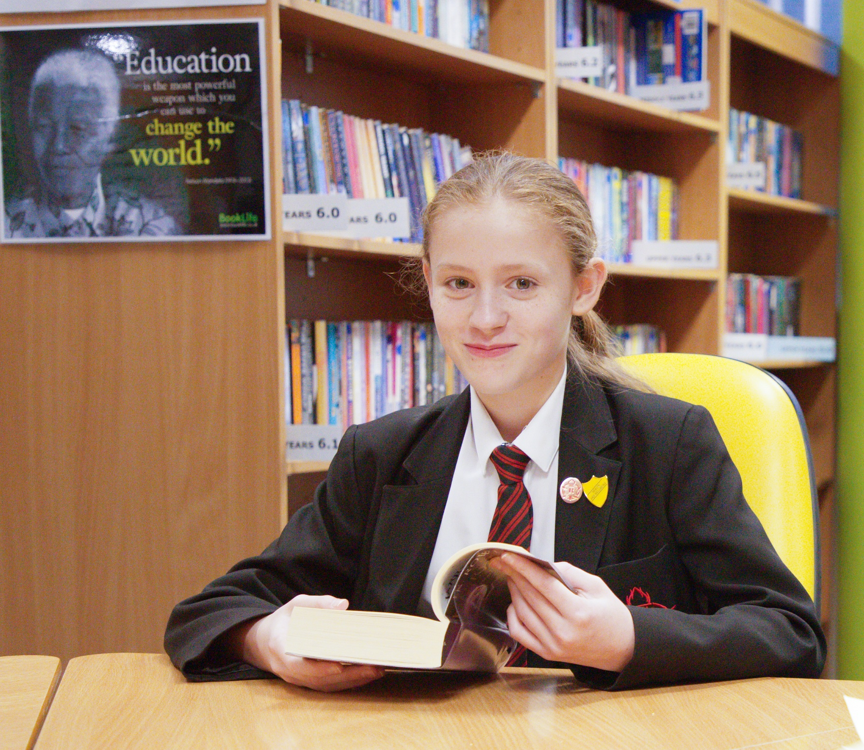
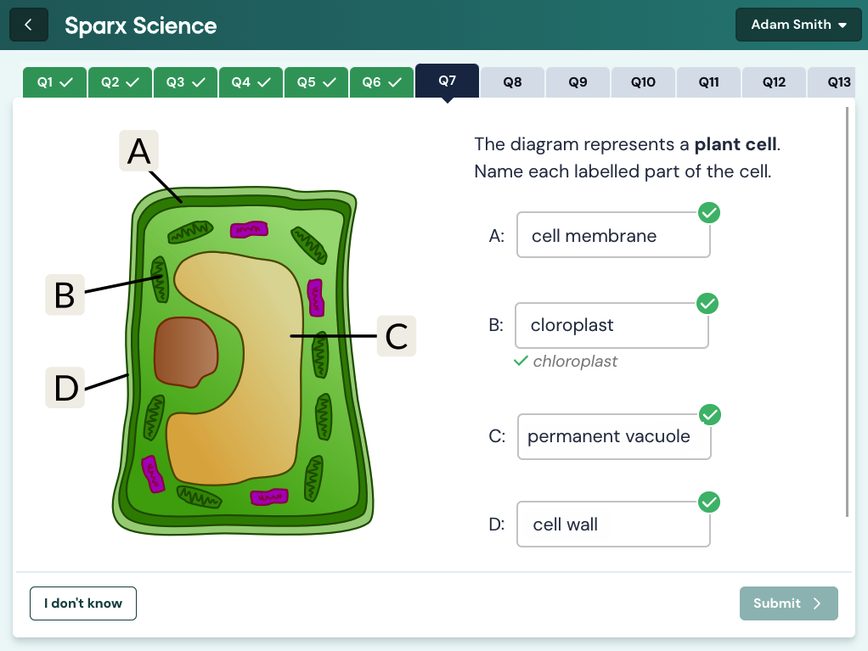
The Science Curriculum
Combined science – once per week – issued on a Monday – 7 days for completion. 2nd chance given.
Separate sciences – one piece of homework per week for Biology, Chemistry and Physics – all merged as one task (60 minutes).
Miss Zulfiqar – KS4 Science Curriculum Lead

Slide 42
Key stage 4 – The science curriculum
Literacy in Science
Every one of the units of work described earlier is supported with literacy resources.
Each unit starts with a PAL sheet- all the key vocabulary with definitions.
Students are trained and supported throughout each unit in attempting long answer questions using various scaffolding strategies.
Definitions related to ‘How science works’ and command words are also provided and stuck in all students exercise books for easy reference and use.

Slide 43
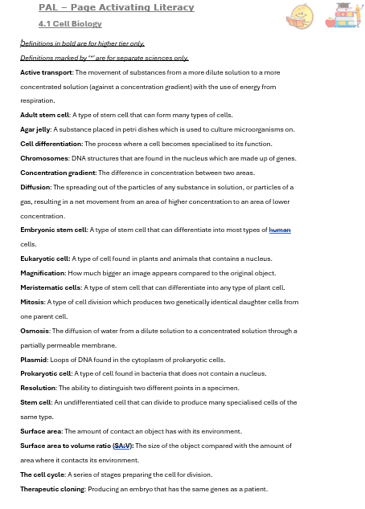
KS4 Science - Literacy
All KS4 units introduced with a ‘PAL’ sheet – ‘Page activating literacy’.
All keywords for combined H/F and separate sciences on one document.

Slide 44
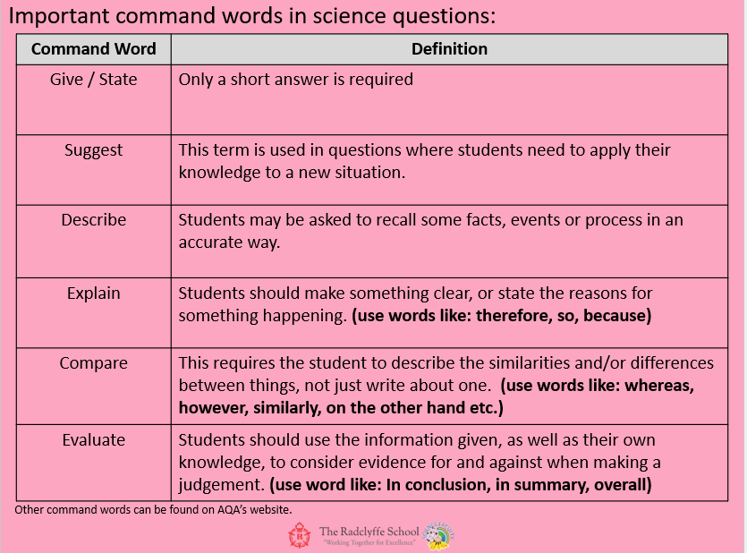
KS4 Science - Literacy
KS4 – all students will have a copy of definitions of command words used in GCSE. Definitions are in student speak so easy to understand with prompts given too.

Slide 45
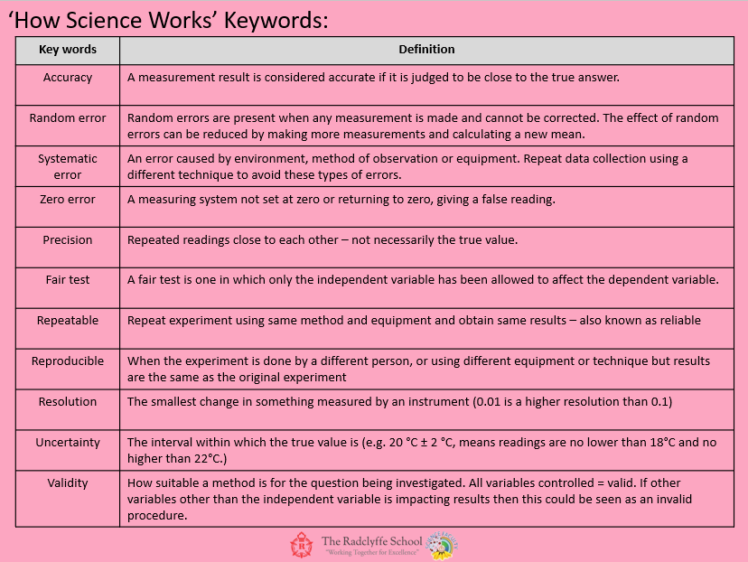
KS4 Science - Literacy
KS4 – same principle behind ‘how science works’ keywords. Student friendly language with examples given – keywords tie in well with all practical aspects of science.

Slide 46
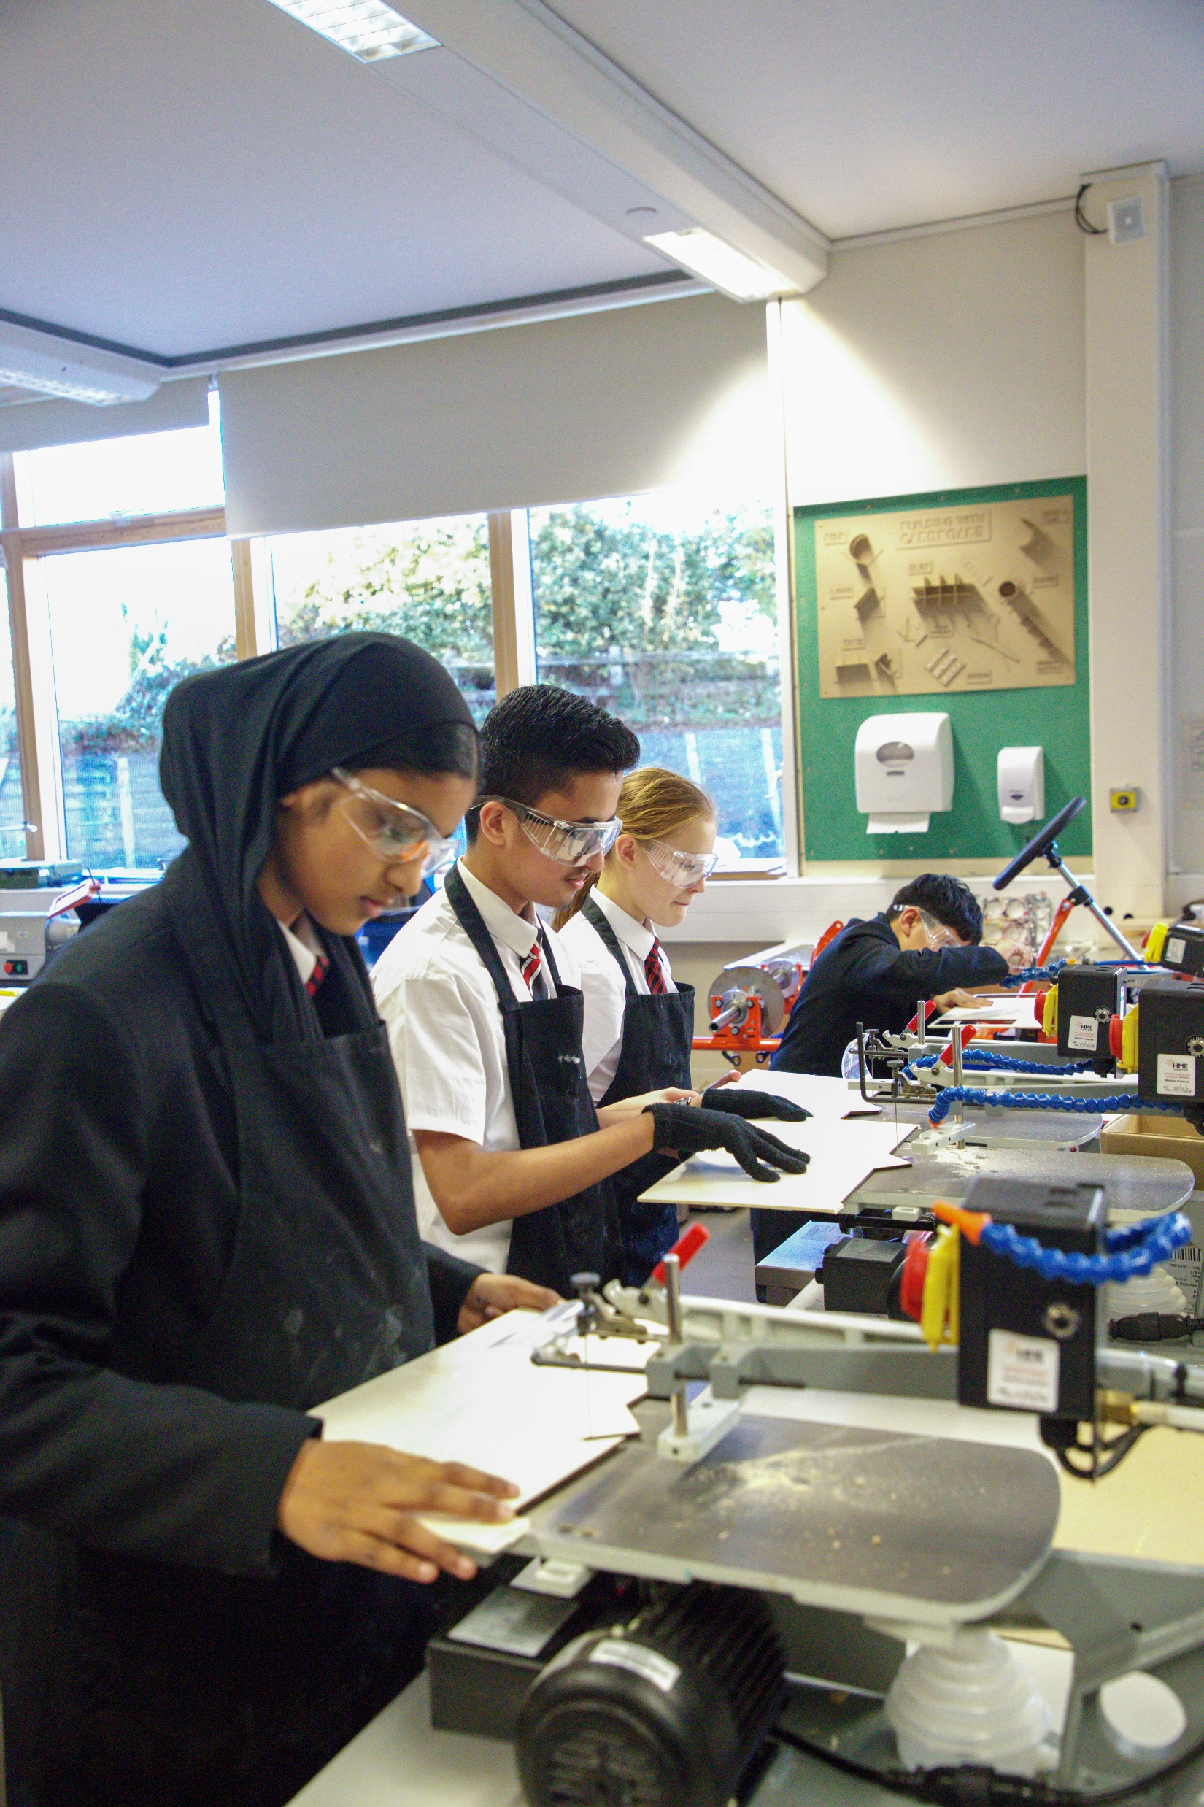
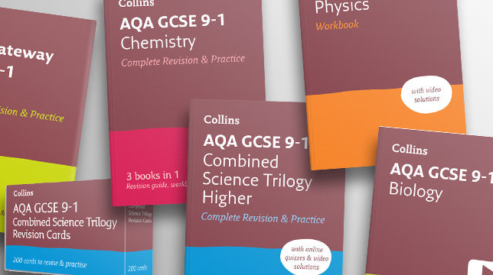
The Science Curriculum
Revision guides as well as workbooks can be purchased on Parent pay.
An excellent resource for students to have at home to help them with revision and homework.

Slide 47

mr kirk
Assistant Curriculum
Leader: English

Slide 48
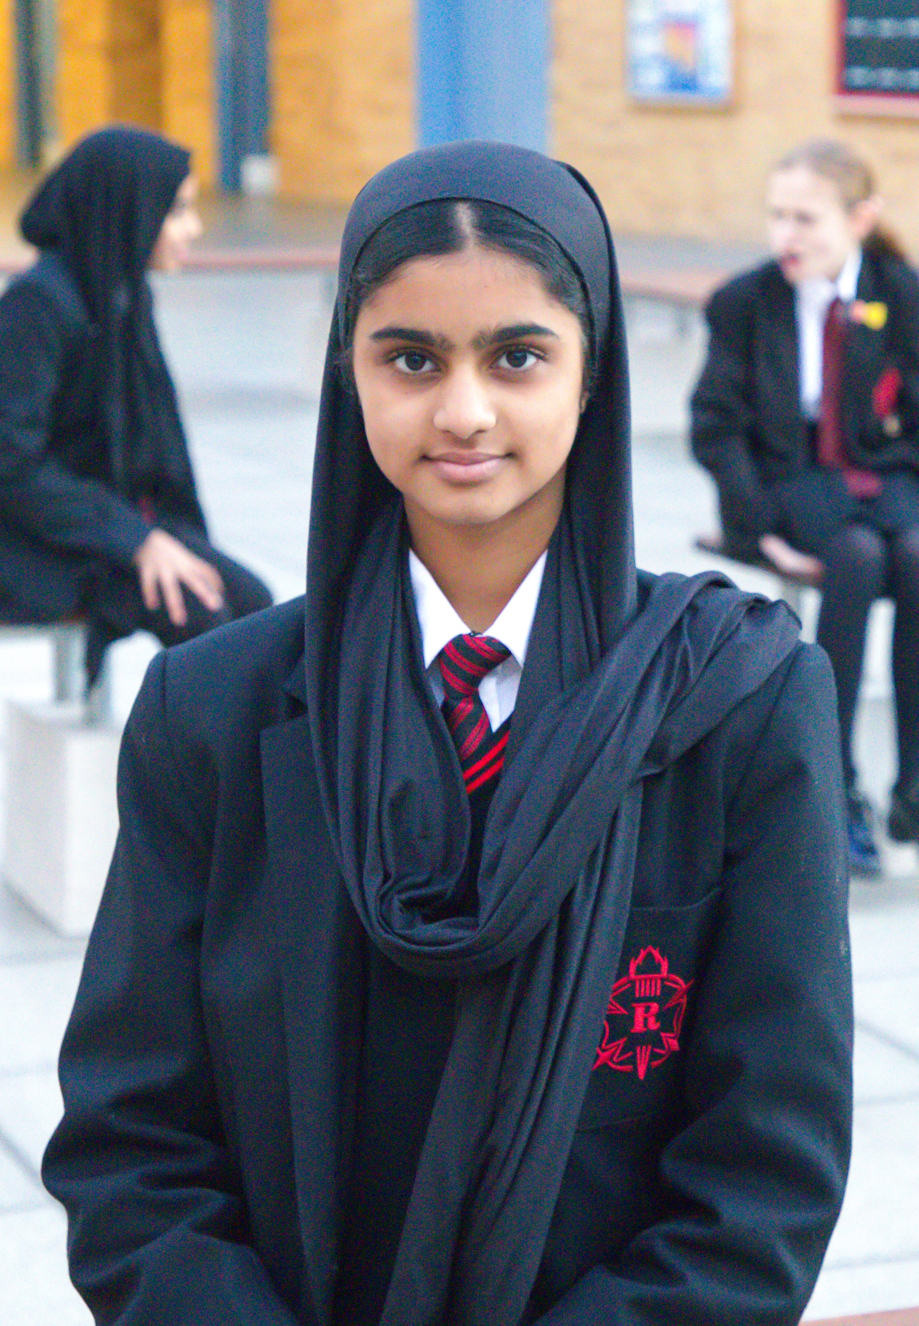
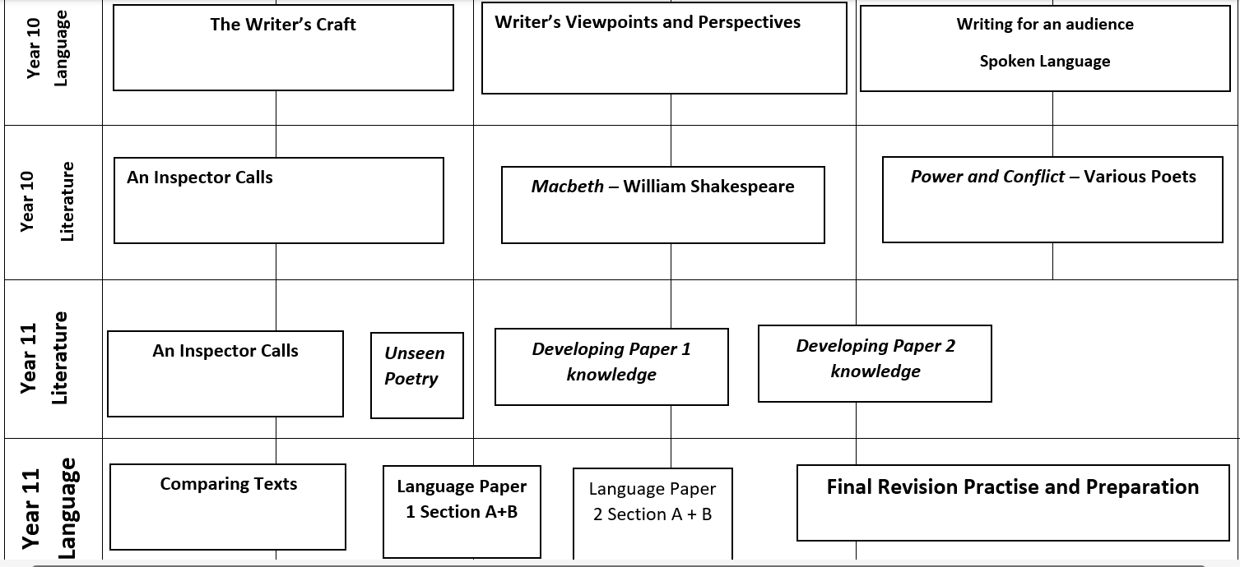
KS4– The English Curriculum
Curriculum Coverage:
‘A Christmas Carol’ – Charles Dickens
Mr Kirk – Assistant Curriculum Leader: English

Slide 49
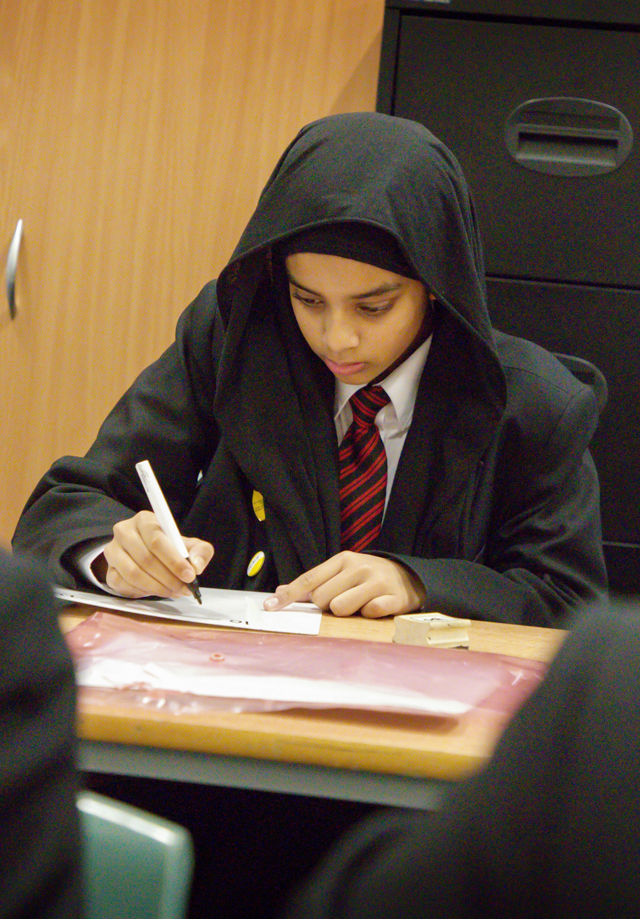
YEAR 11– The English Curriculum
Formative Assessment
Students will be formatively assessed each and every lesson so that teachers can address any misconceptions, gaps in knowledge and inform future assessments. These will take the form of Memory Platforms, low stake quizzes, targeted questioning and MCQs.
Assessment:
At the end of each term there are assessments that check for understanding of the topics covered.
In HT 2 & 3 students sit Pre-Public Examinations; these give students an opportunity to practice for their GCSE exams. In December they will sit:
Language Paper 2
Literature Paper 2- An Inspector Calls and Power and Conflict Poetry
In February, they will sit:
Language Paper 1
Literature Paper 1 – Macbeth and a Christmas Carol
Key Dates:
PPEs w/b 17th Nov. Year 11
PPEs w/b 2nd Feb. Year 11
PPEs w/b 20th April Year 10
GCSEs begin 11th May 2026
Mr Kirk – Assistant Curriculum Leader: English

Slide 50
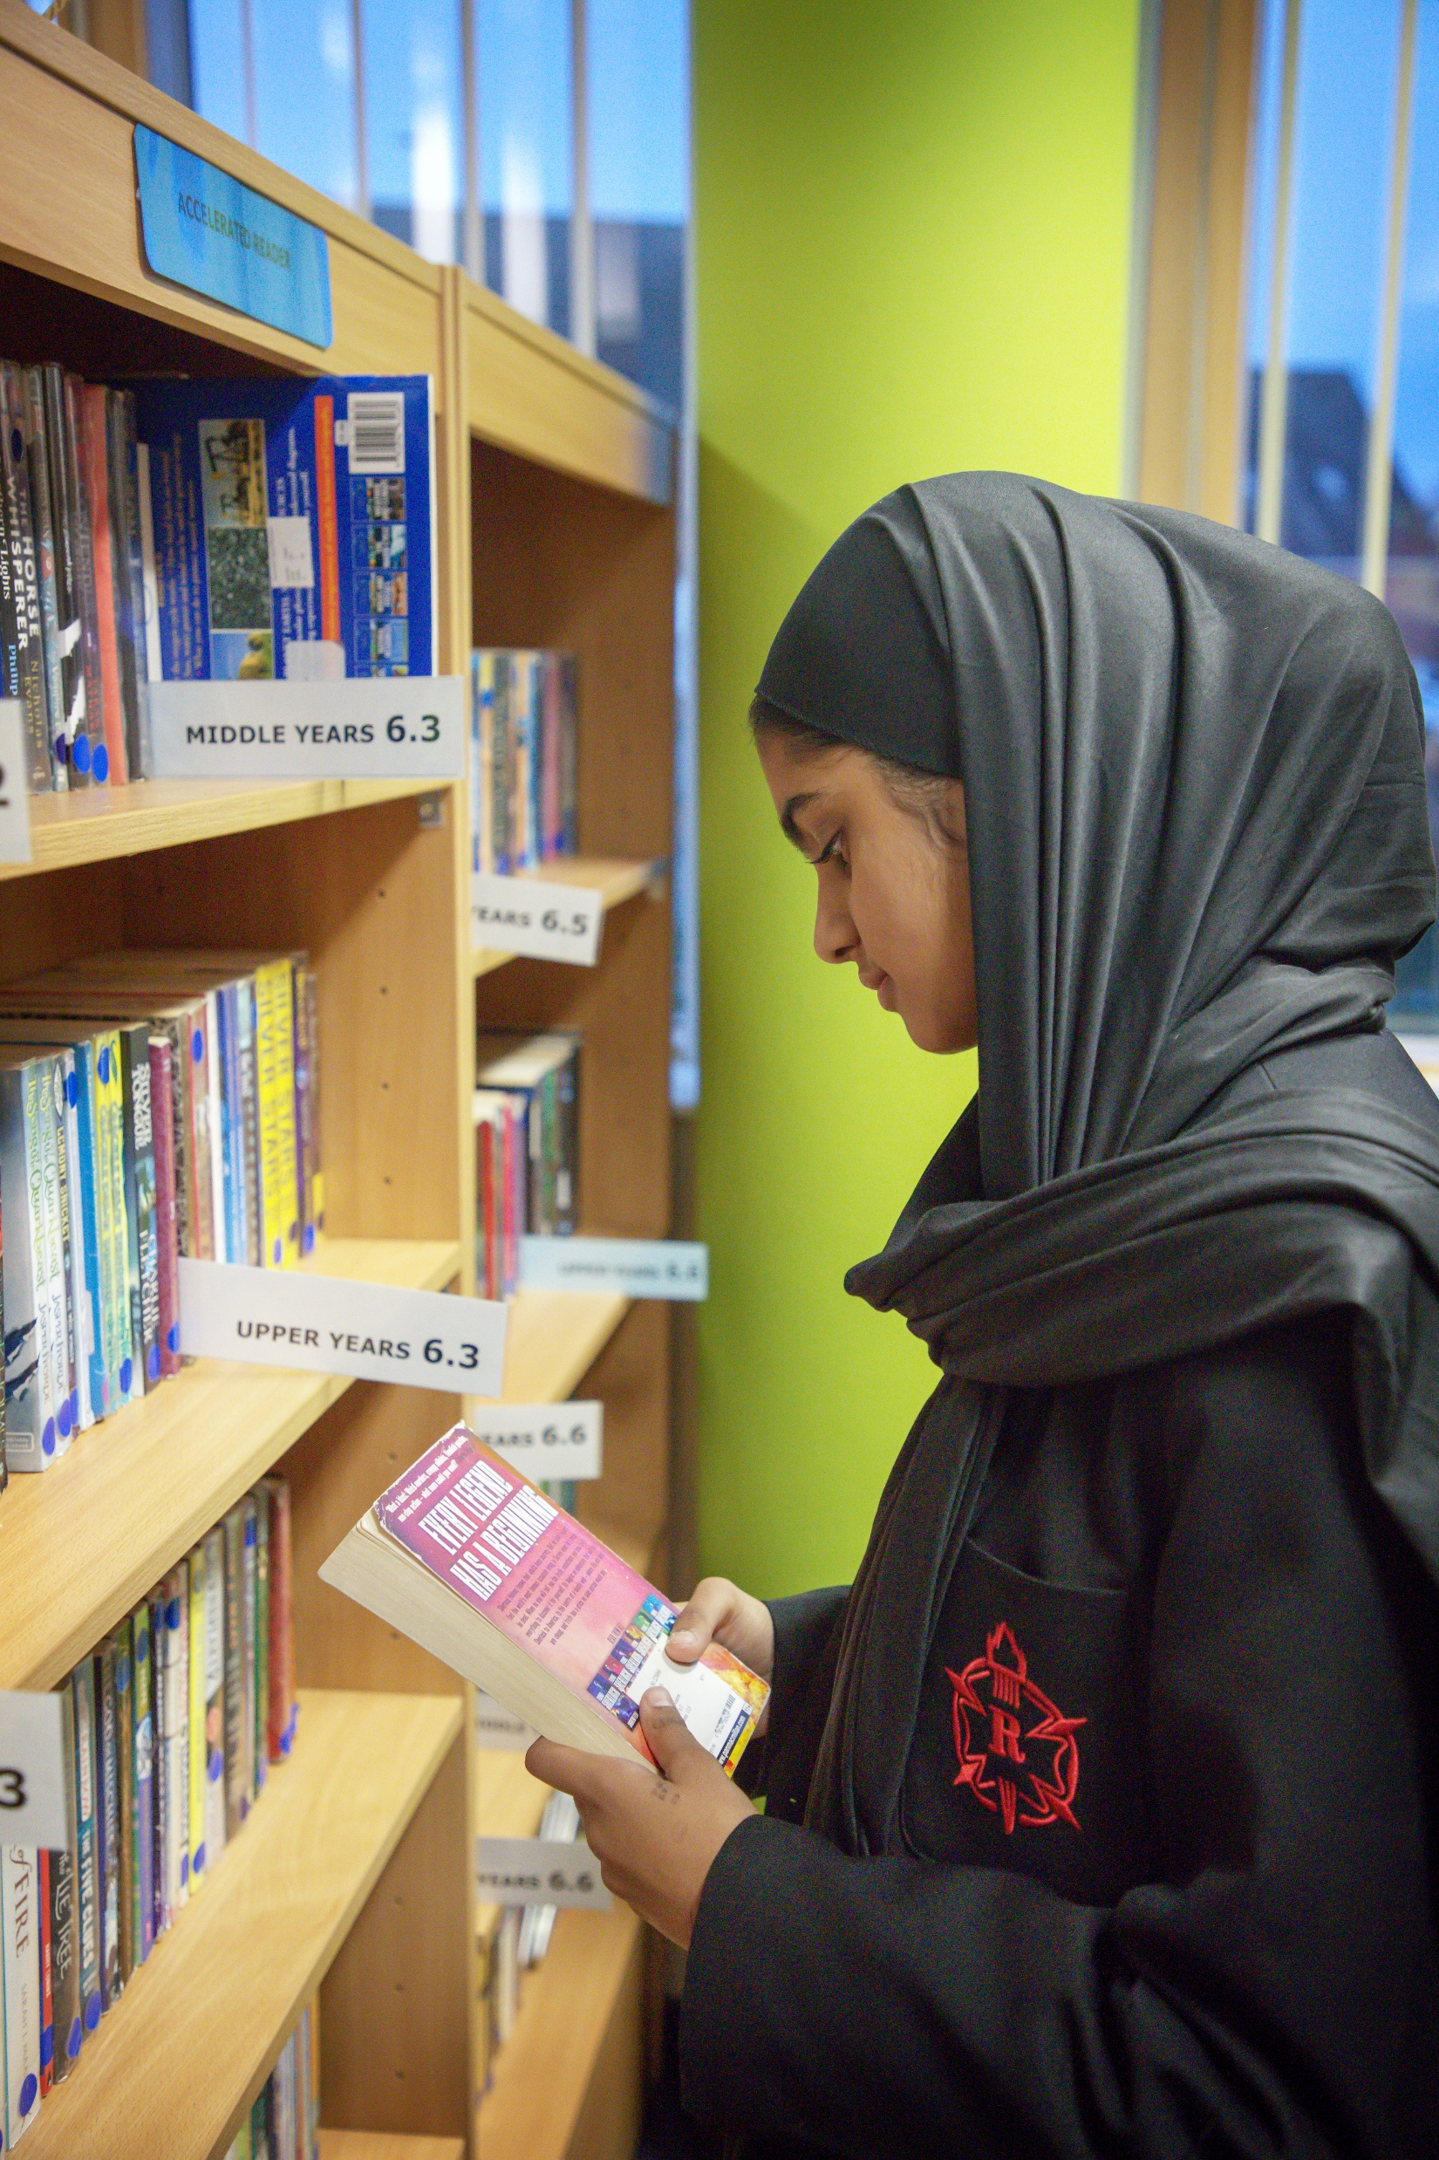
KS4 – The English Curriculum
Learning at home:
Students will be set at least one hour of home learning each week. Home learning is designed to develop knowledge of texts and exam skills in preparation for the GCSE.
Revision for GCSE exams
We would encourage students to start revision EARLY.
Complete, in timed conditions, practice questions and exam papers that have been provided by class teacher.
Utilise the booklets that develop key skills and knowledge of the text
Learn quotations and begin thinking about lines of enquires for possible questions.
Ms Khaliq – Head of English
Mr Kirk – Assistant Curriculum Leader: English

Slide 51
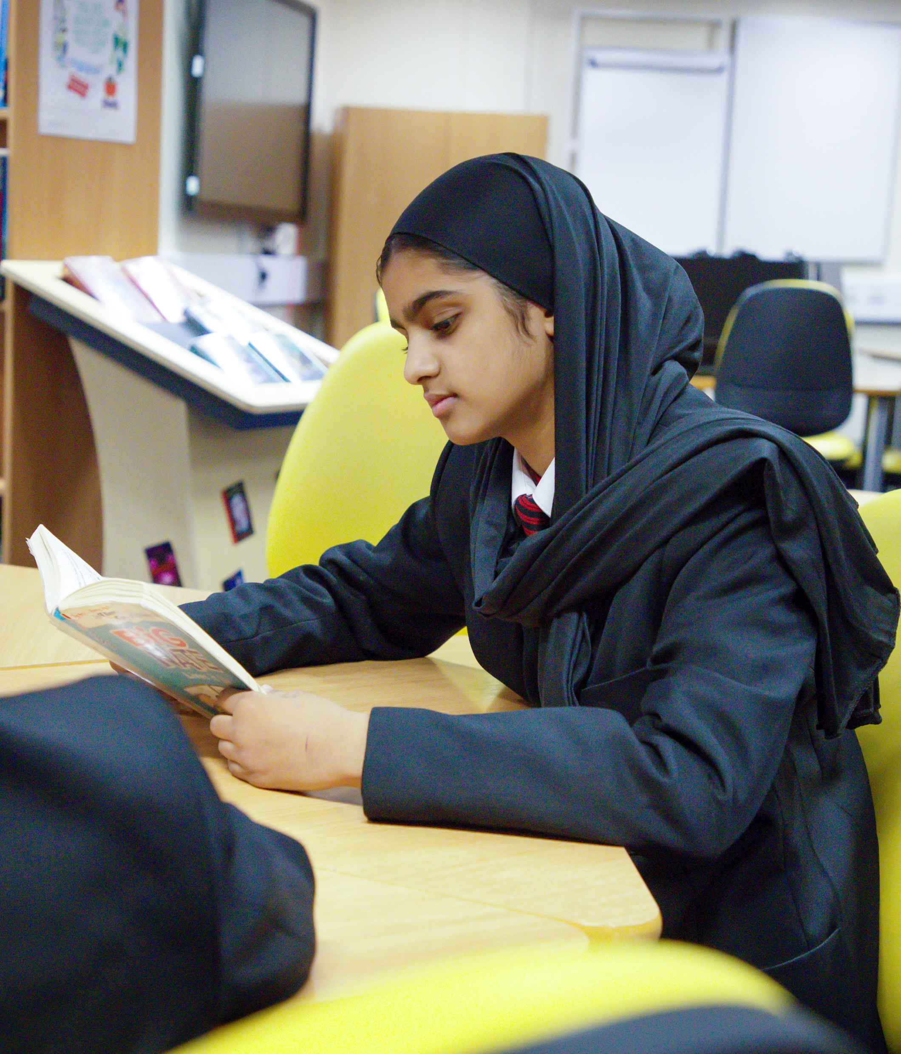
KS4 – Revision and Intervention
Revision every week from 15:00-16:00
TFEE
Half-Term Boosters
7-9 Lectures
Conference days for identified students
Ms Khaliq – Head of English

Slide 52
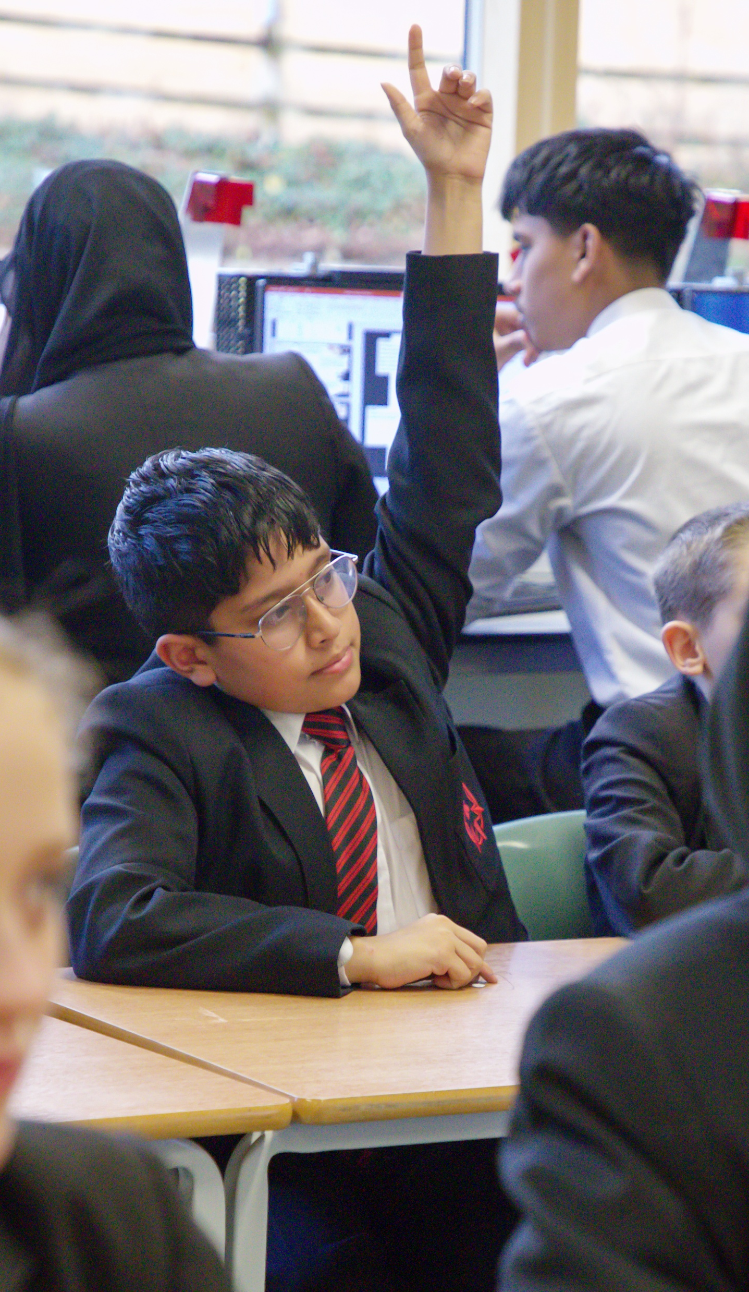
KS4 – The English Curriculum
How parents can support:
Check your child is completing homework each week
Ensure that your child is attending after school revision in English
Encourage your child to begin studying early – work with them to produce a revision timetable
Buy the revision guides that are available on Parent Pay and encourage your child to use these
Contact myself or your child’s class teacher if you have any concerns
Ms Khaliq – Head of English

Slide 53

mrs richardson
Lead Practitioner:
Mathematics

Slide 54
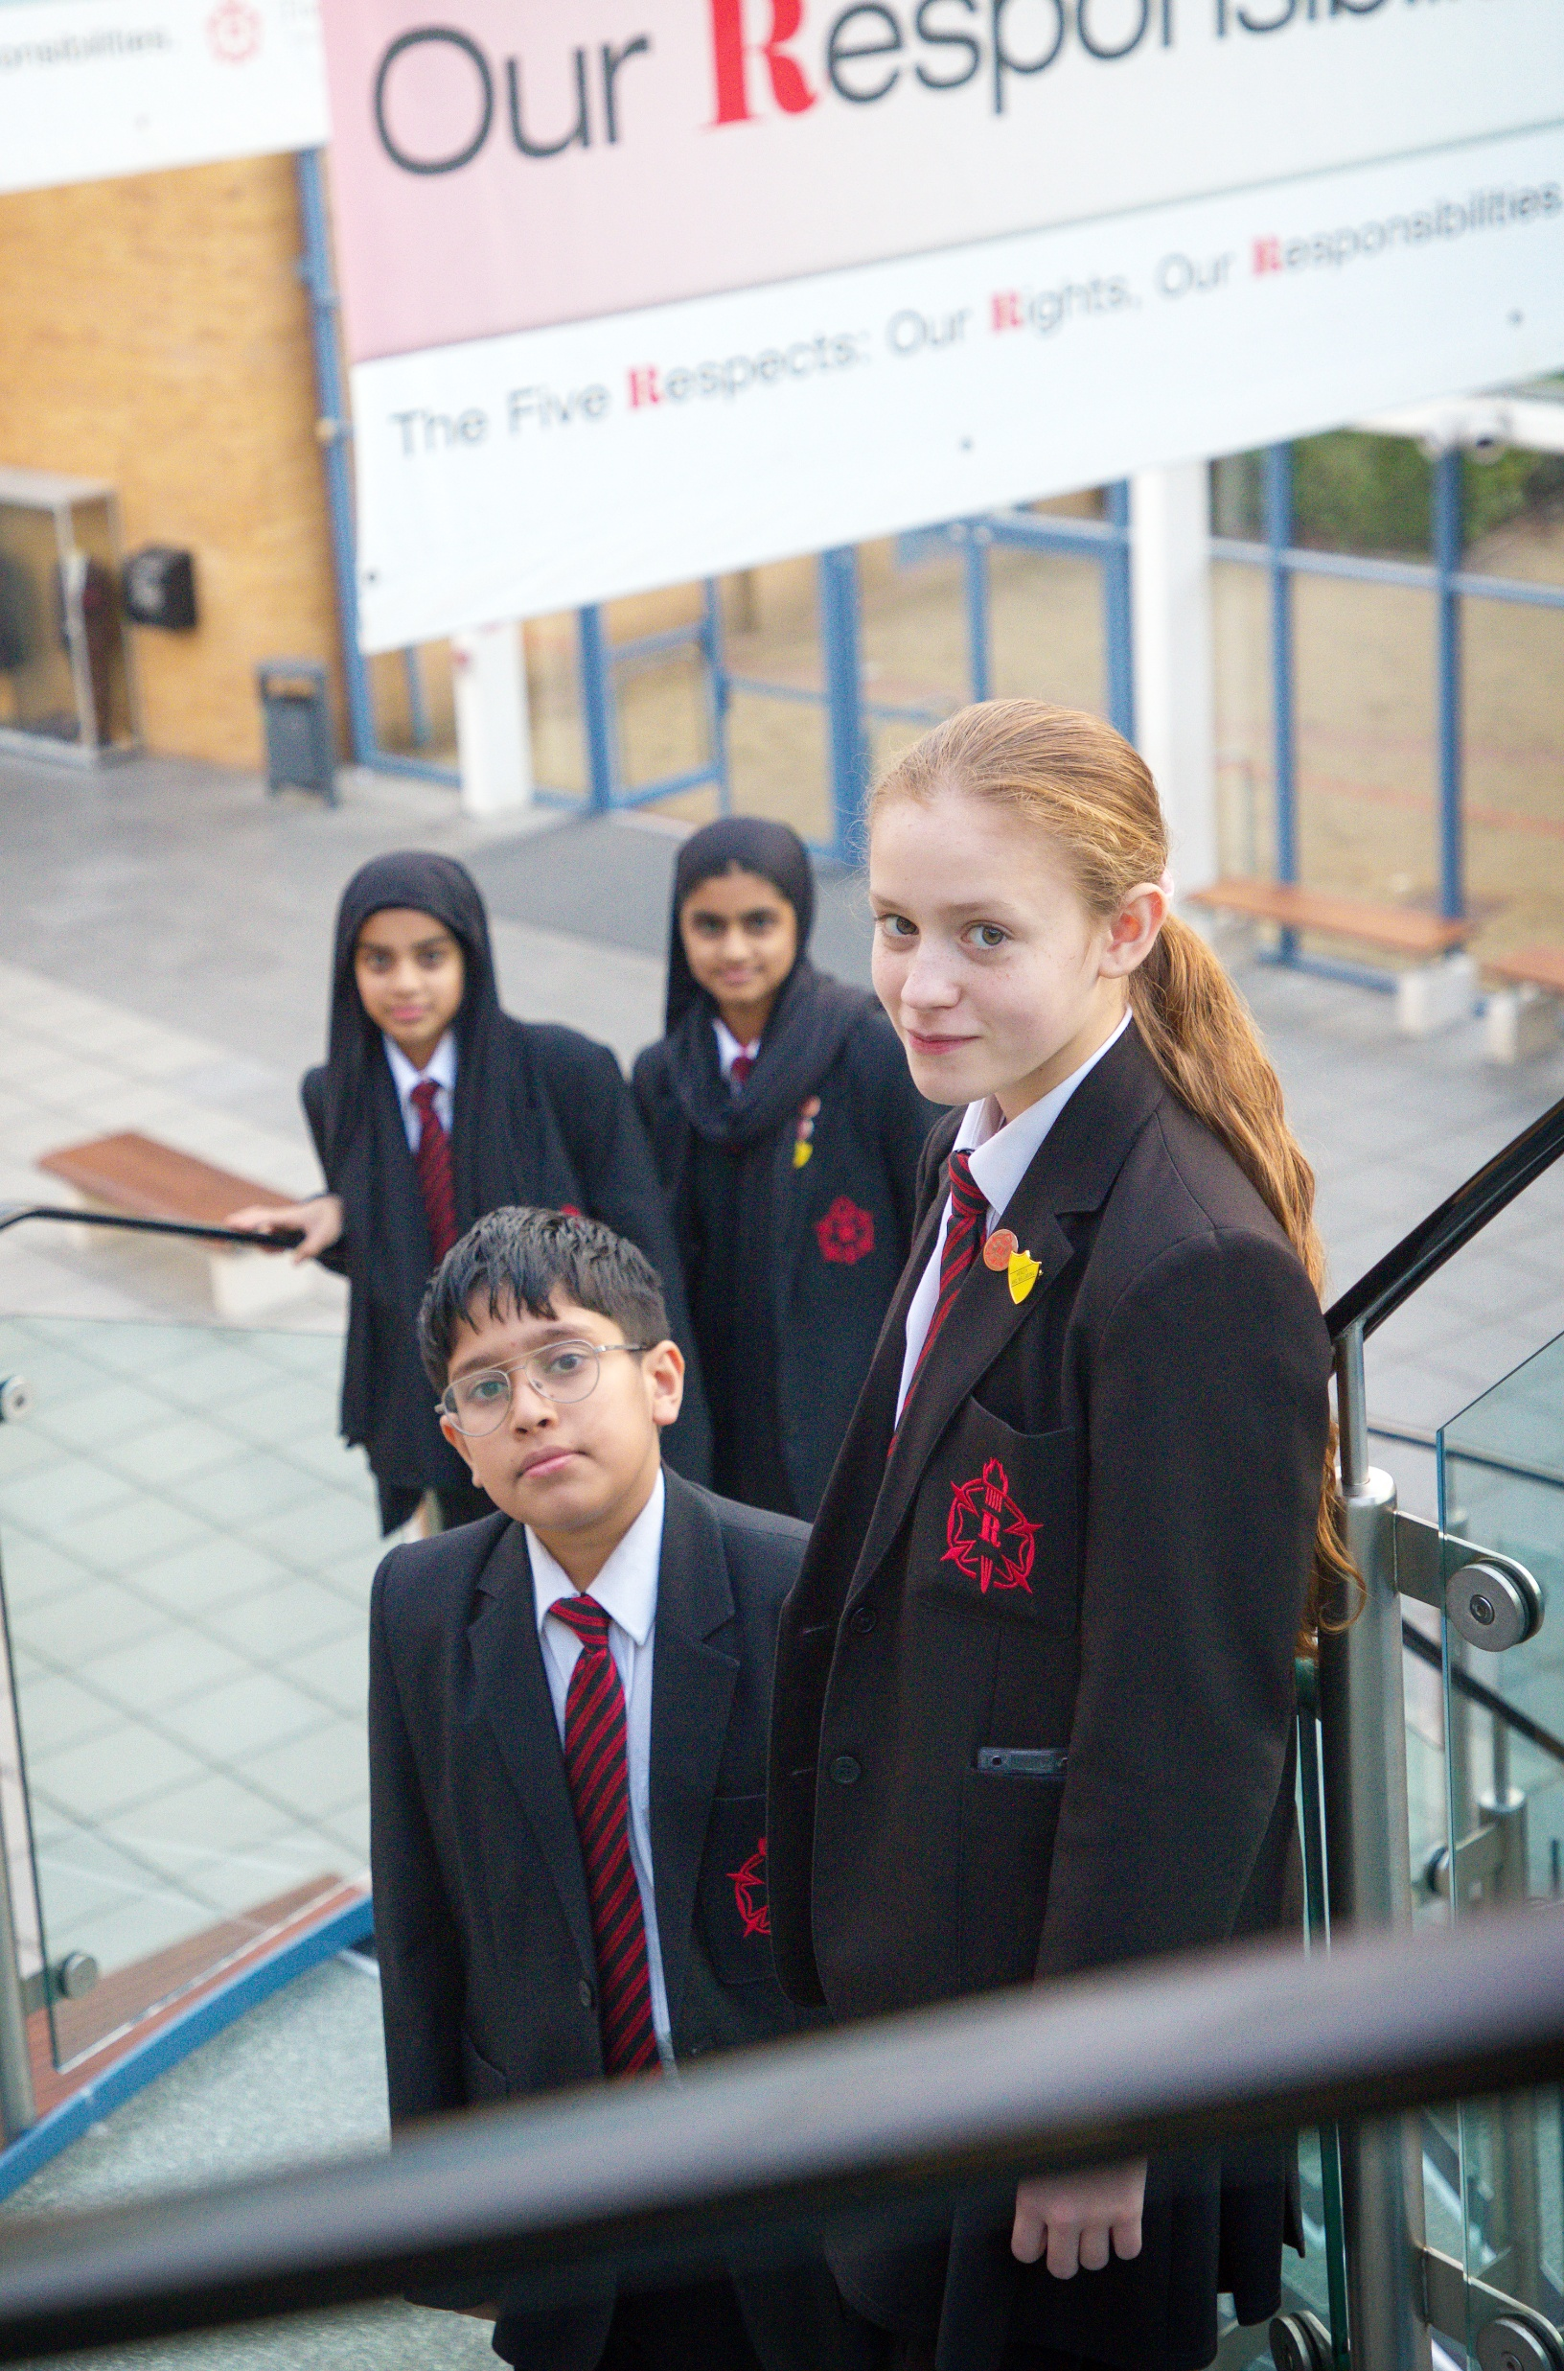
The Year 10 – The Maths Curriculum
Curriculum coverage: White Rose Maths Scheme of Learning
 | Foundation | Higher
HT1 | Algebraic manipulation Equations, inequalities and formulae Quadratic expressions and equations Percentages Ratio and scale | Algebraic manipulation Equations, inequalities and formulae Quadratic expressions and equations Percentages Ratio and scale
HT2 | Ratio and scale Working with fractions Non-calculator methods Straight line graphs Probability | Ratio and scale Working with fractions Non-calculator methods Straight line graphs Probability
HT3 | Probability Perimeter, area and volume Interpreting and representing data | Probability Perimeter, area and volume Interpreting and representing data
HT4 | Rounding and estimating Non-linear graphs Angles PPE prep | Data Rounding and estimation Non-linear graphs PPE prep
HT5 | PPEs Graphs and diagrams Vectors Factors and powers | PPEs Non-linear graphs Angles Graphs and diagrams Vectors
HT6 | Pythagoras and trigonometry Simultaneous equations Algebra skills | Vectors Factors, powers and surds Simultaneous Equations
Covers the National Curriculum
Mastery of small steps
Fluency, reasoning and Problem-Solving
Builds on the learning from KS3
Edexcel Exam Board

Slide 55
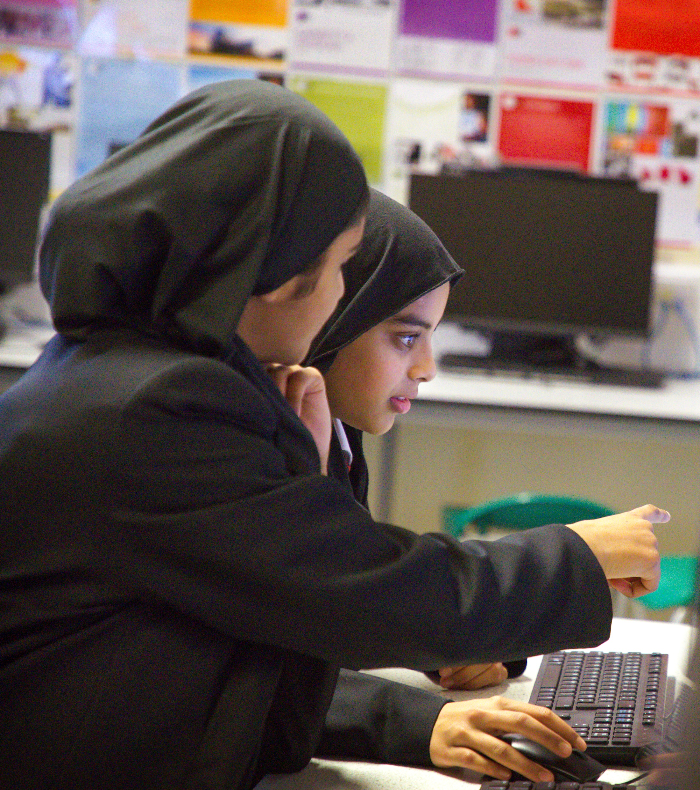
The Year 11 – The Maths Curriculum
Curriculum coverage: White Rose Maths Scheme of Learning
 | Foundation | Higher
HT1 | Ratio and proportion Area, perimeter and volume Linear graphs, gradients and lines Expanding and factorising Changing the subject | Ratio and proportion Area and volume Functions and graphs Expanding and factorising quadratics Changing the subject
HT2 | Sequences Equations, inequalities and formulae Working with circles Standard form PPE prep | Sequences and proof Equations and formulae Transformations PPE prep
HT3 | Transformations Rates Venn diagrams and set notation PPE prep | Probability Non-linear graphs Venn diagrams and set notation Rates PPE prep
HT4 | Non-linear graphs Constructions and loci Number revision Data revision | Constructions and loci Circle theorems Vectors Number revision Data revision
HT5 | Shape revision Algebra revision Ratio and proportion revision | Shape revision Algebra revision Ratio and proportion revision

Slide 56
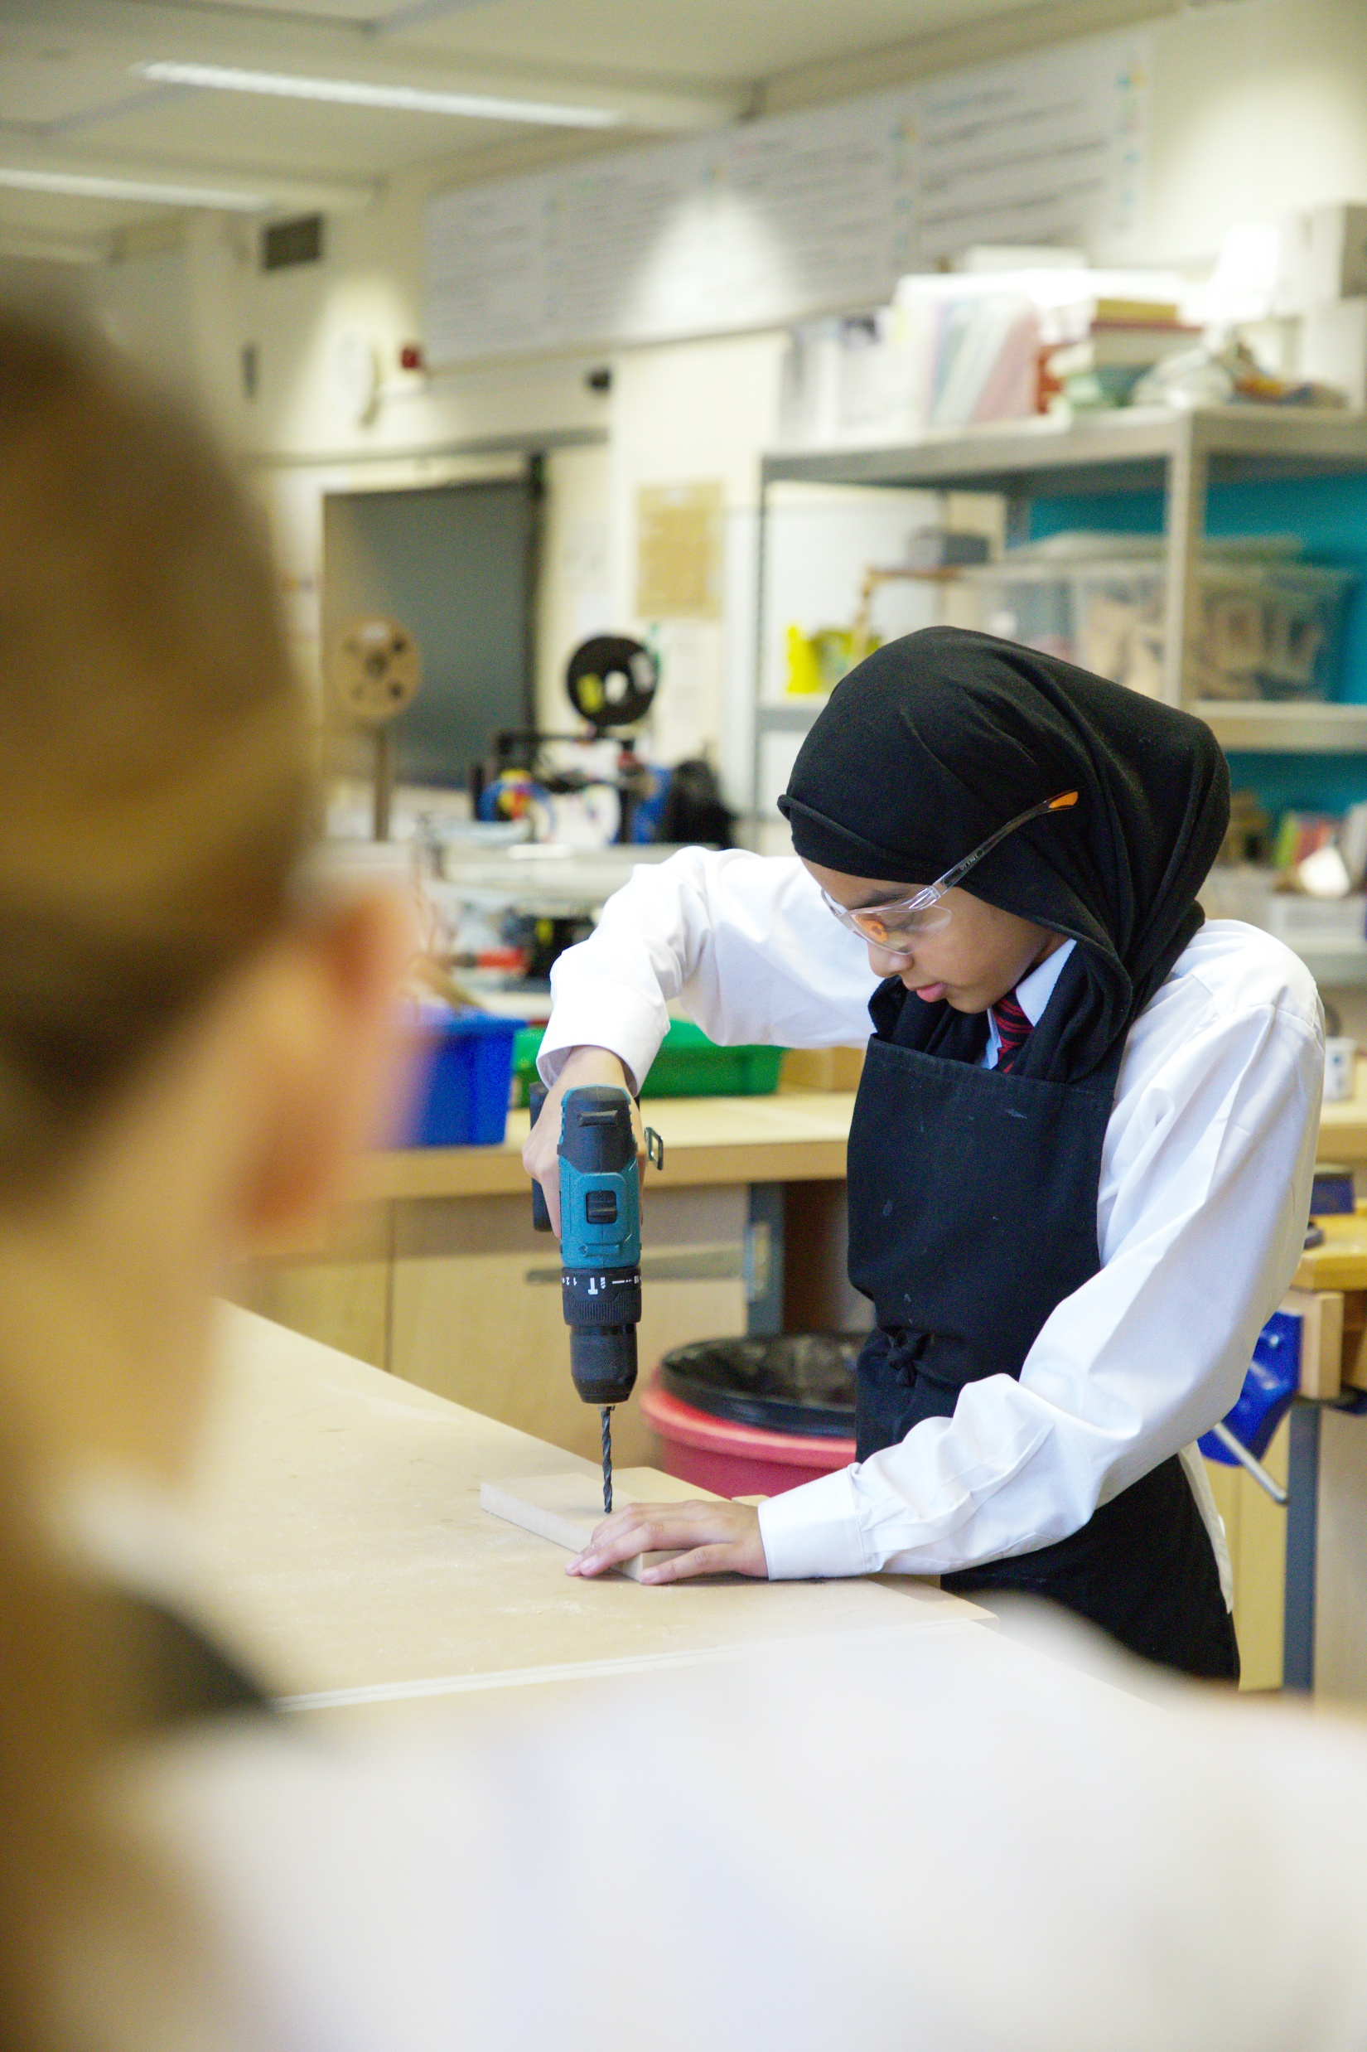
Assessments: The Maths Curriculum
The Edexcel Mathematics GCSE covers a wide range of topics, including number, algebra, ratio and proportion, geometry, probability, and statistics.
The qualification is assessed through three examination papers: one non-calculator paper and two calculator papers.
Throughout the year, students will take part in informal assessments. These are intended to highlight their strengths as well as any areas that may need further development, helping teachers plan the best support moving forward.
These are done on a three-weekly cycle through green booklets (students are sent revision list in advance to aide revision)

Slide 57
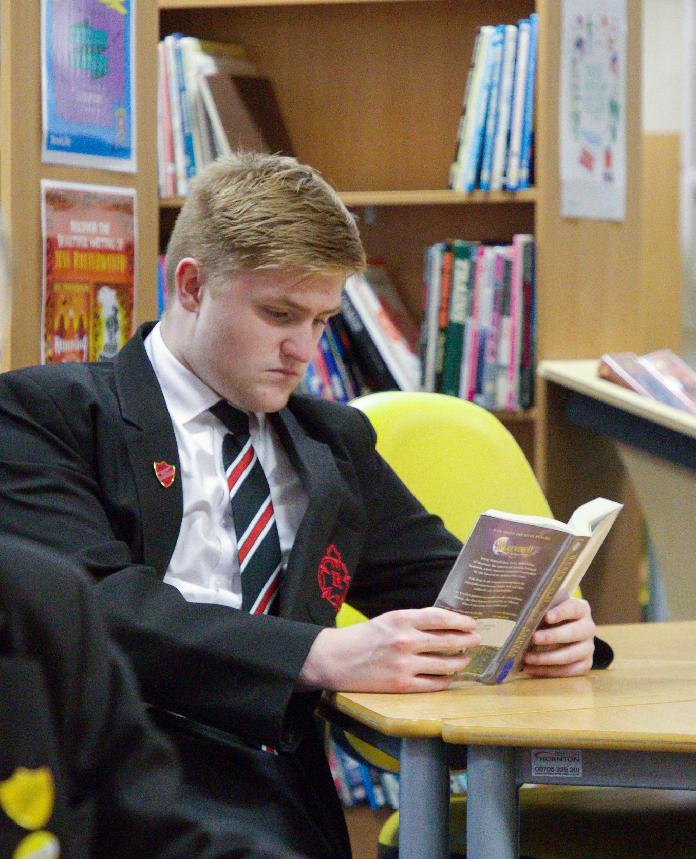
Assessments - The Maths Curriculum
Summative Assessments
Year 10
Year 11
 | Assessment dates
HT1
HT 2
HT 3
HT 4
HT 5 | PPES
HT 6
 | Assessment dates
HT1
HT 2 | PPES
HT 3 | PPES
HT 4
HT 5 | GCSE exams
HT 6 | GCSE exams
Paper 1: Thursday 14th May
Paper 2: Wednesday 3rd June
Paper 3: Wednesday 10th June
Maths GCSE Dates

Slide 58


Home Learning
Learning at home:
Over 10,000 support videos
One hour of home learning each week
100% correct!
Personalised
Home learning
Set on Wednesday
Due in following Wednesday
Lunch time club if students need help
Please ensure school has your current email address
Students can reset their
own passwords!

Slide 59
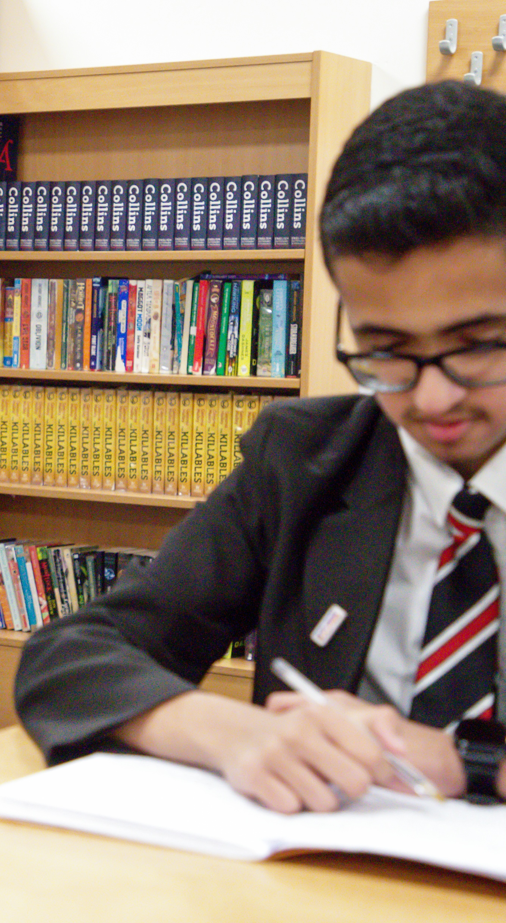
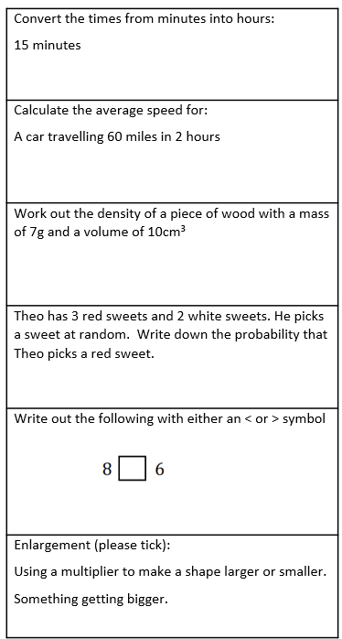
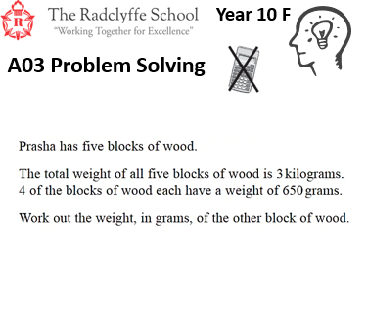
Key Stage 4– The Maths Curriculum
Focus on key words and vocabulary within lessons to ensure students understand and can apply them confidently.
Embed weekly retrieval activities to strengthen retention of mathematical language and concepts.
Regularly practise worded problem-solving questions so students develop resilience and strategies for decoding exam-style tasks.
Encourage students to explain their reasoning verbally and in written form, helping them to practise using precise mathematical language.
Literacy:

Slide 60

Year 11– Revision and intervention opportunities
After school revision
School Holiday Boosters
Targeted intervention sessions
Practice papers available
Monthly calendars emailed home
Revision guides
Online resources available;
Website | Why It’s Recommended
Maths Genie | Free past papers and video walkthroughs – brilliant for real exam practice.
Corbett Maths | Short videos, worksheets, and daily challenges – ideal for regular, bite-sized revision.
OnMaths | Interactive online mock exams with instant feedback – great for tracking progress.
Dr Frost Maths | Thousands of practice questions with worked solutions and fun interactive challenges.
Hannah Kettle Maths | Engaging videos with clear explanations that make tricky topics easier to understand. Weekly live videos on youtube going through exam papers

Slide 61
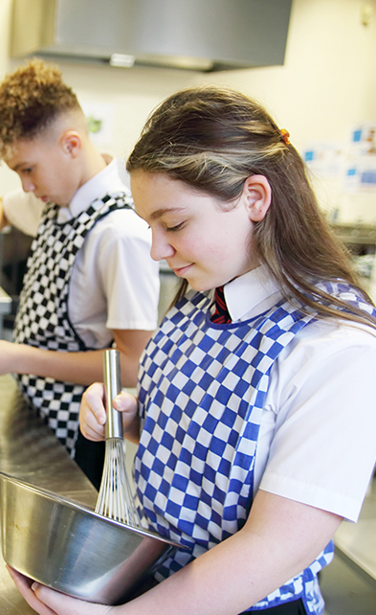


KS4 – The Maths Curriculum
How parents can support:
Make sure they have the correct equipment: scientific calculator, ruler, protractor, compass, pens, pencils.
Encourage your child to practise with this equipment
Check that homework is completed and reviewed regularly.
Ensure attendance at revision sessions and booster sessions.
Contact teacher if there is a concern.
Encourage students to start revision EARLY. ‘small chunks’ of revision.
Encourage a positive approach: remind them that practising maths regularly is the best way to learn it and that consistent effort leads to improvement.
Ms Adenwala – Head of Mathematics

Slide 62

mrs hamilton
Strategic Lead for
Literacy & RS

Slide 63



Reading fluency is like a golden ticket for your child.

Slide 64

Why should you encourage your child to read?
25% of 15-year-olds have a reading age of 12 or under
1 in 8 disadvantaged children in the UK do not own a single book at home
Children who are weak readers will struggle as much in maths and science at GCSE as they do in English and the arts subjects
Students are less able to learn in school if they do not develop sufficient reading skills
In the words of the DfE, ‘more demanding’ GCSE exams were introduced in 2017
Exams now tend to include wordier questions – problematic for students with a low reading age

Slide 65

The benefits of reading
Children who read books more than once a week by age 16 gain higher results than those who read less regularly
19% of readers say that reading stops them from feeling lonely.
Regular readers for pleasure reported fewer feelings of stress and depression than non-readers
Studies have shown that those who read for pleasure have higher levels of self-esteem and a greater ability to cope with difficult situations
Reading for pleasure has been found to improve sleeping patterns
Adults who read for just 30 minutes a week are 20% more likely to report greater life satisfaction
People who read for 3.5hours a week (30mins a day) have a 17% higher life expectancy than those who don’t
30mins is 2% of your day

Slide 66


Reading Interventions
We have invested in two new reading programmes:
Sparx Reader
All students will have access
Can be accessed on most devices
Encourages students to read and regularly review their understanding as they go
LexiaPowerUp
A selection of students will be invited to attend (based on need)
Identifies gaps in knowledge and tailors learning to student needs
Adaptive and reflective to ensure rapid progress
Delivered weekly during PLG time (to avoid lost learning in other areas)
What we are doing:
PLG reading
EXACT testing
Literacy explicitly taught in lessons
Access to library at break and lunch
Lexia intervention
Sparx Reader
What you can do:
Encourage them to read 'widely and often'
Read with them/ to them
Support the interventions

Slide 67

Advice:
Check regularly that they have a book and are reading it
Start small (5mins to start and build up)
Encourage them to attend their intervention sessions
Be a role model – stand in the gap
Contact school if you have any questions
Invitation:
Please come up to the library on level 3 straight after this session for light refreshments and to collect a ‘golden ticket’ for your child.

Slide 68

Thank you!
If you have any questions about your child’s education, please contact:
 | Year 10 | Year 11
Year Manager | Mr Islam | Mr Lunt
Assistant Year Manager | Mrs Chowdhury | Miss Dalton

Slide 69

Please scan the QR code and complete the feedback!

